Slide 1


SciDAC discussion on Bayesian UQ:
Multi-fidelity & Transfer Learning Emulation
Simon Mak
Dept. of Statistical Science
Duke University

Slide 2
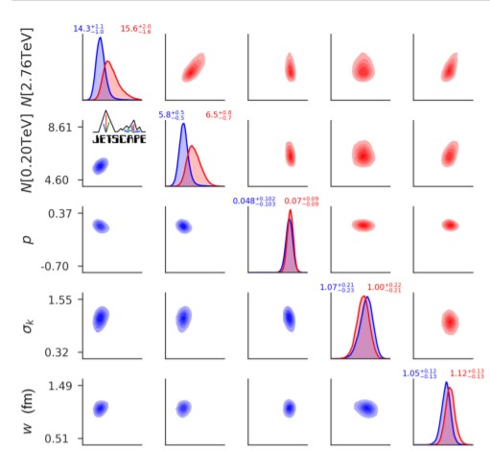
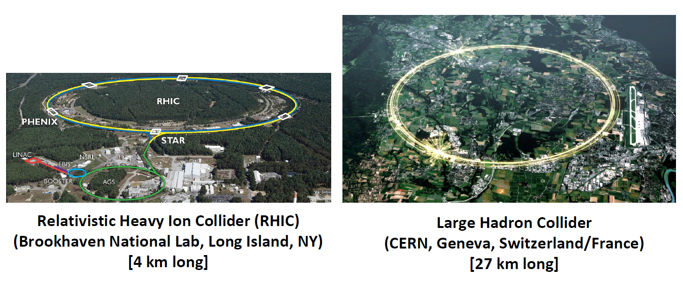
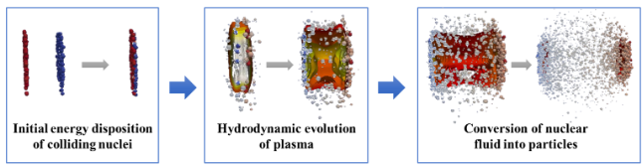


Bayesian calibration
LHC
Experimental Data
RHIC
Everett et al. (2021, Phys Rev C)
Bayesian calibration
Observables $η\left(θ\right)$
Parameters $θ$
Simulator
Notes:
Likelihood = experimental error + emulation uncertainty
Millions of $ for experiments
1000 CPU hours / point in parameter space

Slide 3
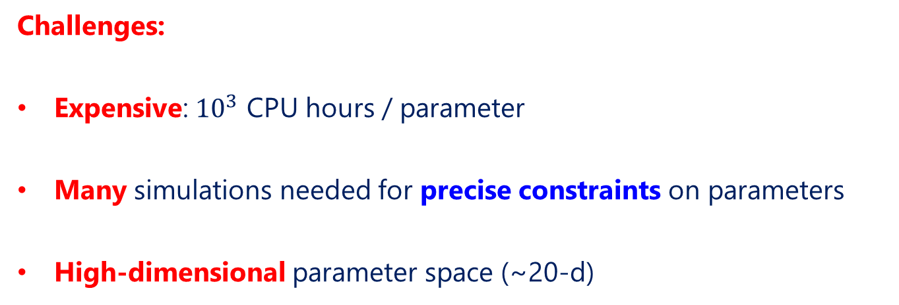
Bayesian calibration
Challenges:
Expensive: ${10}^{3}$ CPU hours / parameter
Many simulations needed for precise constraints on parameters
High-dimensional parameter space (~20-d)
Observables $η\left(θ\right)$
Parameters $θ$
Simulator
Notes:
Likelihood = experimental error + emulation uncertainty
Millions of $ for experiments
1000 CPU hours / point in parameter space

Slide 4
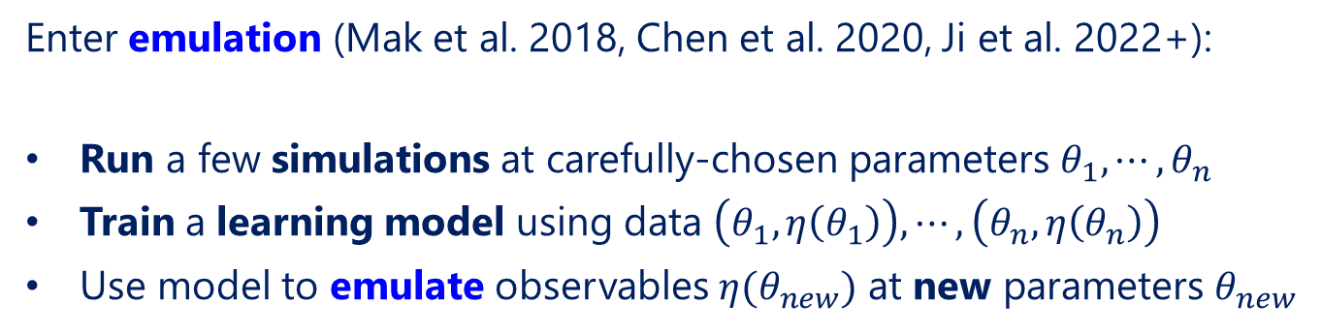
Bayesian emulation
Enter emulation (Mak et al. 2018, Chen et al. 2020, Ji et al. 2022+):
Run a few simulations at carefully-chosen parameters $θ_{1}, ⋯, θ_{n}$
Train a learning model using data $\left(θ_{1},η\left(θ_{1}\right)\right), ⋯,\left(θ_{n},η\left(θ_{n}\right)\right)$
Use model to emulate observables $η(θ_{new})$ at new parameters $θ_{new}$
Limitation: Training simulation data also computationally expensive - many runs needed to build accurate predictive model in high-dim.!
Observables $η\left(θ\right)$
Parameters $θ$
Simulator
Emulator
Notes:
Likelihood = experimental error + emulation uncertainty
Millions of $ for experiments
1000 CPU hours / point in parameter space

Slide 5
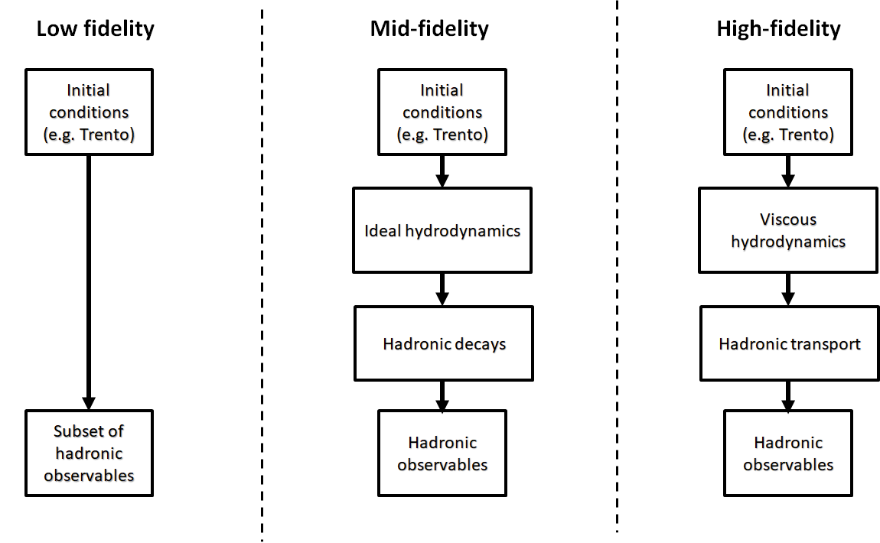
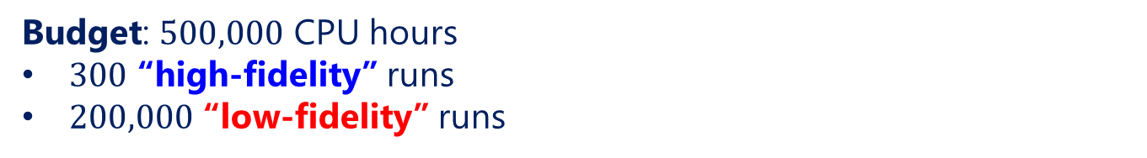




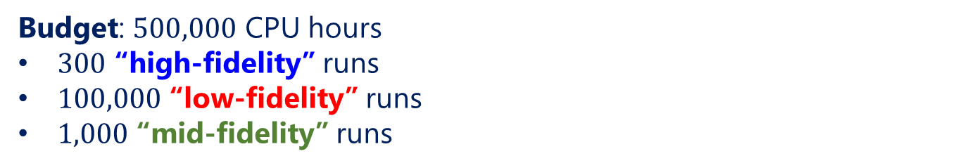
Multi-fidelity emulation
${10}^{0}$ CPU hours / run
${10}^{2}$ CPU hours / run
${10}^{3}$ CPU hours / run
Many ways to vary fidelity:
Simulation models
Meshing / course-graining
Closure models
Budget: $500,000$ CPU hours
$300$ “high-fidelity” runs
$100,000$ “low-fidelity” runs
$1,000$ “mid-fidelity” runs
Budget: $500,000$ CPU hours
$300$ “high-fidelity” runs
$200,000$ “low-fidelity” runs
Budget: $500,000$ CPU hours
$500$ “high-fidelity” runs
Multi-fidelity emulation: Emulation of a target system using simulation data of multiple fidelities (or accuracies)

Slide 6
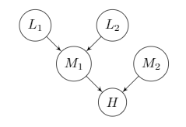


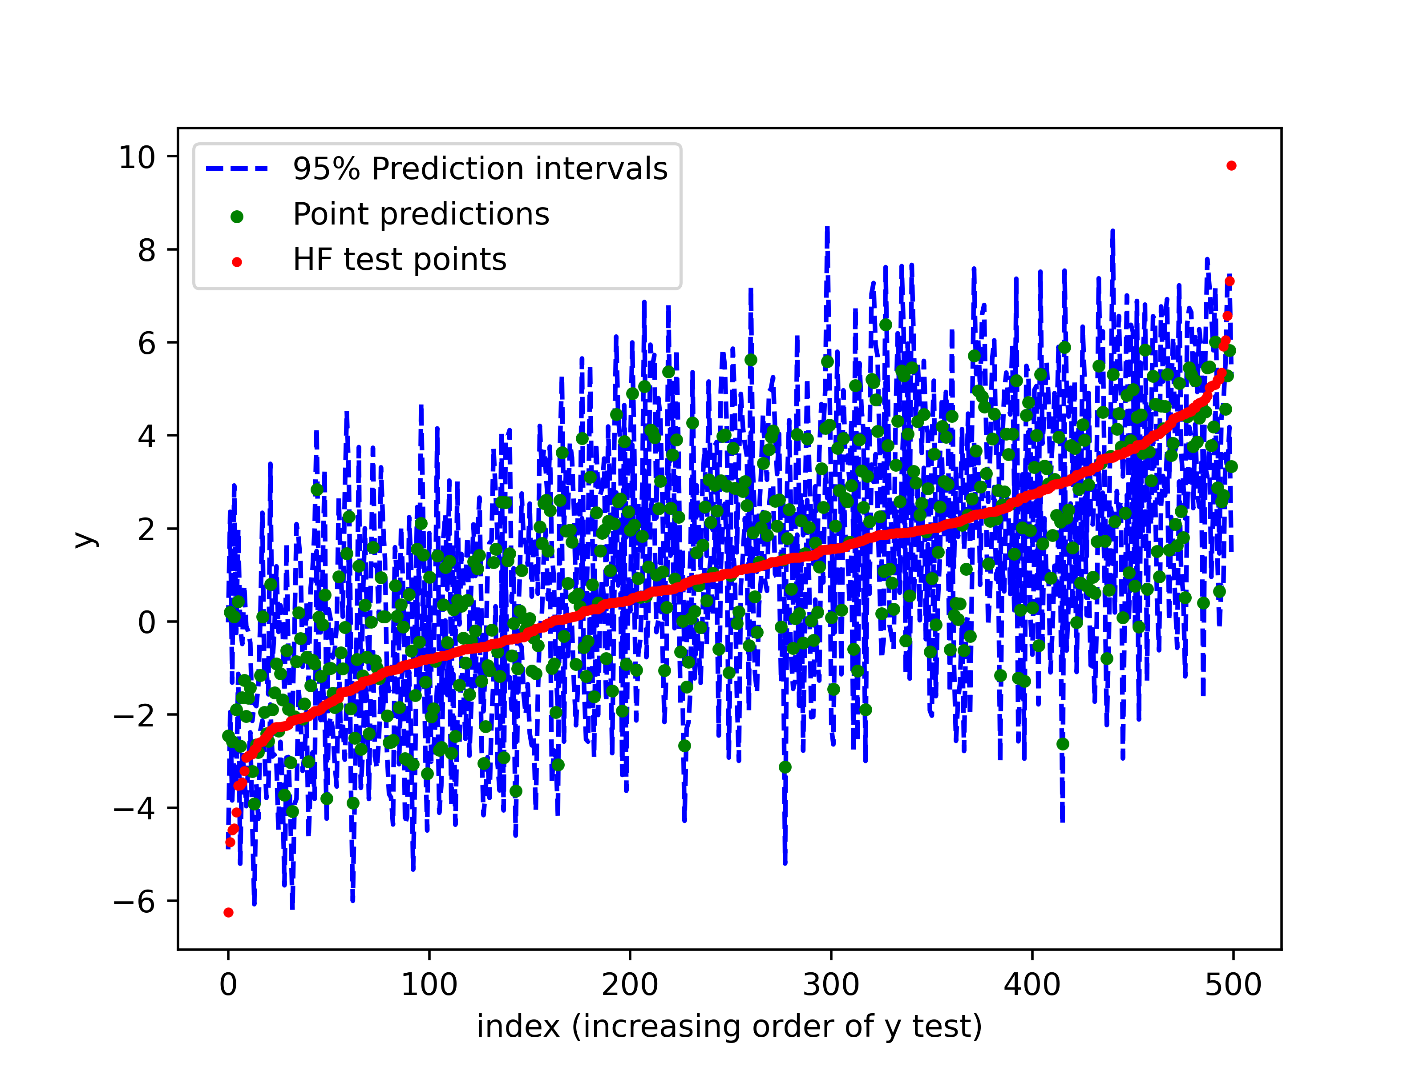
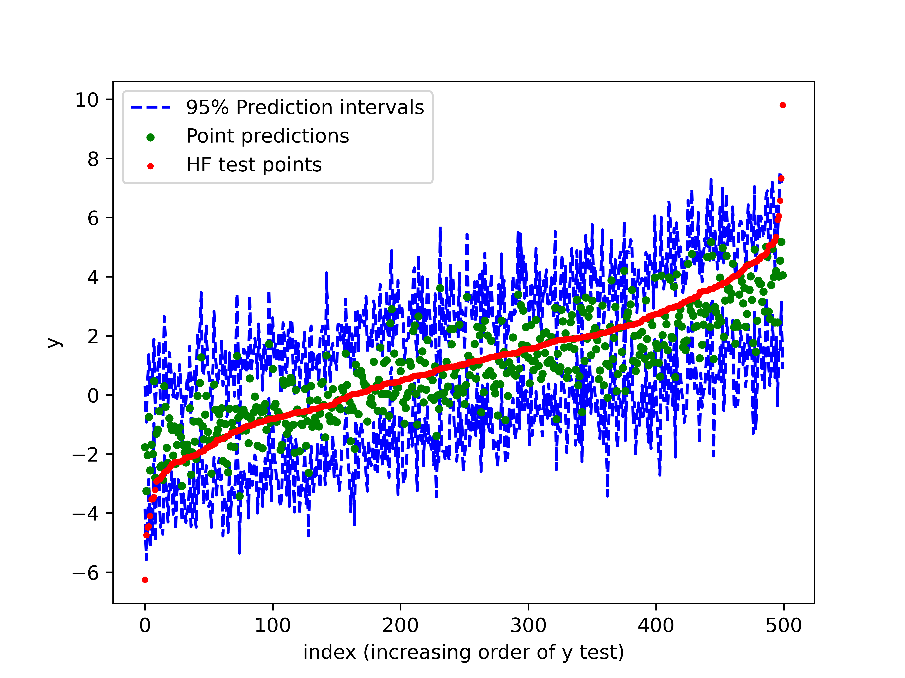
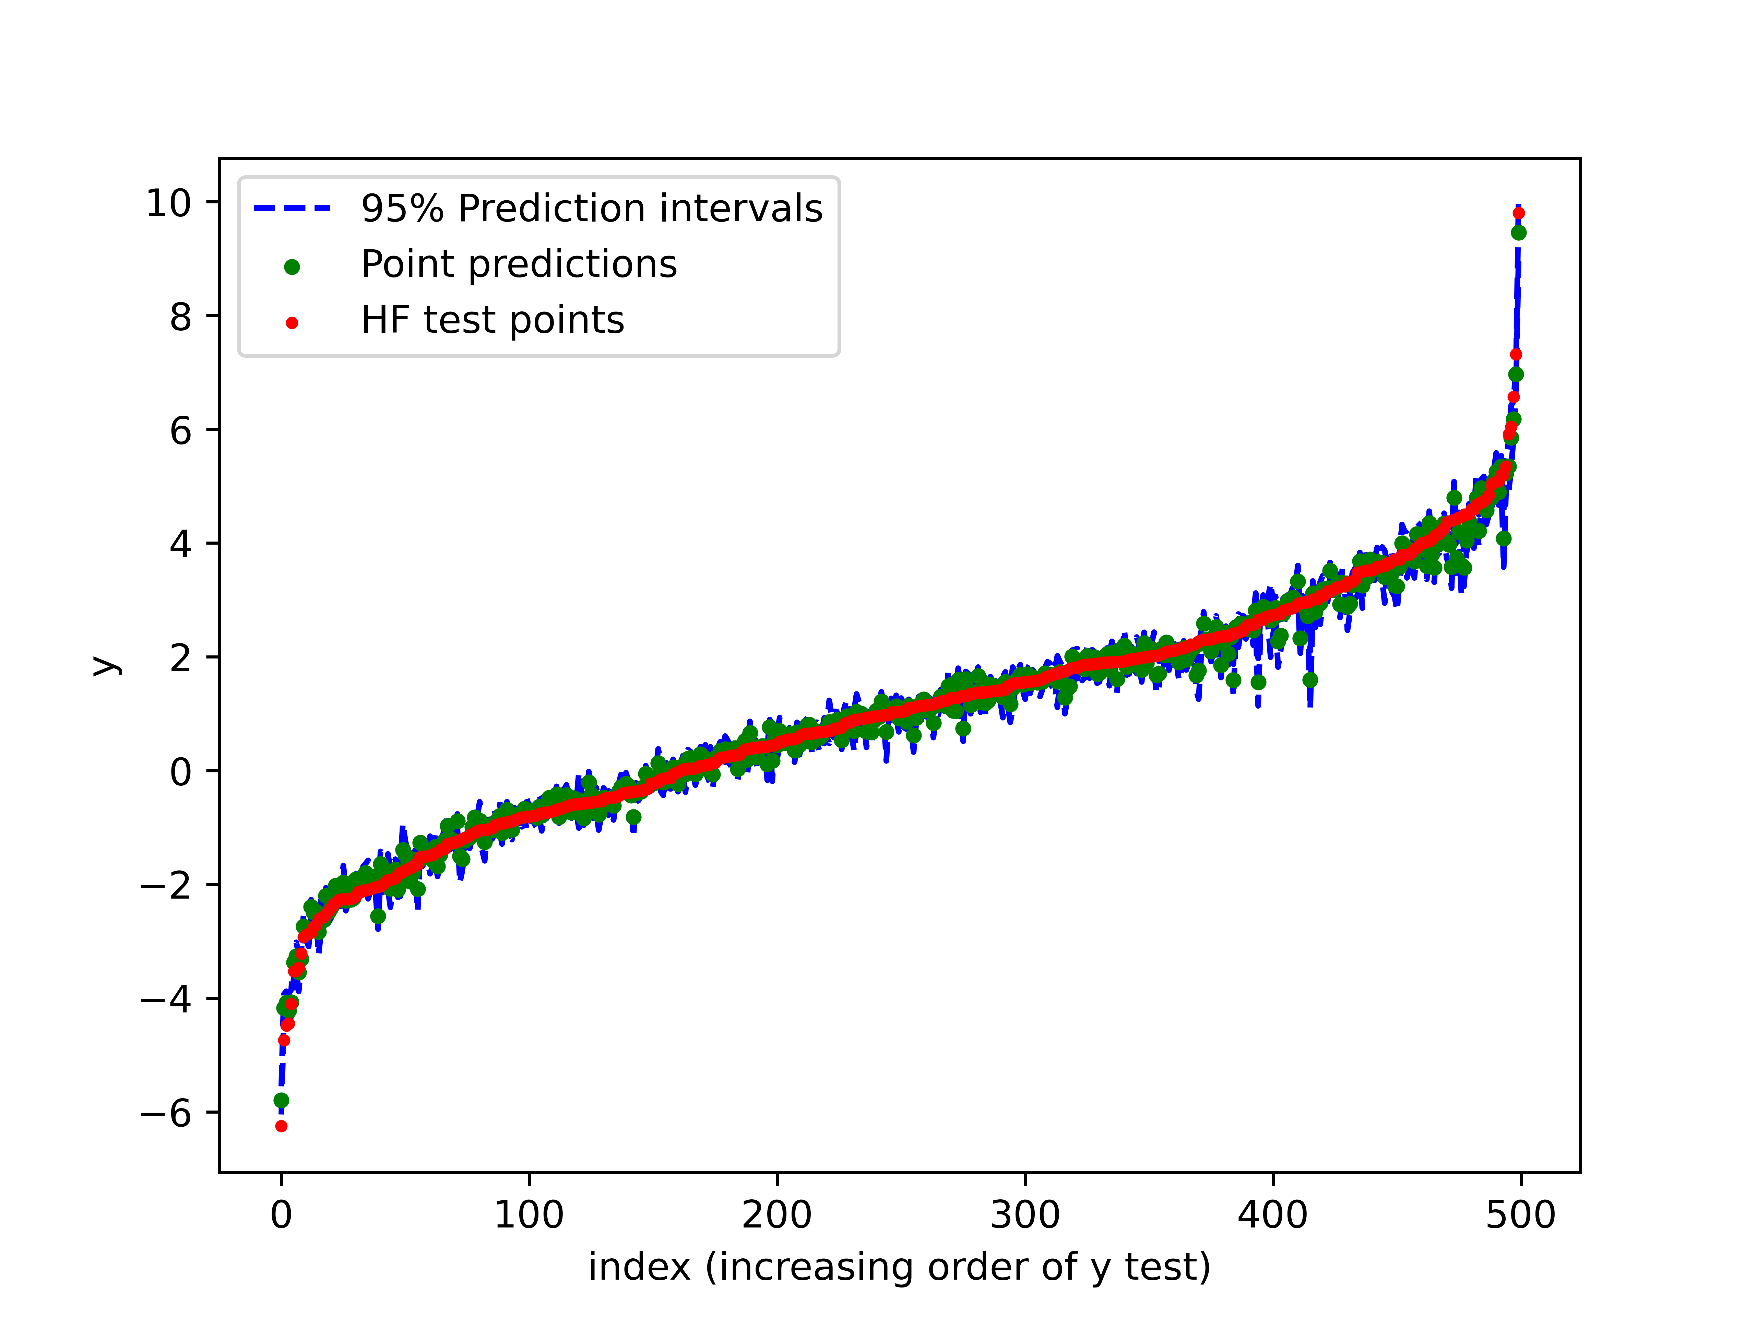
GMGP multi-fidelity model
Ji et al. (2022+): Graphical multi-fidelity GP model
Extends the popular Kennedy-O’Hagan (2000) model (state-of-the-art)
GMGP Model:
Standard GP:
KO Model:
Better predictions & reduced uncertainty given a fixed comp. budget!

Slide 7
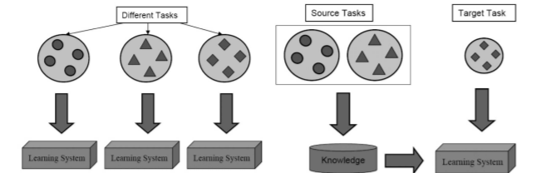



Transfer learning
Traditional Machine Learning: Learning models built from scratch (e.g., data collection, model training) for different tasks
Transfer learning: Transfer of knowledge from related (source) tasks to more efficiently & effectively solve target task
Pan & Yang, 2010)
Pb-Pb
(Grad)
Pb-Pb
(CE)
Au-Au
(Grad)
Pb-Pb
(Grad)
Pb-Pb
(CE)
Au-Au
(Grad)
By transferring knowledge from related existing systems, we can achieve comparable learning performance with less training data!

Slide 8
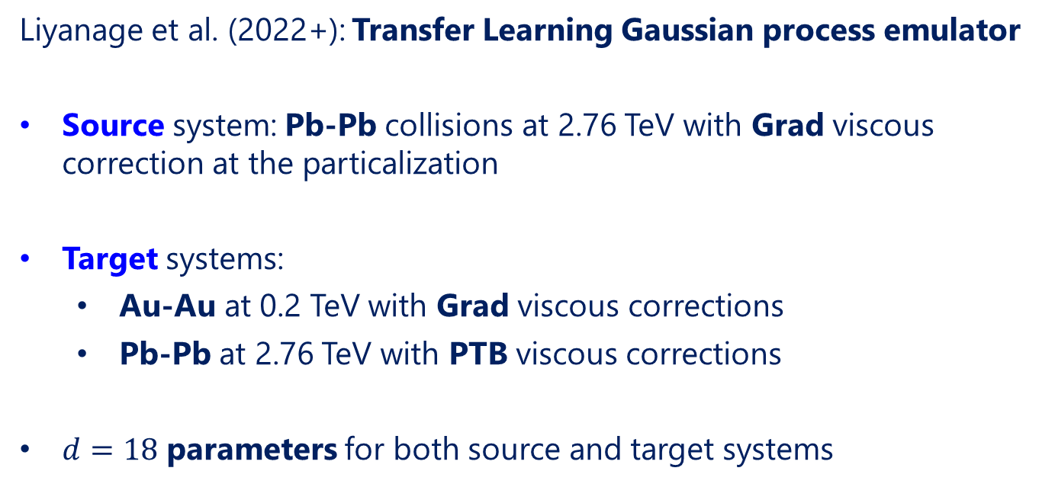
TLGP emulator
Liyanage et al. (2022+): Transfer Learning Gaussian process emulator
Source system: Pb-Pb collisions at 2.76 TeV with Grad viscous correction at the particalization
Target systems:
  Au-Au at 0.2 TeV with Grad viscous corrections
  Pb-Pb at 2.76 TeV with PTB viscous corrections
$d=18$ parameters for both source and target systems

Slide 9
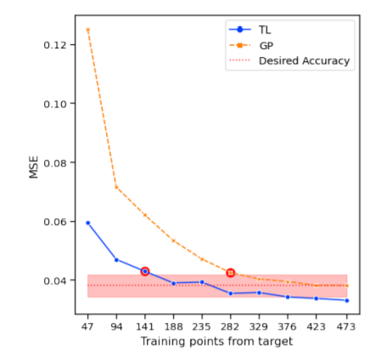
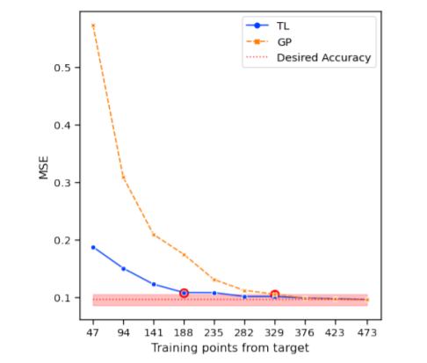
TLGP emulator
Source: Pb-Pb (Grad)
Target:
Au-Au (Grad)
Pb-Pb (PTB)
Comparable emulation performance with noticeably reduced training data (i.e., reduced simulation costs)!

Slide 10

Questions

Slide 11
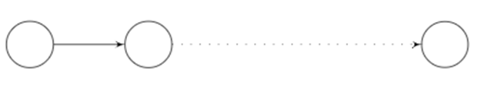
Kennedy-O’Hagan model
Lowest fidelity
Highest fidelity
$$η_{1}$$
$$η_{2}$$
$$η_{S}$$
Kennedy-O’Hagan (KO, 2001) multi-fidelity emulator model:
Lowest fidelity computer code assigned a GP prior model:
$$η_{1}\left(⋅\right)∼GP\left(μ_{1}\left(⋅\right),k_{1}\left(⋅,⋅\right)\right)$$
Higher fidelity computer codes are linked via the model:
$$η_{t}\left(θ\right)=ρ_{t−1}⋅η_{t−1}\left(θ\right)+δ_{t}\left(θ\right), t=2, ⋯, S$$
  $ρ_{t−1}$ : correlation parameter between $t−1$ and $t$-th level codes
  $δ_{t}\left(θ\right)$ : discrepancy between $t−1$ and $t$-th level codes

Slide 12
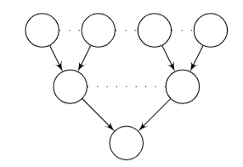
Graphical multi-fidelity GP model
Proposed GMGP emulator model:
Connections between codes represented by a directed acyclic graph
Lowest fidelity codes have prior:
$$η_{l}\left(⋅\right)∼GP\left(μ_{l}\left(⋅\right),k_{l}\left(⋅,⋅\right)\right)$$
Higher fidelity codes have prior:
$$η_{t}\left(θ\right)=\sum_{l∈Pa(t)}{ρ_{l}η_{l}\left(θ\right)}+δ_{t}\left(θ\right)$$
where $Pa\left(t\right)$ are the parent nodes of code $t$
Lowest fidelity
$$η_{1}$$
$$η_{2}$$
$$η_{S}$$
Highest fidelity

Slide 13
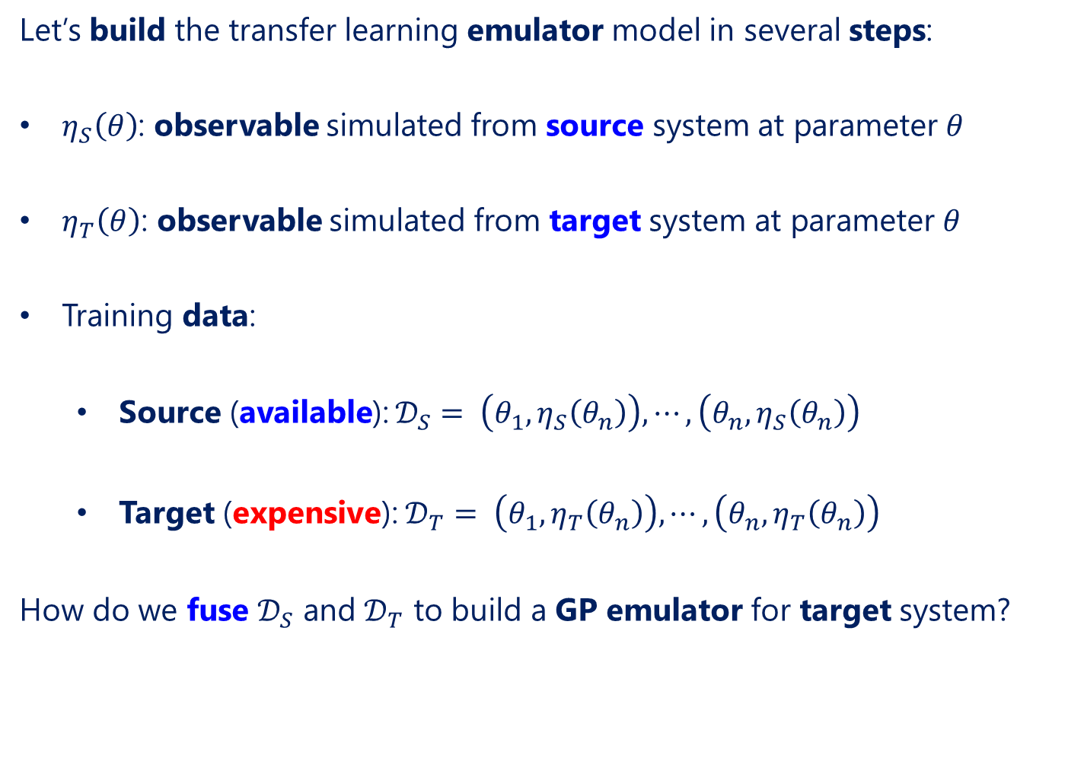
Transfer learning emulator
Let’s build the transfer learning emulator model in several steps:
$η_{S}\left(θ\right)$: observable simulated from source system at parameter $θ$
$η_{T}\left(θ\right)$: observable simulated from target system at parameter $θ$
Training data:
  Source (available): $𝒟_{S}= \left(θ_{1},η_{S}\left(θ_{n}\right)\right), ⋯,\left(θ_{n},η_{S}\left(θ_{n}\right)\right)$
  Target (expensive): $𝒟_{T}= \left(θ_{1},η_{T}\left(θ_{n}\right)\right), ⋯,\left(θ_{n},η_{T}\left(θ_{n}\right)\right)$
How do we fuse $𝒟_{S}$ and $𝒟_{T}$ to build a GP emulator for target system?

Slide 14
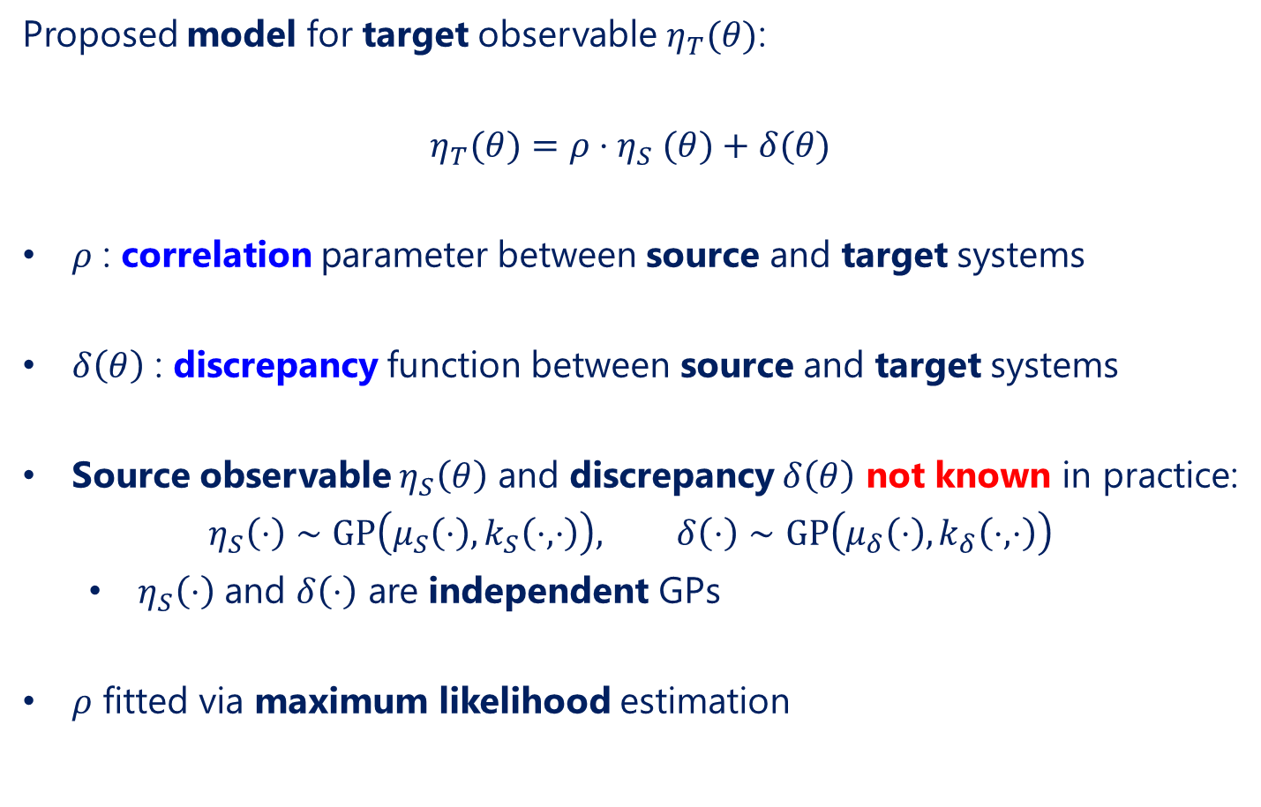
Transfer learning emulator
Proposed model for target observable $η_{T}(θ)$:
$$η_{T}(θ)=ρ{⋅η}_{S}(θ)+δ(θ)$$
$ρ$ : correlation parameter between source and target systems
$δ\left(θ\right)$ : discrepancy function between source and target systems
Source observable $η_{S}\left(θ\right)$ and discrepancy $δ\left(θ\right)$ not known in practice:
$$η_{S}\left(⋅\right)∼GP\left(μ_{S}\left(⋅\right),k_{S}\left(⋅,⋅\right)\right), δ\left(⋅\right)∼GP\left(μ_{δ}\left(⋅\right),k_{δ}\left(⋅,⋅\right)\right)$$
  $η_{S}\left(⋅\right)$ and $δ\left(⋅\right)$ are independent GPs
$ρ$ fitted via maximum likelihood estimation

