Slide 1
Comparative Study of Common Coil Geometry and
Relative Conductor Usage in a 20 T Hybrid Design
Ramesh Gupta
2/2/22

Slide 2
Content
Initial results of the comparative study of the 20 T designs
  The conductor usage are significantly lower in the common coil as compared to that in other designs (cosine theta and canted cosine theta).
  This is opposite to what many expected. Difference is even more for the expensive HTS.
  Is it real? If so, why?
  Other interesting findings:
    flexibility in the common coil design, including in the number of layers
    overall cost of R&D dipole (for common coil one must have two bores)
Work ahead and Summary

Slide 3
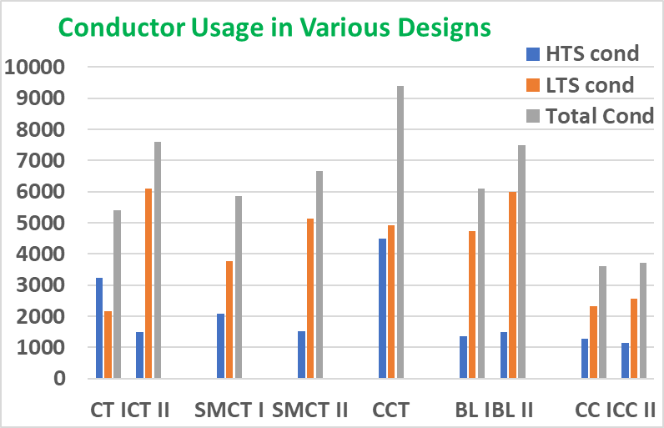
Initial Observation from the Comparative Study of Various Designs
Stress Managed Cosϑ
Block coil
(BL)
Cosϑ
(CT)
(SMTC)
Common Coil (CC)
Canted Cosine Theta
(CCT)
Comparative studies of 20 T designs (as presented at MT) revealed that the common coil design uses significantly less conductor than the other designs. Small differences in relative margin doesn’t explain that.
This finding is opposite to that expected from the conventional wisdom. Why? Back to the design board…
Explanation comes from the basic design principles. As the design field gets higher, relative ratio between the bore area and the coil area changes significantly. That changes the optimization and the outcome.
The difference is likely to grow for field quality magnets and particularly on the use of the expensive HTS

Slide 4
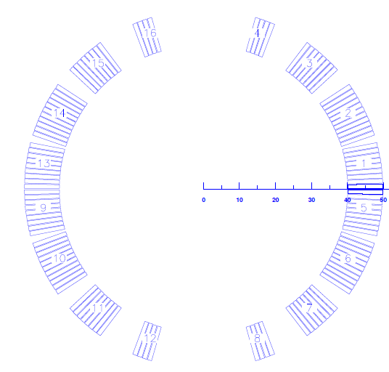
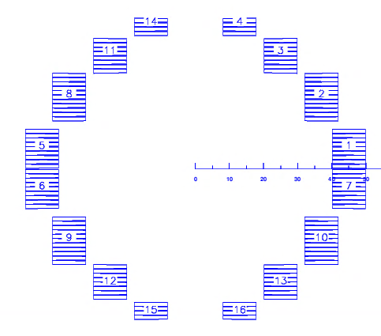
Coil Geometries for Low to Medium Field Dipoles
(coil width much less than the magnet bore)
Accelerator magnets typically have circular bore. Therefore, a shell geometry is a natural choice. At low fields, the required width (and area) of conductor needed is much less than bore. One can design magnets with a single layer coil (RHIC). Block coil geometry will require many coils (layers) and may also use more conductor.
The basic rules of the cos theta dipole design:
Block Coil Design
Cosine theta design
B is proportional to the width * (current density)
Conductor area needed to create the dipole field increases linearly with the radius of each layer (worse for fixing higher order multipoles)
Coil must extend to 60º (or more with wedges) for b₃=0. Maximum is 90º.
These principles define the geometry and the conductor area, with little flexibility left.
At low fields, block coil designs appear less efficient and less elegant. They have not been used in any major conductor dominated design

Slide 5
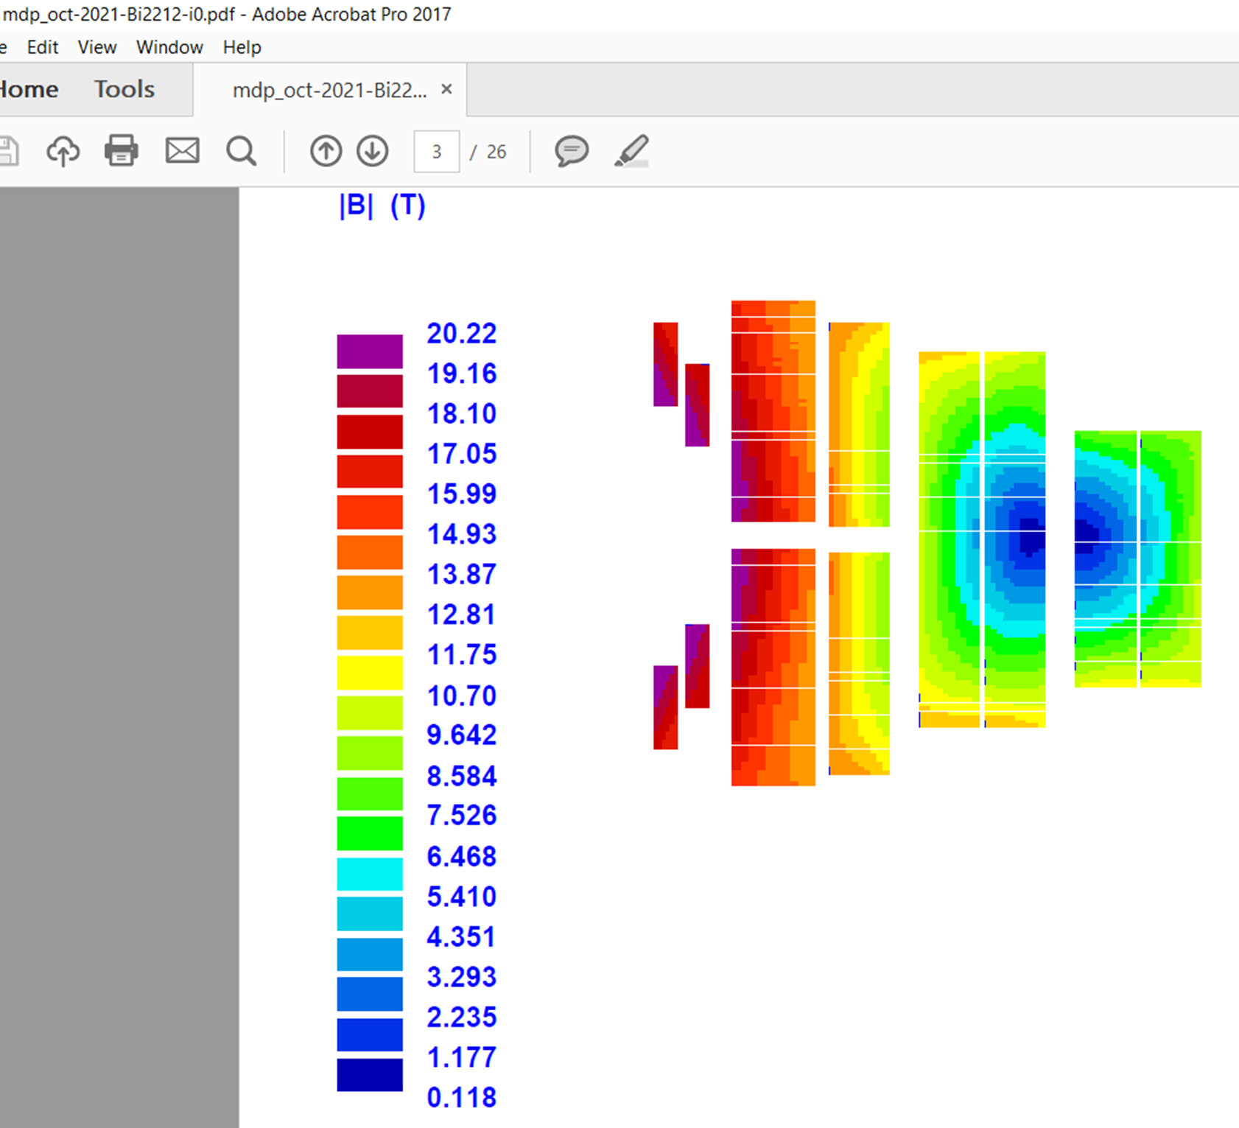
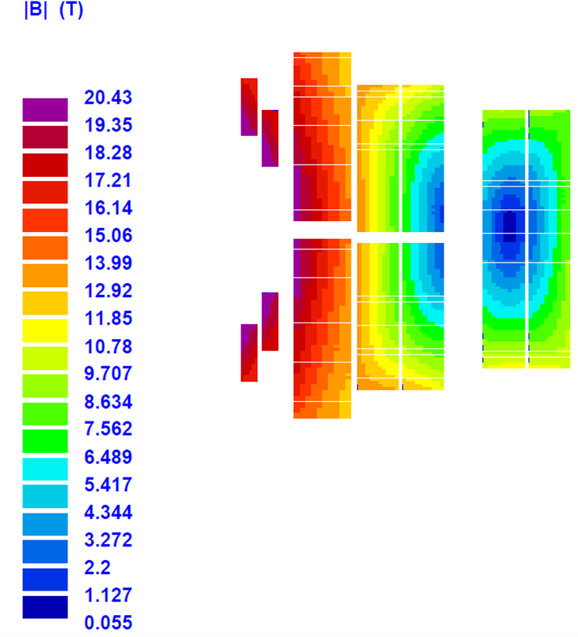
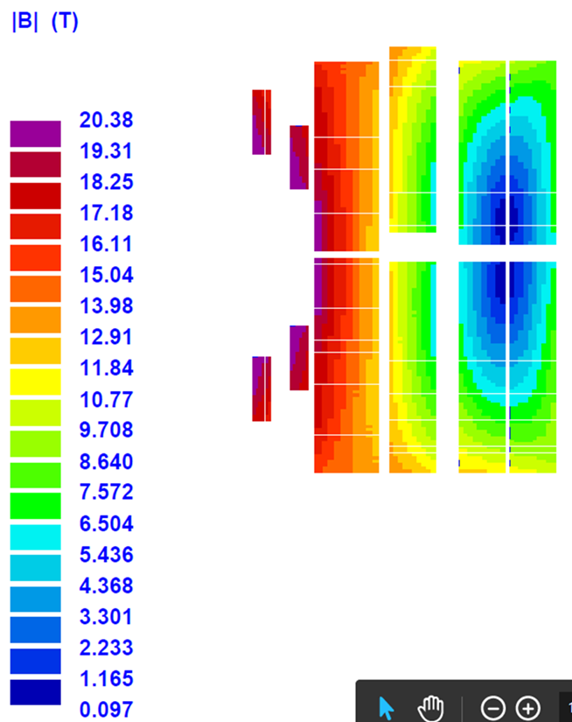
Another Observation: Coil Thickness
The coil width (number of layers) is primarily determined by the design field in the cosine theta and in the canted cosine theta designs. A large flexibility in coil width to create same field has been observed in the common coil design. And interestingly the coil width didn’t impact the conductor requirement that much.
4-layer design
6-layer design
5-layer design
HTS: 1 layer + pole blocks
  74 turns in ½ bore
LTS: 5 layers
  198 turns in ½ bore
Total turns = 272
HTS: 1 layer + pole blocks
  80 turns in ½ bore
LTS: 4 layers
  188 turns in ½ bore
Total turns = 268
HTS: 1 layer + pole blocks
  82 turns in ½ bore
LTS: 5 layers
  180 turns in ½ bore
Total turns = 262

Slide 6
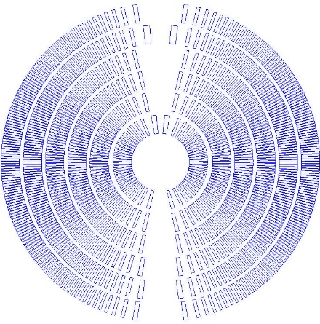
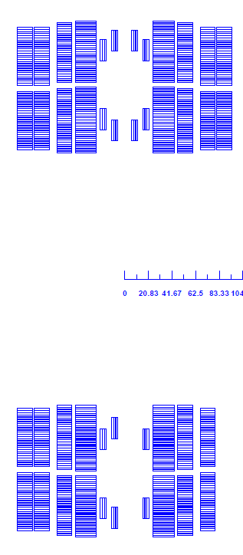
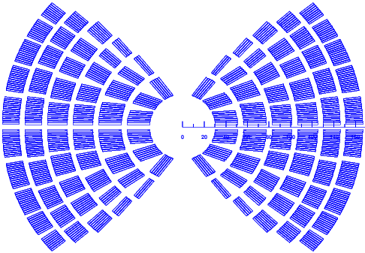
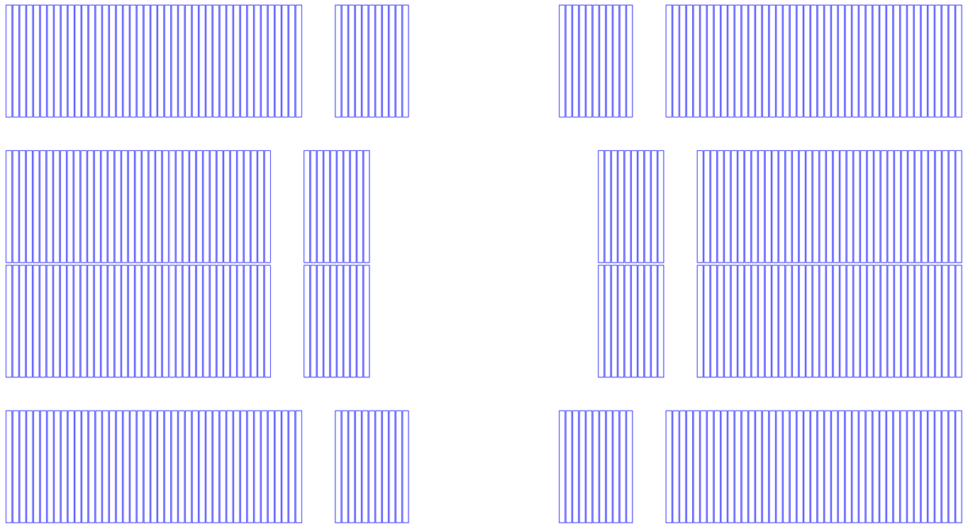
Coil Geometries for Very High Field Dipoles
(coil width much greater than the magnet bore)
Situation changes for high field designs when the coil width (area) becomes much larger than the bore (aperture). One must evaluate again the impact on geometry and other constraints.
Variables and constraints to optimize the cosine theta and the canted cosine theta designs:
Variables and constraints to optimize the block coil and the common coil designs:
Total coil width (horizontal width – free to grow)
Coil Height (vertical height – free to grow) – major difference from the cos ϑ or canted cosine theta
Field quality: use spacer (structure) & pole coils
Horizontal space for structure elements
Total coil width (radial width – free to grow)
Pole Angle (limited to 90º max., 60º min. for b₃=0)
Field quality: use wedges (may be used for structure)
Radial space between layers for structure element

Slide 7
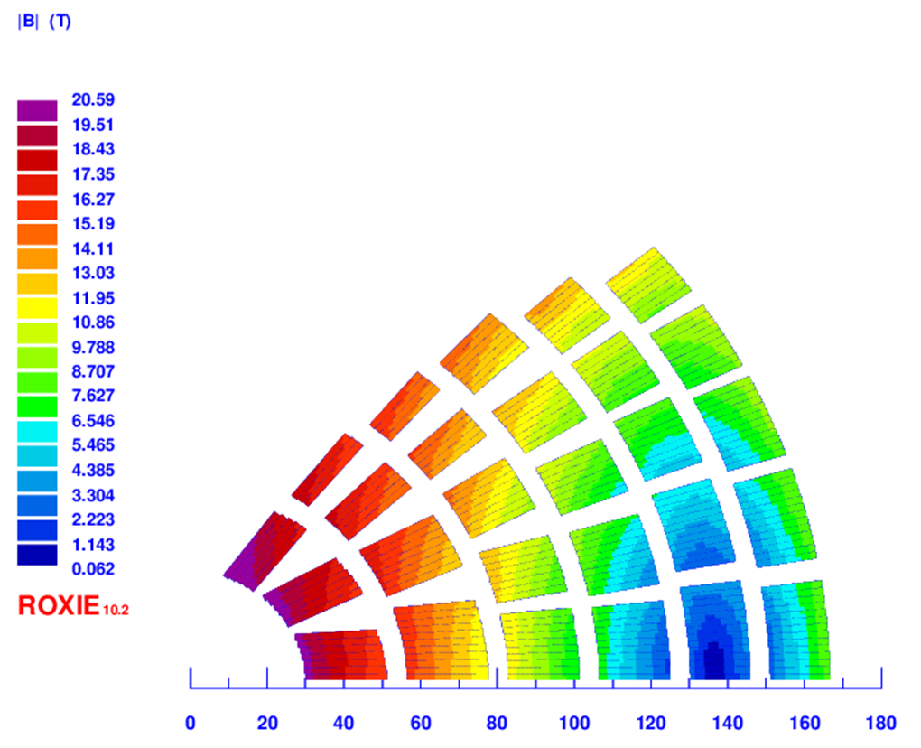
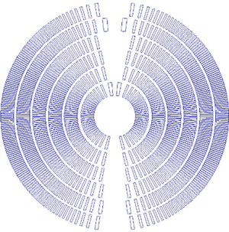
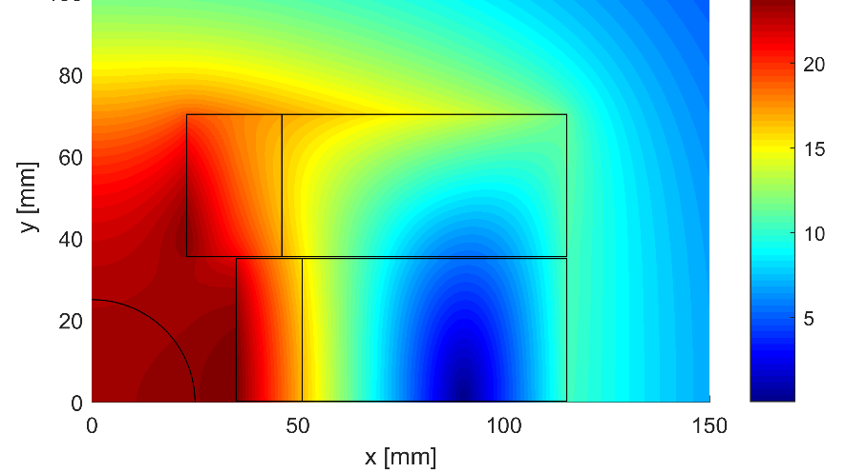
Optimization of 20 T Design – max area & max field
(coil area much larger than the bore area)
Need six layers (of which 2 to 4 layers must be of HTS)
4-layer design
(HTS: only 1 layer)
In cosine theta and canted cosine theta, certain coil thickness or # of layers, is needed to create field.
The same thickness (#of layers) must continue to the pole (60 to 80 degrees), the fill in between is determined by the cosine theta optimization.
The field remains high at pole for many layers, means may need HTS, depending on the angle.
Outer layers of current cosine theta designs, need to be extended to larger angle for field quality, which will use more conductor without creating much field.
Furthermore, since the field will be higher there, the need for HTS and more layers of HTS will grow.
Cosine theta
Common coil
Block Coil
Situation is very different in the common coil design.
Horizontal and vertical sizes are fully decoupled.
This provides flexibility and saving on the conductor.
Moreover, the separation between the very high field and medium field region is good between the layers.
This means that the HTS is needed only in one layer!
Canted cosine theta

Slide 8
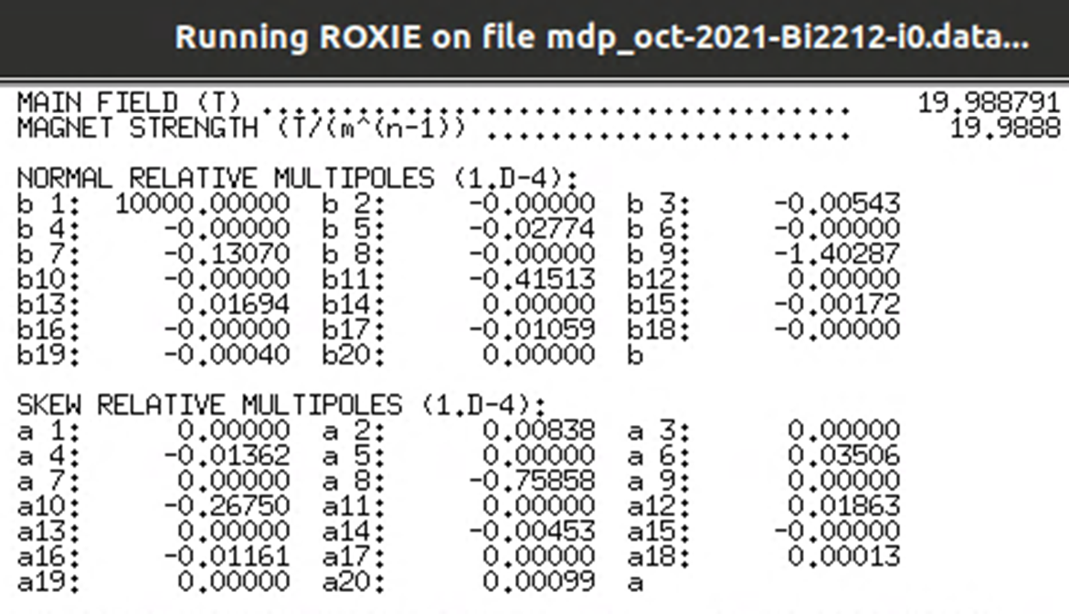
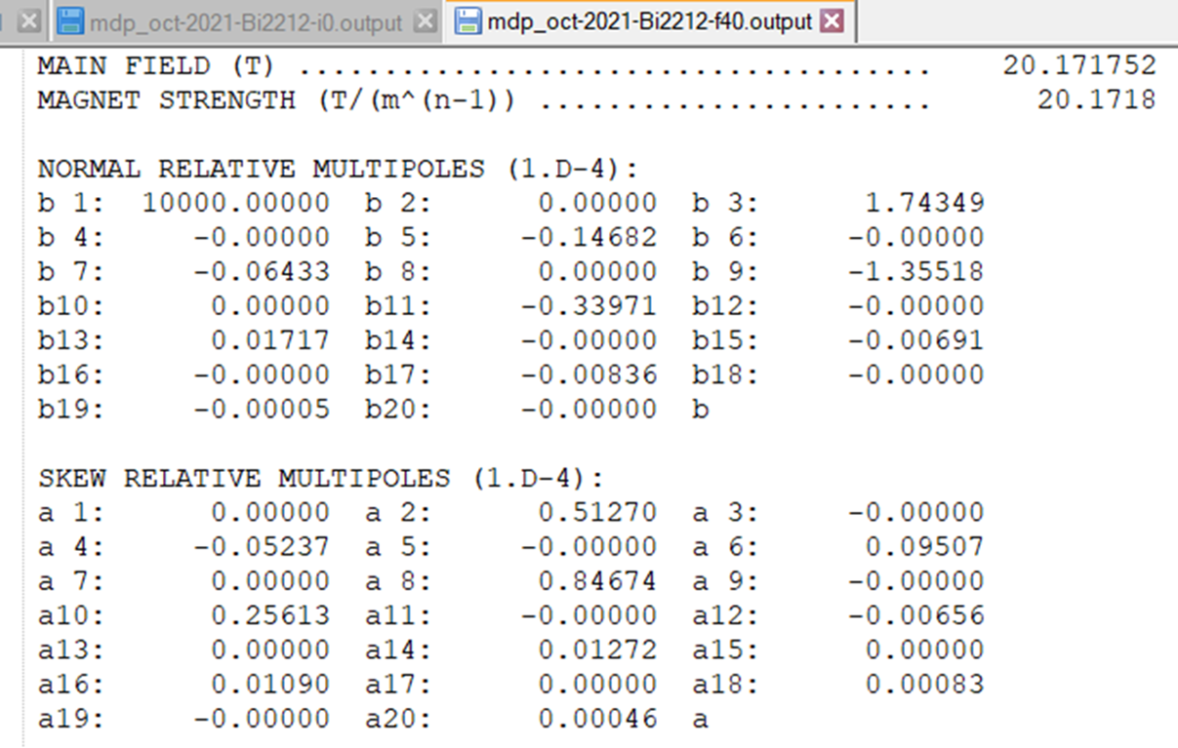
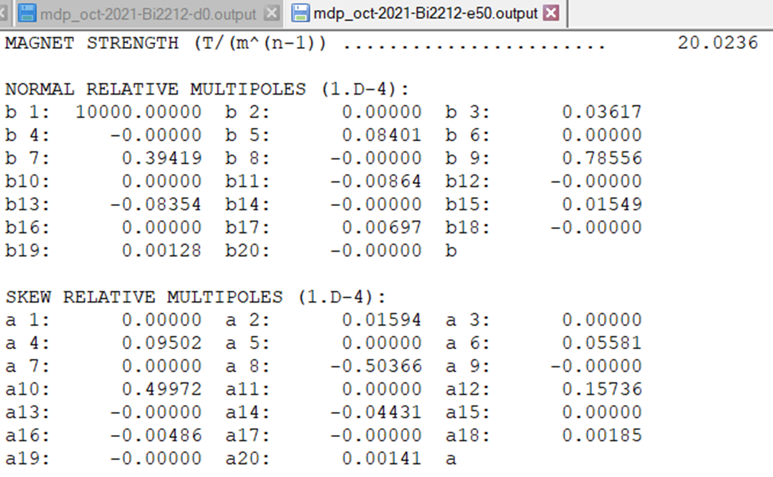
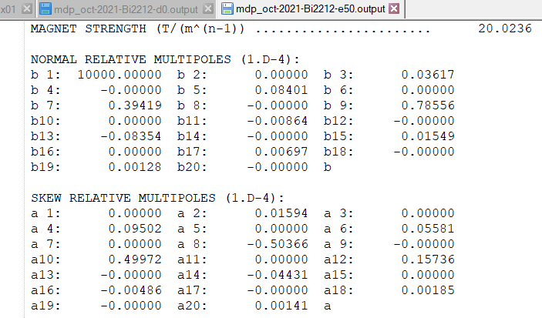
Field Quality in Common Coil Geometries
(all MT designs had 10⁻⁴ harmonics)
4-layer design
6-layer design
5-layer design

Slide 9
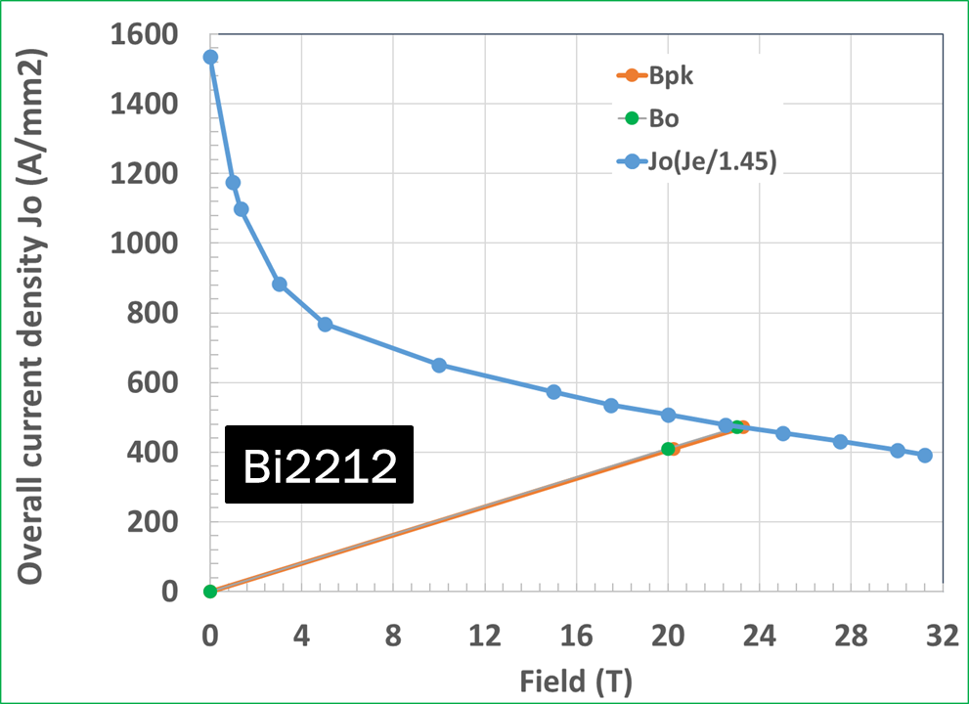

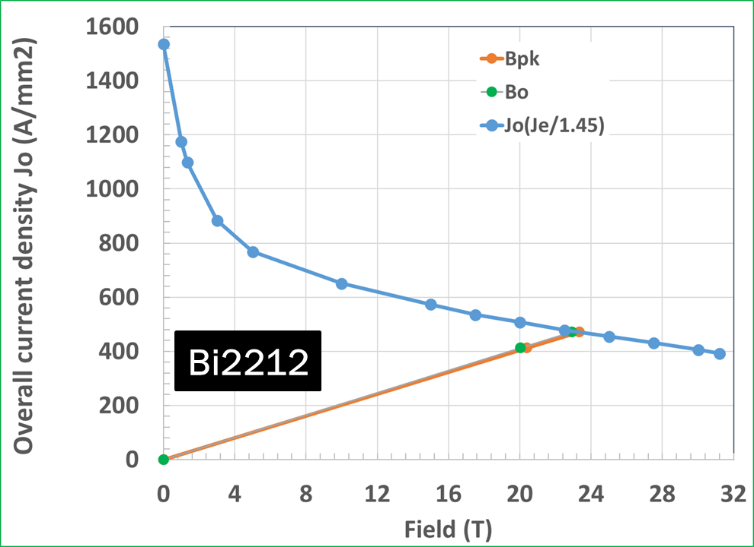
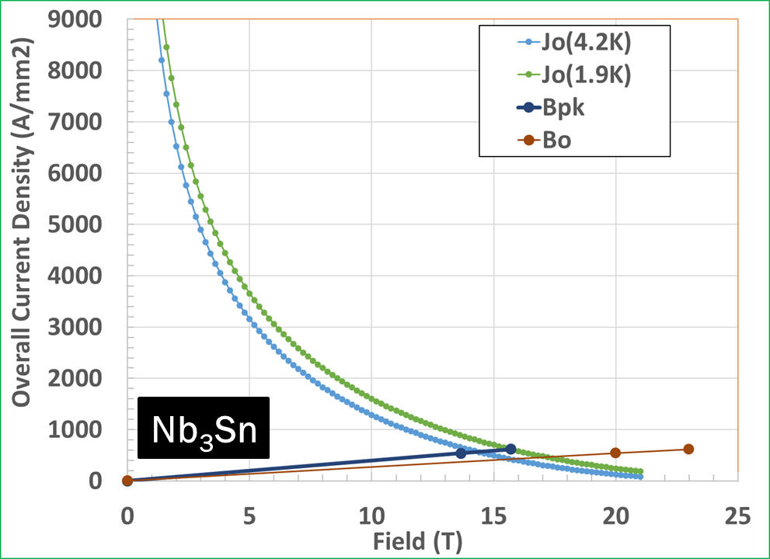
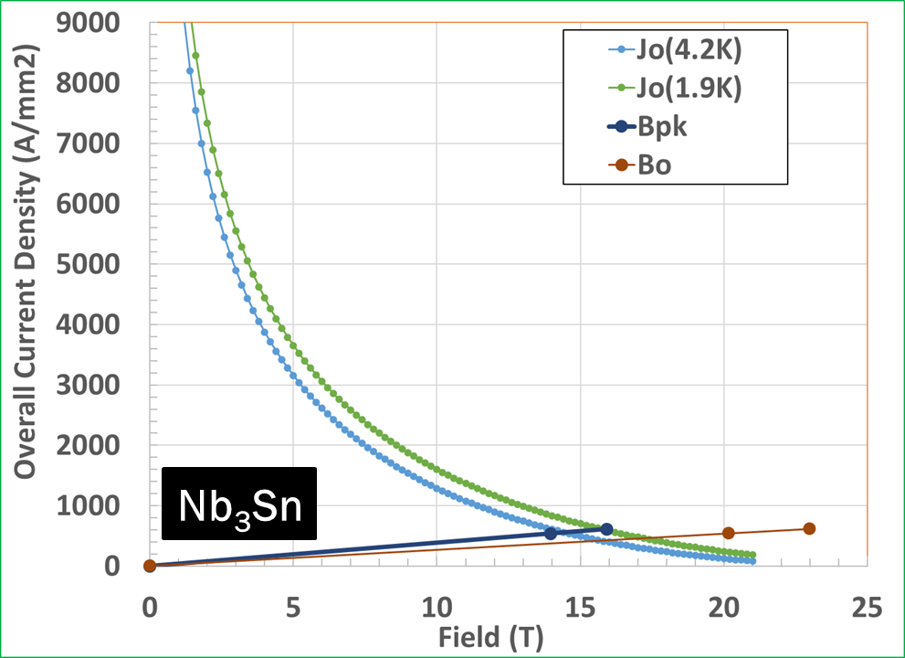

Operating Margins in Common Coil Geometries
(all MT designs had ~23 T Short Sample - 15% over 20 T)
6-layers
5-layers
4-layers

Slide 10
RECAP 1: Relative Difference in the “Bore Area” and “Coil Area” between Low-field and High-field Dipoles
High Field
Block coil design
Cosine theta design
Block coil design
(common coil)
Cosine theta design
Low Field

Slide 11
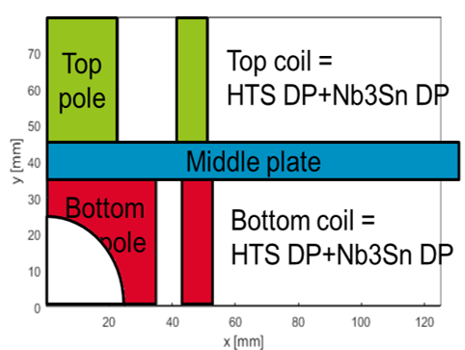
RECAP 2: Initial optimization of 20 T geometries reveals that the common coil designs uses “significantly” less conductor (not more) than the other designs
Cosine theta
4-layer design
Common coil
Block Coil
Canted cosine theta
6-layer design

Slide 12
Specific to the Common Coil Design
Updates
Challenges, Opportunities, Work Ahead

Slide 13
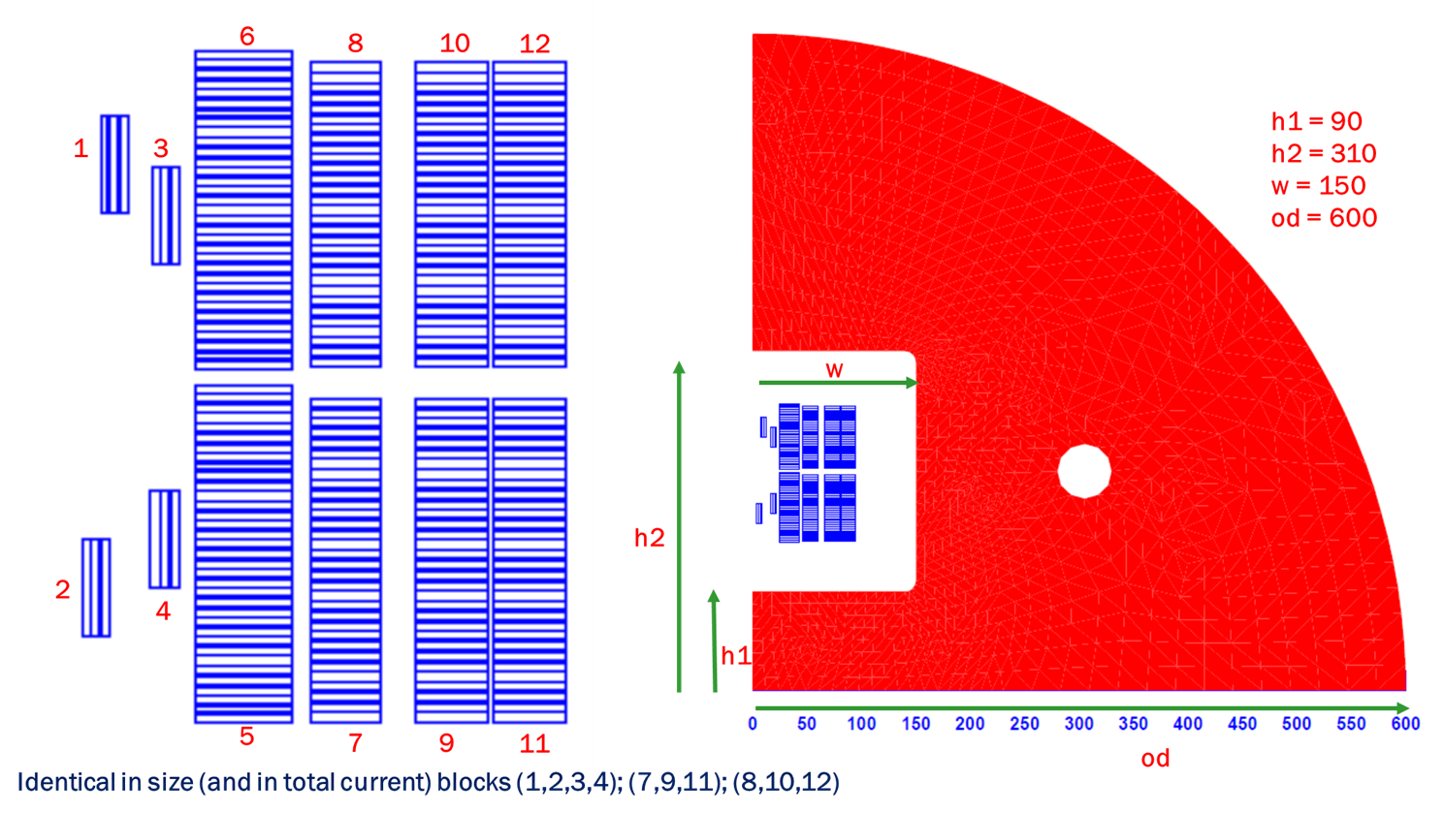
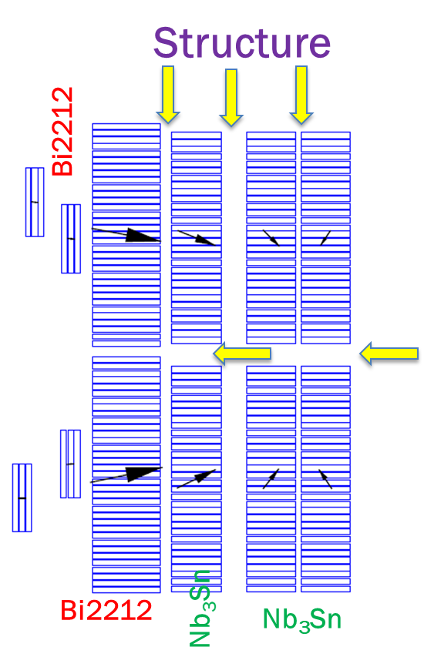
Modular Common Coil Design (1/22)
(matched margins, all Nb₃Sn identical, one HTS + pole)
Three Nb₃Sn layers made identical - less tooling, less spares, sort/switch between layers – reduces cost of R&D magnet
Good field quality; margins between HTS & LTS matched within a few tenth of a percent; considerations for the structure
Next step:
Iterate magnetic & mechanical design

Slide 14
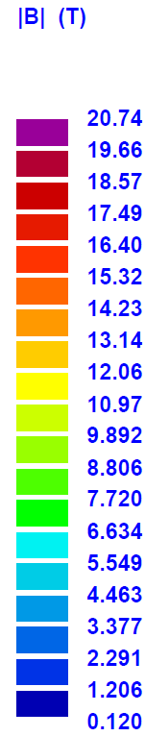
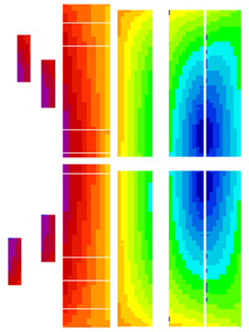
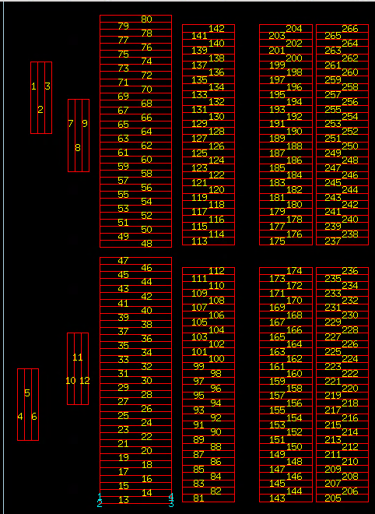
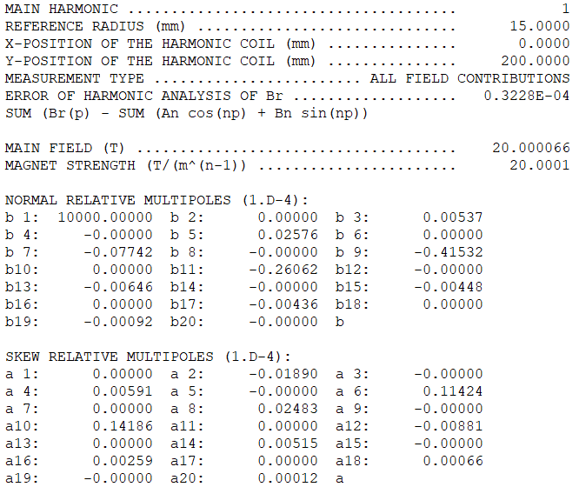
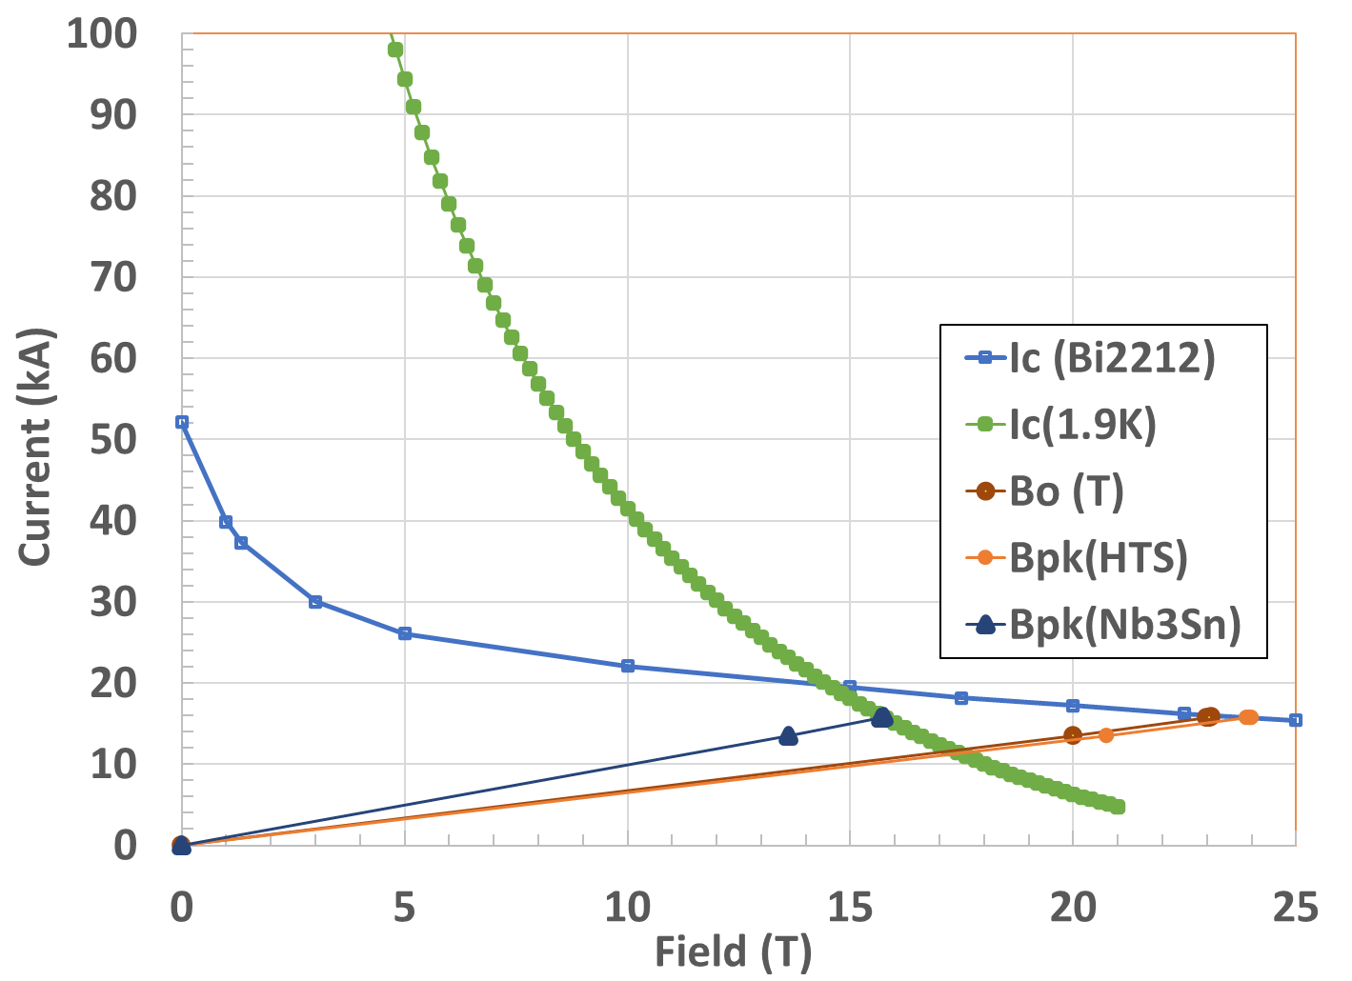
Summary of the Modular Design (1/22)
(good field quality, matched margins, HTS & 3 identical Nb₃Sn)
Geometric harmonics < 0.5 10⁻⁴ (not 5.0 10⁻⁴)
No. of Turns
(½ bore)
HTS: 80
LTS: 182
Total: 262

Slide 15
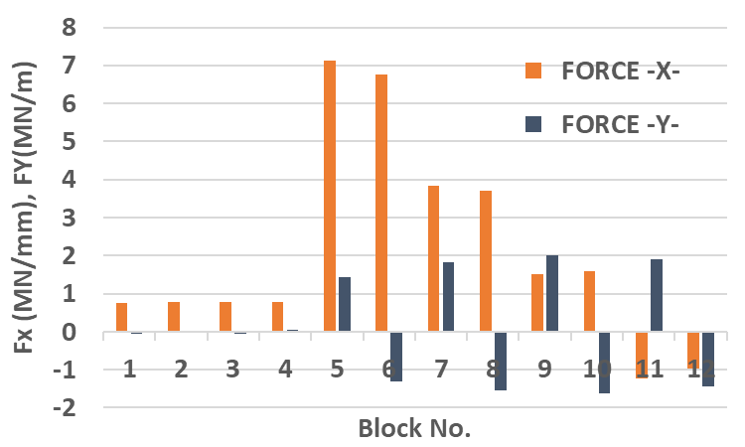
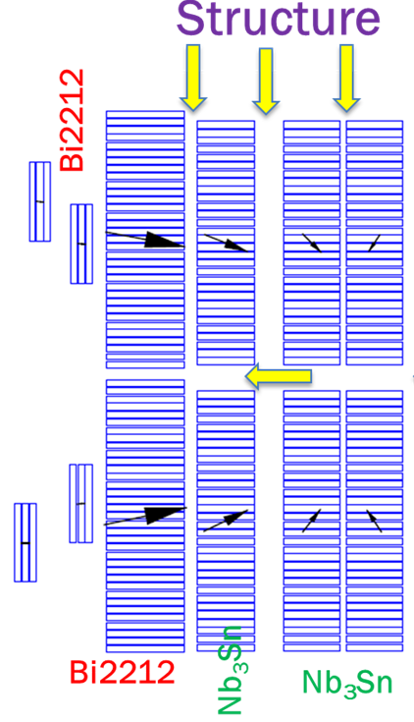
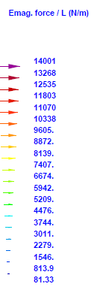
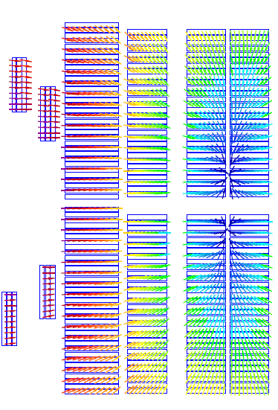
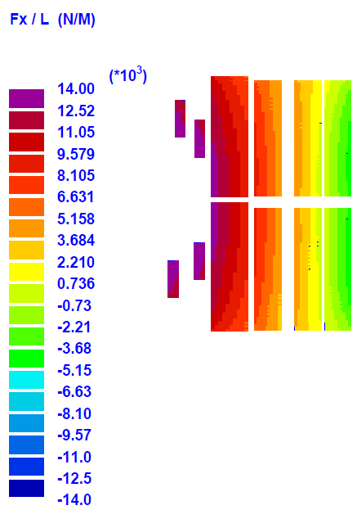
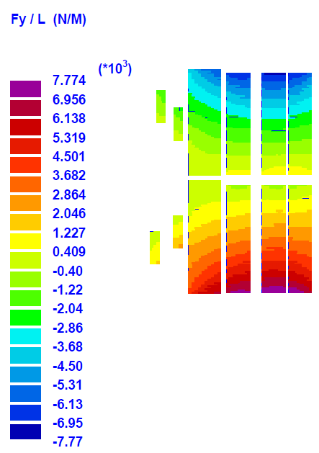
Lorentz Forces in the Common Coil
Common coil geometry is advantageous in dealing with the large Lorentz forces
Primary horizontal (maximum vertical force on any block is 1/3 of horizontal)
Horizontal forces do not put much strain on conductor in common coil (more later)
Small forces on pole (mostly horizontal)
Space for structure to be iterated
6
7
10
12
1
3
4
5
7
9
11
2

Slide 16
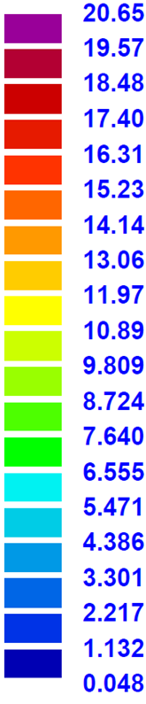
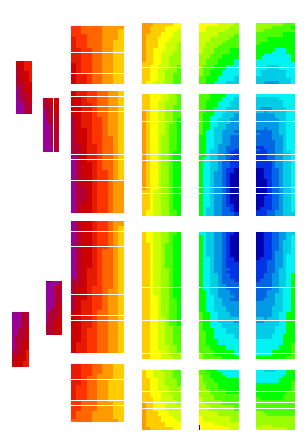
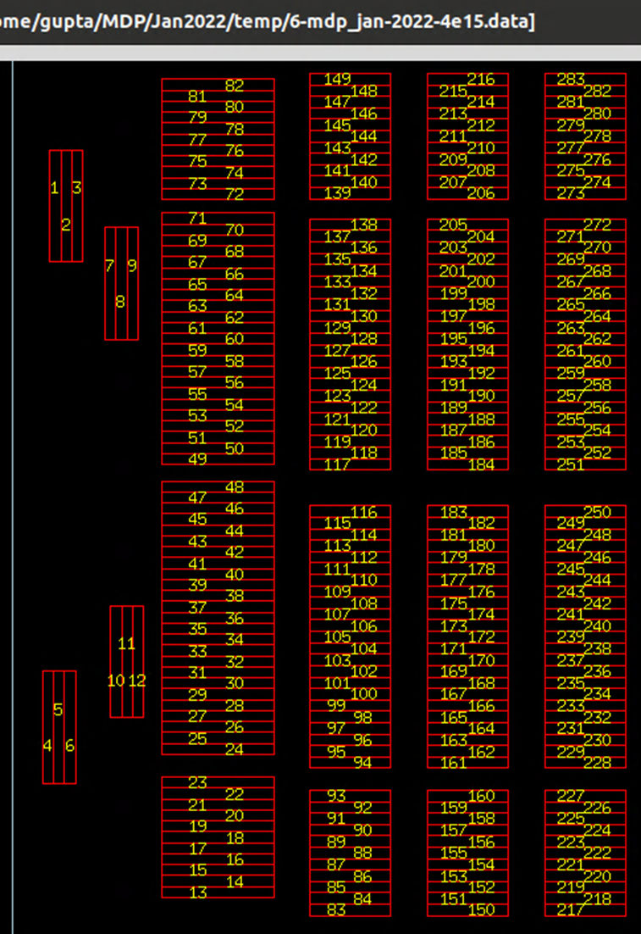
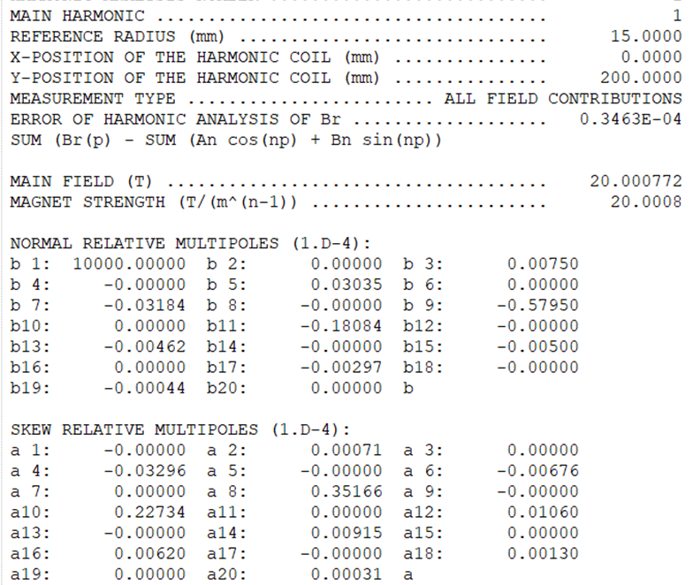
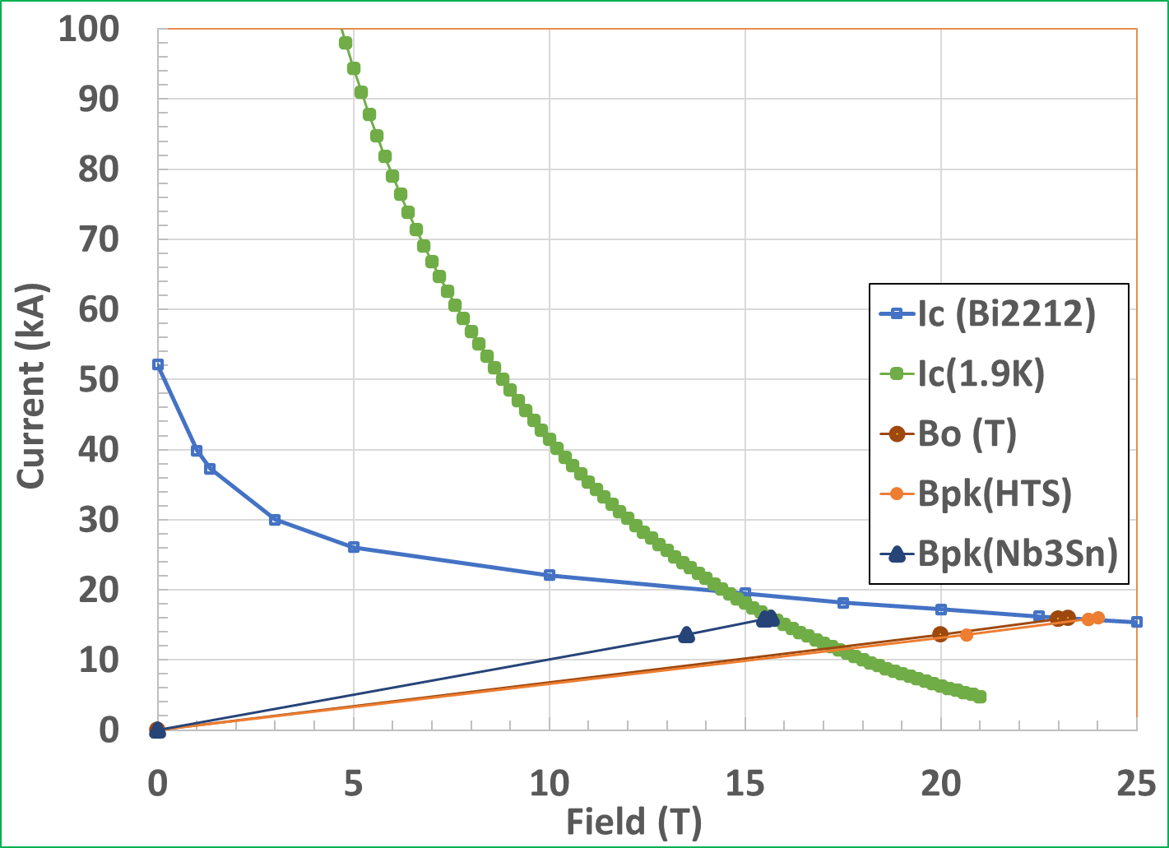
Design with More Space for Structure
(to be iterated with mechanical analysis, may need less)
Only 8% increase in conductor for providing ~3-6 mm vertical and 6 mm horizontal space
No. of Turns
(½ bore)
HTS: 82
LTS: 201
Total: 283
(increase from 80+182=262)

Slide 17
Work Ahead
(priority mechanical design and analysis)
Mechanical analysis of the 20 T HTS/LTS hybrid design (work just started).
Provide feedback to magnetic design for the space needed for the structure between layers and within layer. Iterate magnetic and mechanical designs.
Develop concepts for assembling the magnet.
Perform 3-d magnetic and mechanical analysis for a 20 T design.
Perform refined mechanical analysis for practical 3-d structures.
Several common coil dipoles with main coils have been built and tested. However, none have been built with the pole coils necessary for the field quality. Build pole coils and demonstrate them in a proof-of-principle magnet.
Perform cost estimates of R&D dipoles and for large scale series production.

Slide 18
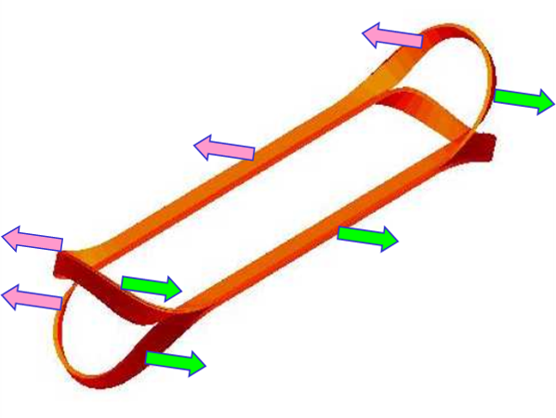
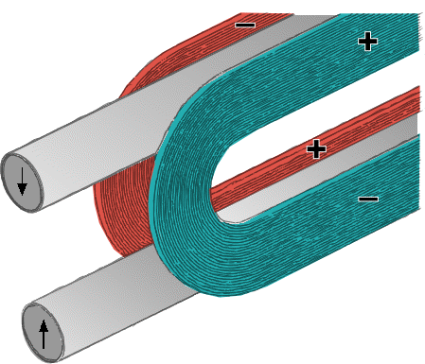
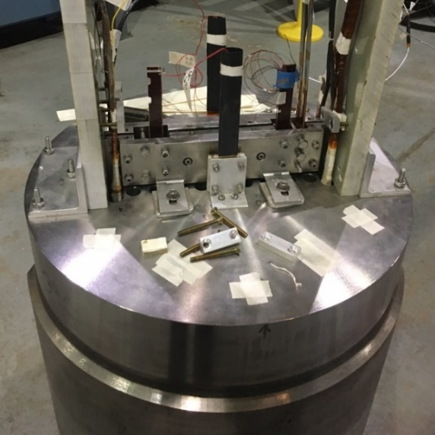
Key Benefits of the Common Coil Design for HTS/LTS High Field Hybrid Dipoles
Coil layers move as a module without causing strain at ends (BNL common coil had 200 μm). This should also save on the structure needed
Flexible space for stress managed structure
Natural segmentation between HTS and LTS for efficient optimization of conductor usage
Simple coil geometry with large bend radii allow more technologies (W&D, R&W), more cables, more materials, etc.
Modular design for low-cost, fast-turn-around R&D (PoP: 12.3 T MDP HTS/LTS hybrid dipole)
6
7
10
12
1
3
4
5
7
9
11
2
Insert coils in Empty space

Slide 19
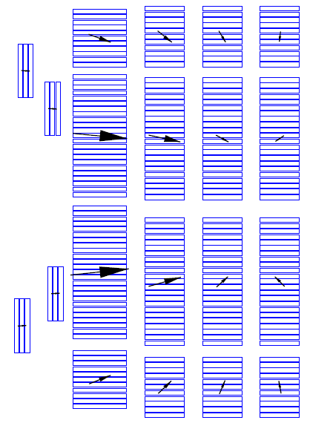
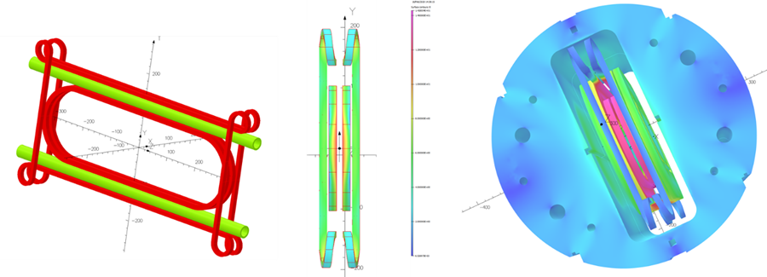
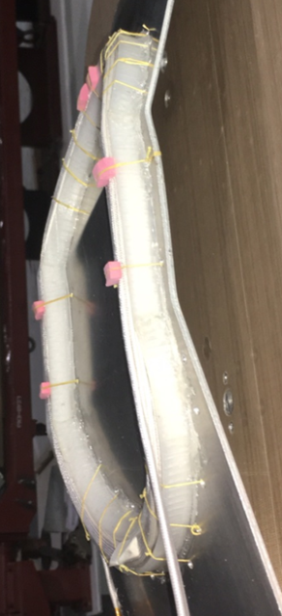
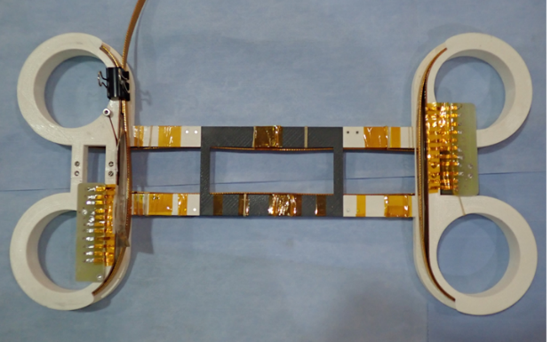
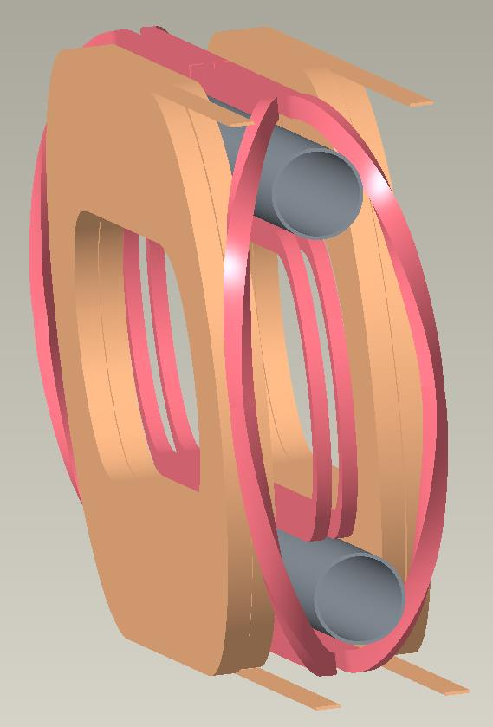
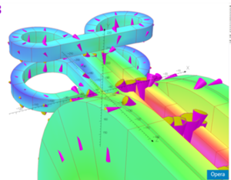
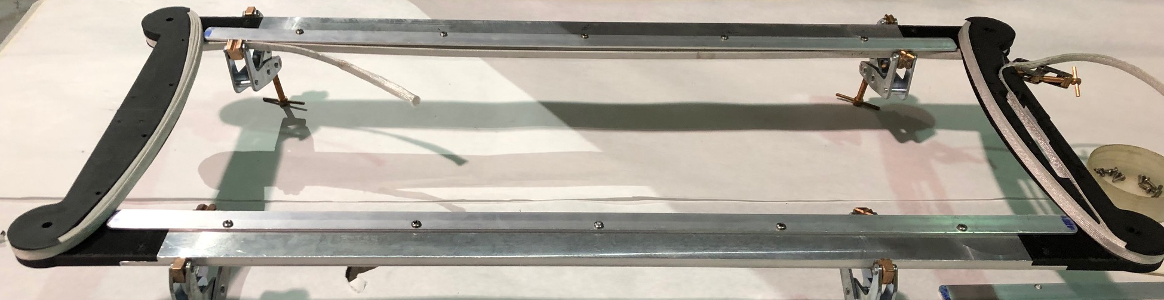
A Few Possible Layouts of Pole Coils Clearing the Bore (other geometries shown elsewhere)
Practice pole coil windings and preliminary designs (performed under three SBIR Phase I; no Phase II).
They can be built and tested under MDP.

Slide 20



Splices in Common Coil Design
(between two single layer coil)
In common coil design, splice (even between two types of coils), can be easily made in the middle of the coil where the field is very low
Perpendicular Nb-Ti splice in the low field region of BNL common coil dipole DCC017
Bi2212
Nb₃Sn

Slide 21
Summary
MDP comparative study revealed that for very high field dipoles (20 T), common coil design uses significantly less conductor than that used in other designs. The analysis presented here explains why it is so. Is mystery solved?
Common coil allows easy and efficient segmentation between HTS and LTS - only one HTS (Bi2212) layer is needed for creating 20 T with 15% margin.
Designs presented here show that the same design of Nb₃Sn coils can be used for all layers. This provides a significant savings on design, engineering, tooling, number of practice and spare coils, etc. This means that the cost of common coil R&D dipole may be competitive despite the two apertures.
A lot of work is still remaining to fully develop various aspects of the design and technology for all options (including ReBCO). A good opportunity for long term R&D for young scientists and engineers for pioneering work.

Slide 22
Extra Slides

Slide 23

Some Observations and Possible Explanation
Comparative studies of 20 T designs revealed that in the common coil design, one can get away with fewer layers and it uses less conductor.
This is opposite to what was the conventional wisdom. Small differences in margin can’t explain that.
Any basic change in going from lower to higher fields?
Cosϑ without and “with stress management”
Block coil designs
Canted Cosine Theta
Common coil designs
<=Typo?

Slide 24







Magnet Designs for <10 T Dipoles
(all use NbTi conductor and cosine θ design)
Tevatron Dipole
HERA Dipole
Cosine (θ) like current distribution
LHC Dipole
RHIC Dipole
complex ends

Slide 25


Common Coil Concept for Collider Magnets
Simple 2-d coil geometry for collider dipoles
Conductor friendly design with large bend radii (determined by the spacing between two apertures) without complex 3-d ends
Allows both React & Wind and Wind & React
Block design with lower internal strain on the conductor under Lorentz forces
Easier segmentation between LTS and HTS coils for high field magnet (modular design)
Fewer coils (about half) as the same coils are common between the two apertures
Simple magnet geometry and simple tooling, expect lower labor and tooling costs
More options for producing relatively lower cost and more reliable high field magnets
Coil #1
Beam #1
Beam #2
Coil #2
2-in-1 Coil
2-in-1 yoke
Main Coils of the Common Coil Design
(more complex pole coils also required for field quality)

