Slide 1
Composite Material and Design I
E Anderssen, G Vallone
SMP Seminar Series
19-April 2022

Slide 2
Overview
What are composites and why we use them
Fabrication and assembly Processes
Very brief introduction to design estimation and strength criteria (more detailed in the next session)
Some examples of Detector Structures
LBNL Composites Shop Capabilities
LBNL Composites Workshop https://conferences.lbl.gov/event/54/
CERN Composites Workshop https://indico.cern.ch/event/736952/
For this discussion: ‘Carbon Fiber’ as a material, is Carbon Fiber Reinforced Plastic (CFRP)—a ‘Composite’. Composites with other fibers and matrices are also broadly mentioned.

Slide 3
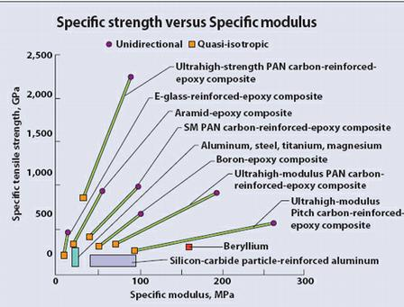
Why Composites: It’s not just mass
Clearly where mass is critical composite materials excel
Main competition is Be—not desired for several reasons
Non-magnetic properties important in some B-Field applications
Glass fiber composites non-conductive for Hi-Voltage
Thermal expansion tunable from near zero to Steel
Matrix resin choice flexible based on other requirements
α +10ppm/C
α +4ppm/C
α -2ppm/C
*Except Beryllium
ALL Metals*
In units of E/ρ where Aluminum = 1
CFRP has a ρ ~60% of Al, GFRP similar;
Modulus (E) of CFRP tunable from just under Aluminum to just over Titanium with Quasi-isotropic laminates. Oriented laminates can exceed Berylium in a desired direction.

Slide 4
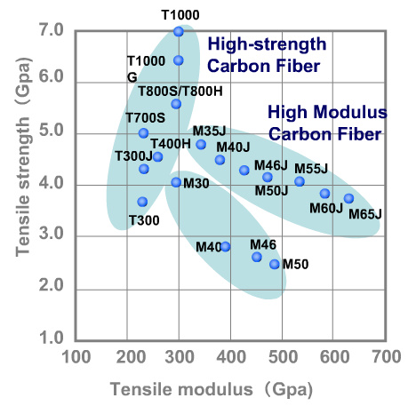
Carbon Fiber Properties
Carbon Fiber is not a material, it is a family of materials
Other fibers such as Glass, PE, Kevlar, etc have more unique properties (tightly defined)
CF properties vary based on their %-Graphitization—from mostly ‘glassy’ to ‘crystalline’
Also on ‘precursor’ material e.g. PAN versus Pitch
Chart is for PAN based fibers
Pitch based fibers can have modulus in excess of 1000GPa and start at 600GPa
Hi Strength
Steel
7075
PAN (Poly Acrylo-Nitrile) is a polymer: (viscose). Pitch is geologic tar, a byproduct of oil extraction with very high carbon content and long polymer chains thus char ratio

Slide 5
Fiber Reinforced Plastic Composite
In the composites shop we typically use Pre-impregnated fiber (Prepreg), but occasionally use resin-infusion for larger/thicker laminates
Most common resin is Epoxy (wide range of properties are possible) Elevated temp cure for toughened systems
Cyanate Esters are useful for High radiation and moderately high temperature, also stability as they resist micro-cracking (actually the most common we use)
Polyester is used as a tooling resin for wet hand-layup
Will be investigating PEEK and Poly-imides in the future

Slide 6
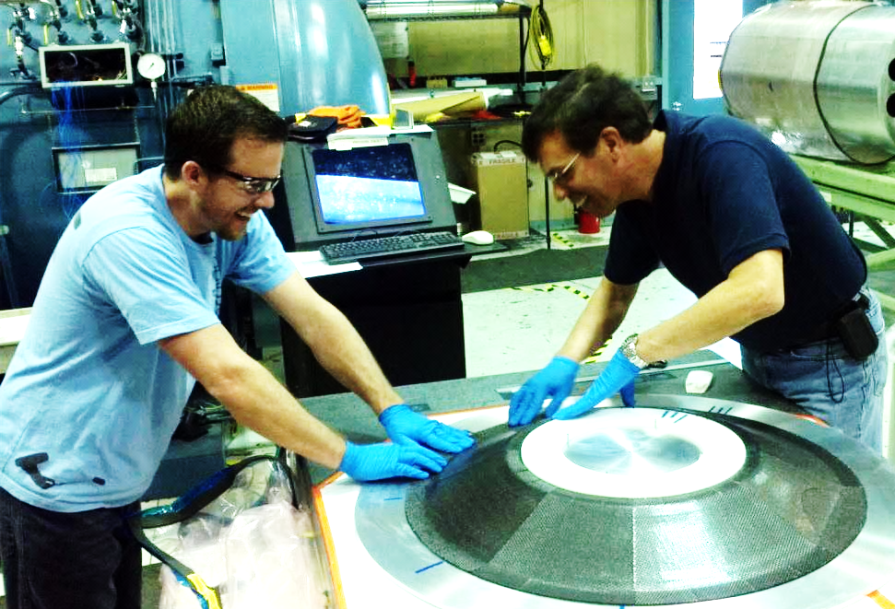
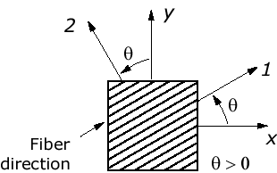
Lamination: Additive manufacture
3 and Z:
Normal to
1,2/X,Y
(1)
‘Carbon Fiber’ material is built layer by layer on a mold
Each layer has a fiber direction and ‘thickness’ specified by the design requirements (X,Y are Body Coordinates)
‘Thickness’ is a function of Fiber Areal Weight and Resin content—typically 55-60% Fiber Volume Fraction

Slide 7
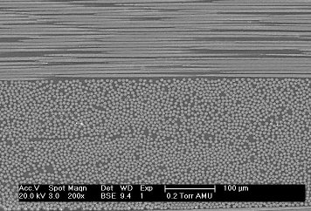
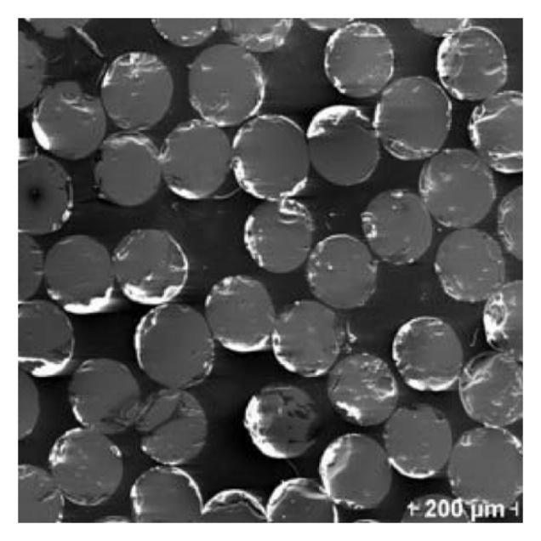
Composite Material ‘Lever Rule’
Cross-Ply Direction
Modulus of ‘unit’ section:
E_{c} = E_{f}*V_{f} + E_{m}*V_{m} +E_{v}*V_{v}
“1” Direction
Normal to Fibers
Void Fraction
Where:
V_{f} + V_{m} + V_{v} = 1 (Unity)
t_{k}
E_{c} * t_{k} = Stiffness of lamina (unit width)
Volume fractions of Fiber, Matrix, and Void content map directly to ‘lamina’ engineering properties
Various ‘Volume Fractions’ are a combination of material specification (FAW) and lamination process control
Lamina are layers in a ‘laminate’ LPT is used to predict the structural performance of a sum of lamina
Cured Ply Thickness (CPT = t_{k})

Slide 8
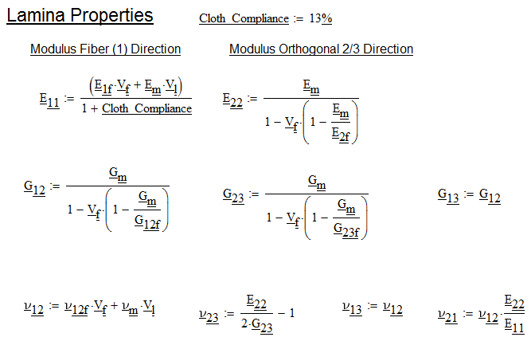
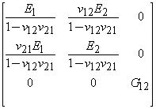
Lamina Properties: Lever Rule in 2D
V_{f} = Fiber Volume Fraction ~ 0.50-0.60 depending on process
V_{m} = Matrix Volume Fraction ~1-V_{f}
~E_{fiber}* V_{f}
Modified by
Cloth Compliance
~E_{matrix}* V_{m}
[C] =
Actually C₆₆
Note: (1+ν₁₂ν₂₁) ~1.06-1.1
[C] represents orthotropic properties of one layer of composite material in ‘Fiber Coordinates’ (note not 6X6 due to orthotropic approximation)
“1” is fiber Direction, “2” is transvers to fiber (in plane), “3” is thru thickness dimension (ignored for orthotropic case)
Matrix moduli ~1-2 orders of magnitude less than fiber
ν_{12f} (fiber poisson ratio) not well published, ranges from 0.2-0.35
‘Cloth Compliance’ is empirical—not all fiber contributes to in-plane properties ranges from 8-15% base on weave (“0” for Uni-Directional Tape—see later slide)
Lamina properties ~50% Fiber Properties in modulus, even less with cloth
Notes:
Need to check for sign errors in the poisson ratios—apparently in the Mathcad file—try to find which one was the basis for these figures.
Eq 5.2.2.1(x) in HDBK 17-3F indicates they are correct… Verify in Tsu Micromechanics…

Slide 9
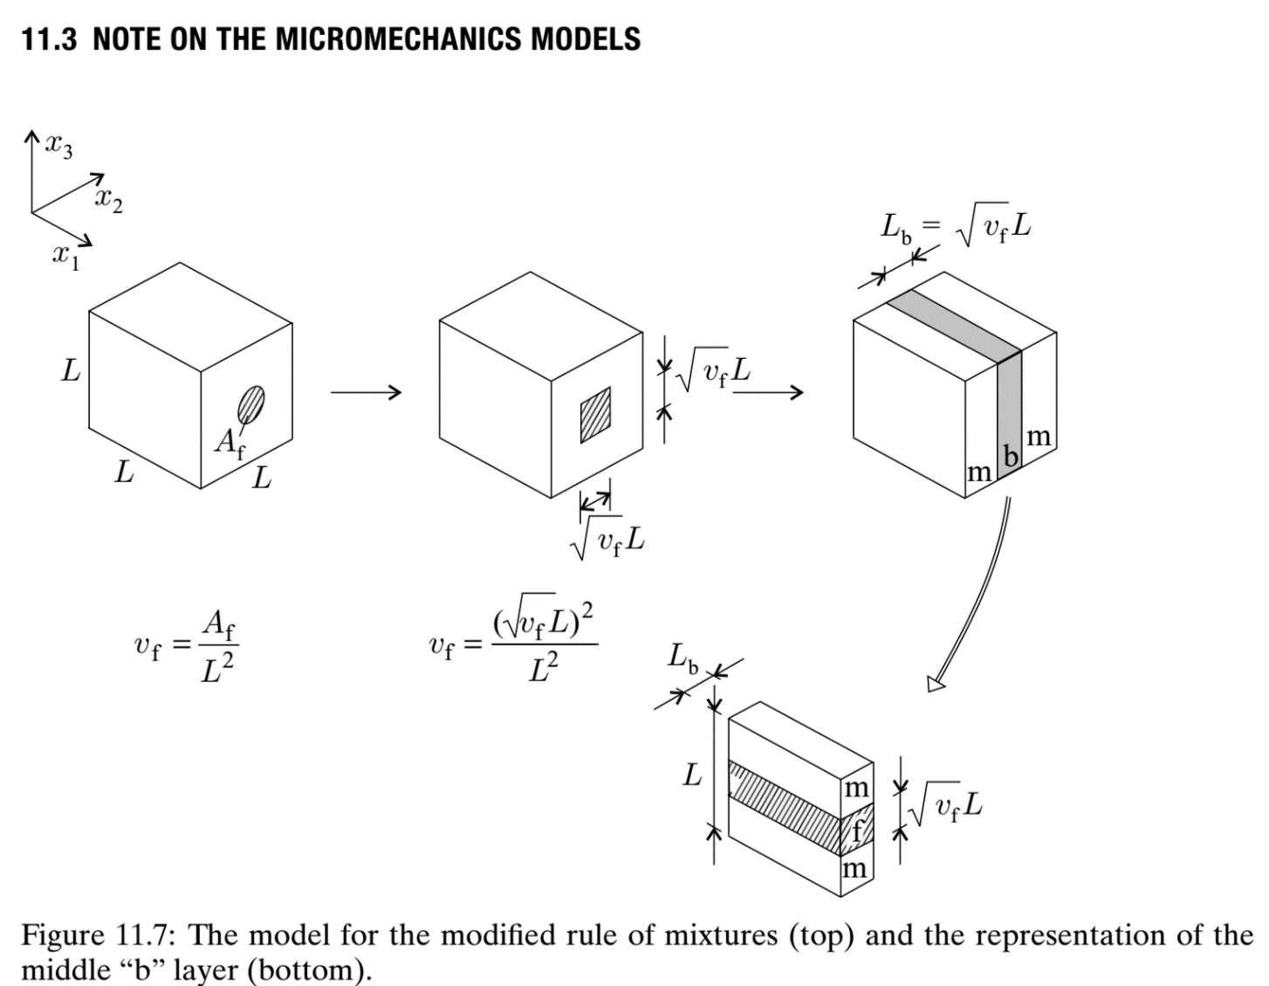
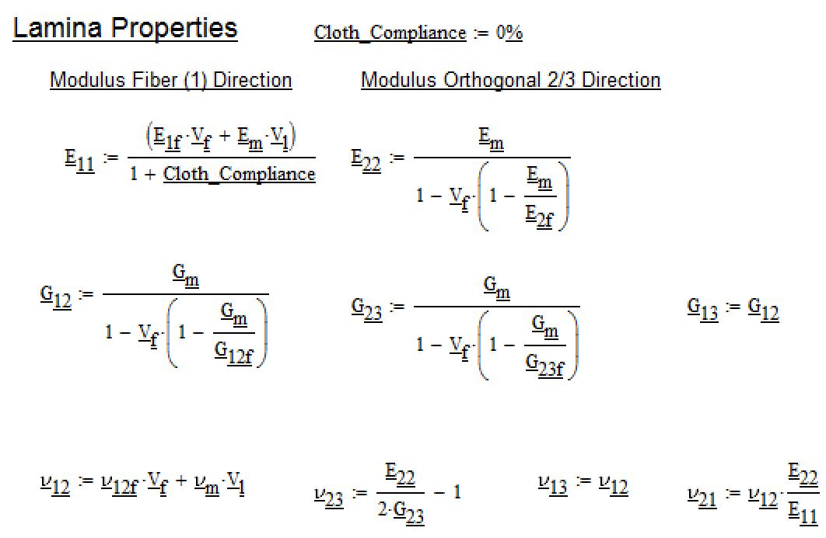

Not all micromechanics use the same equations
Chou
Kollar-Springer
Different methods to calculate E22 (transverse lamina modulus)
Differ by ~6% but effect is small—E11>>E22

Slide 10

Oriented Lamina Properties: Transform
Primary Body Direction (X)
Theta (Degrees) | Cos^4(Theta) (Value)
5 | 0.984
10 | 0.941
15 | 0.840
45 | 0.250
60 | 0.063
90 | 0.000 (matrix)
[T] =
(Properties defined by [C] in fiber coordinates)
(Coordinate Transform Matrix)
Sensitivity
[C_{body}] = [T]⁻¹[C][T]^{T}
Common Orientations
[T]^{T} (transpose) works out due to definition of [C] and mapping to ‘engineering strain’ via [R] factor 2
In G₁₂ term
Transverse Direction
Transform to ‘Body Coordinates’ (X, Y) is ~ Cos⁴(θ)
X is primary direction, Y is transverse
Body Coordinates are aligned with physical structure, convention is θ = 0 is aligned with X
Sensitivity shows accuracy required during lamination and/or design

Slide 11
Properties dependent on orientation
Cos⁴(22.5◦) ~ 73% properties
Full Properties
22.5◦
Cloth
Orientation
Local analysis coordinate systems are important for material definition in ANSYS (FEM)
45deg
Flat plates and Cylinders are simple—body and fiber coordinates retain a unique mapping throughout the structure
Transition elements: flanges or other non-planar structures are more complicated—fiber orientation thru volume needs to be accounted for
“Laminate” properties are an average over multiple layers
This can be done by hand calculation but software exists to aid in this

Slide 12
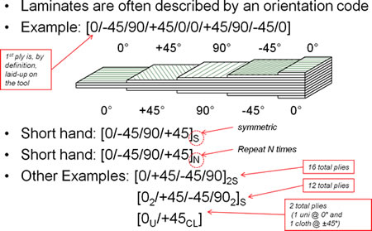
Laminate Properties: Multiple Lamina
Laminate nomenclature describes orientations of layers
Generally assumes all layers are the same material
Shorthand is not applicable for ‘hybrid’ materials e.g. materials with different fiber/thickness
Later analysis assumes common material per layer/ply—generalization to hybrid materials is straightforward…
Sum of stiffness contributions of each layer: [A] matrix divided by thickness is the Modulus of the laminate
This is good for preliminary design
http://www.quartus.com/resources/white-papers/composites-101/
The above laminate is QIBS
“Quasi-Isotropic Balanced Symmetric”
‘Quasi-Isotropic’ modulus in plane
‘Balanced’ about the mid-plane by area
‘Symmetric’ matched orientations about mid-plane
[0,60,-60]_{s} and [0,90]_{s} are also QIBS

Slide 13
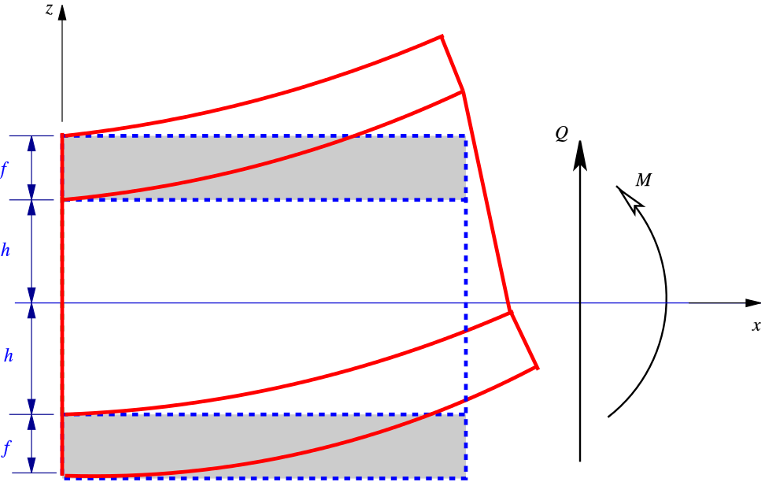
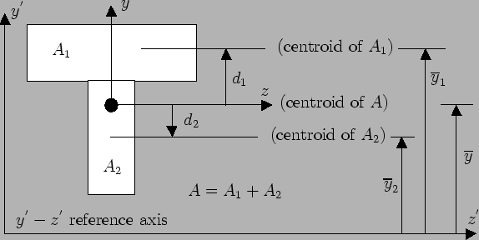
Composite Beam Theory
Tensile Properties of Facings
Dominates performance
Transfer Shear
Between Facings
Composite Beam Theory is a method for adding various sections to calculate bending stiffness (weighted by offset from ‘neutral axis’)
Sectional inertia is also weighted by the stiffness of each section e.g. an Aluminum A₁ versus a Steel A₂ in the example above
LPT is an identical formality—it simply sums smaller elements to arrive at similar section properties for tension, shear, and bending.
The matrix formalism of LPT is simply an accounting mechanism…

Slide 14
Stacking Sequence
0
90
90
0
90
0
0
90
Looks Like I-Beam when bent
Looks NOT Like I-Beam when bent on this axis
A Symmetric Laminate is symmetric wrt to ply orientation above and below the laminate mid-plane
  Example [0,+30,+30,0] sometimes written (0,+30)_{s} is symmetric but not balanced
Balanced laminate is one where for every +θ there is also a –θ lamina
  Example [0, +30, -30, -30, +30, 0] or [0, +30, -30]_{s}
For a symmetric laminate, [B] = 0 always
For Balanced laminates, A₁₆ = A₂₆ = 0 i.e. no shear extension coupling
Stacking sequence does not affect [A] matrix
  Both Laminates above have same Tensile properties—same [A] matrix

Slide 15
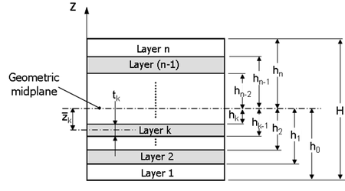
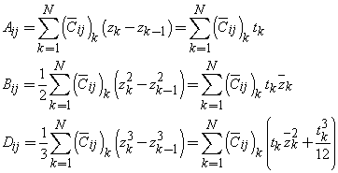
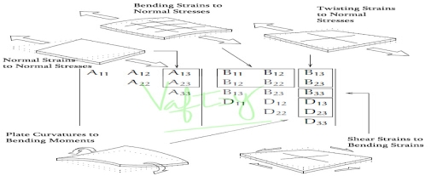
Laminate Plate Theory (nutshell)
Note: calculated from mid-plane
*NOT* neutral axis…
LPT has a matrix formalism which seems overtly complex:
  The ‘A’ matrix: Tensile Prop’s
  The ‘B’ matrix: Shear Coupling
  The ‘D’ Matrix: Plate Bending
  These are all about the mid-plane of the laminate (not section)
‘A’ matrix dominates for most ‘beam-like’ structures!
Δh_{k} (ply thickness t_{k} of each ply) is constant here—unimportant for [A], important for [B], and [D].
http://cae.vaftsycae.com/abd_matrix_composites.html

Slide 16
Balanced Symmetric laminates: no [B]
Ignore for Balanced Symmetric
t_{k} is signed:
Negative below
Geometric mid-plane
Positive above
Balanced Symmetric Identically cancels all [B] matrix elements!
[B] is un-fun to deal with without specific expertise
Balanced Symmetric laminates render [A] and [D] essentially independent
B and D are second, even third, order problems for most structures—they mostly come into consideration for ‘local’ loading of structures
[A] (tensile properties) dominate for most applications

Slide 17
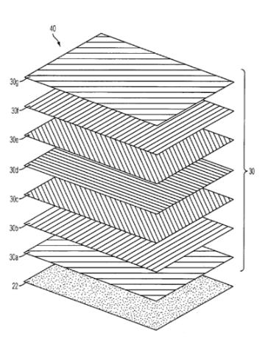
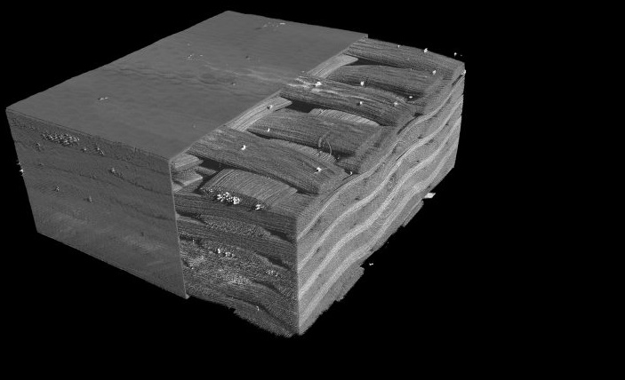

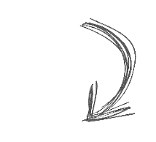
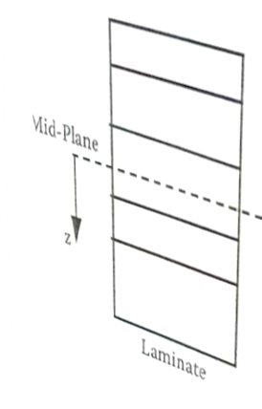


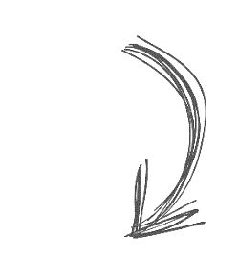


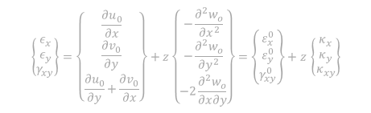
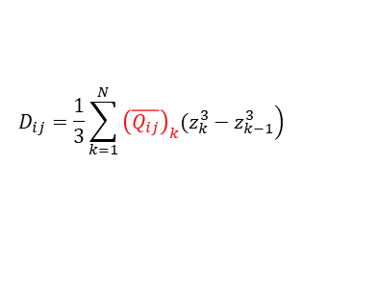













From lamina to LAMINATE
Equilibrium Equations
X
1
$$\frac{∂N_{xy}}{∂x}+\frac{∂N_{y}}{∂y}+Y=0$$
Kinematic equations
‘kink’ in Cloth
~13% more compliance
$$ε_{x}=\frac{∂u}{∂x} = \frac{∂u_{0}}{∂x}−z\frac{∂^{2}w_{o}}{∂x^{2}} ,$$
Y
$$\frac{∂N_{x}}{∂x}+\frac{∂N_{yx}}{∂y}+X=0$$
$$ε_{y}=\frac{∂v}{∂y} = \frac{∂v_{0}}{∂y}−z\frac{∂^{2}w_{o}}{∂y^{2}} ,$$
2
$$\frac{∂^{2}M_{x}}{∂x^{2}}+\frac{∂^{2}M_{xy}}{∂x∂y}+\frac{∂^{2}M_{y}}{∂y^{2}}+P=0$$
$$γ_{xy}=\frac{∂u}{∂y}+\frac{∂v}{∂x}= \frac{∂u_{0}}{∂y}+\frac{∂v_{0}}{∂x}−2\frac{∂^{2}w_{o}}{∂x∂y} .$$
Z
X
$$u=u_{0}−z\frac{∂w_{0}}{∂x}$$
$$\left\{\begin{matrix}ε_{x} \\ ε_{y} \\ γ_{xy}\end{matrix}\right\}=\left\{\begin{matrix}\frac{∂u_{0}}{∂x} \\ \frac{∂v_{0}}{∂y} \\ \frac{∂u_{0}}{∂y}+\frac{∂v_{0}}{∂x}\end{matrix}\right\}+z\left\{\begin{matrix}−\frac{∂^{2}w_{o}}{∂x^{2}} \\ −\frac{∂^{2}w_{o}}{∂y^{2}} \\ −2\frac{∂^{2}w_{o}}{∂x∂y}\end{matrix}\right\}=\left\{\begin{matrix}ε_{x}^{0} \\ ε_{y}^{0} \\ γ_{xy}^{0}\end{matrix}\right\}+z \left\{\begin{matrix}κ_{x} \\ κ_{y} \\ κ_{xy}\end{matrix}\right\}$$
$$v=v_{0}−z\frac{∂w_{0}}{∂y},$$
Y
Myx
Constitutive equations
Mxy
My
$$A_{ij}= \sum_{k=1}^{N}{\left.{\left(\overline{Q_{ij}}\right)}_{k}(z_{k}−z_{k−1}\right)}$$
$$B_{ij}=\frac{1}{2}\sum_{k=1}^{N}{\left.{\left(\overline{Q_{ij}}\right)}_{k}(z_{k}^{2}−z_{k−1}^{2}\right)}$$
Nxy
Ny
Nyx
$$D_{ij}=\frac{1}{3}\sum_{k=1}^{N}{\left.{\left(\overline{Q_{ij}}\right)}_{k}(z_{k}^{3}−z_{k−1}^{3}\right)}$$
Mx
$$z_{k−1}$$
Nx
Lamina k
$$z_{k}$$
$$\left\{\begin{matrix}N_{x} \\ N_{y} \\ N_{xy} \\ M_{x} \\ M_{y} \\ M_{xy} \\ \end{matrix}\right\}=\left[\begin{matrix}\begin{matrix}A_{11} & A_{12} & A_{16} \\ A_{21} & A_{22} & A_{26} \\ A_{61} & A_{62} & A_{66}\end{matrix} & \begin{matrix}B_{11} & B_{12} & B_{16} \\ B_{21} & B_{22} & B_{26} \\ B_{61} & B_{62} & B_{66}\end{matrix} \\ \begin{matrix}B_{11} & B_{12} & B_{16} \\ B_{21} & B_{22} & B_{26} \\ B_{61} & B_{62} & B_{66}\end{matrix} & \begin{matrix}D_{11} & D_{12} & D_{16} \\ D_{21} & D_{22} & D_{26} \\ D_{61} & D_{62} & D_{66}\end{matrix}\end{matrix}\right]\left\{\begin{matrix}{ε_{x}}^{0} \\ {ε_{y}}^{0} \\ {γ_{xy}}^{0} \\ κ_{x} \\ κ_{y} \\ κ_{xy} \\ \end{matrix}\right\}$$
[B]=0 Decoupling between in-plane and out-of plane action *
A16=A26= 0 Decoupling between traction/compression and shear actions**
D16= D26= 0 Decoupling between flexural and torsional actions***
* at each lamina + Ѳ at +z correspond a lamina of the some thickness + Ѳ at – z Ex. [-45/+35/0/0/+35/-45]= [-45/+35/0]s
** at each lamina +Ѳ corresponds a lamina of the some thickness – Ѳ Ex. [+45/-45/0/0/+35/-35]
*** at each lamina +Ѳ corresponds a lamina of the some thickness – Ѳ at – z Ex. [+45/-35/0/0/+35/-45]
Slide from C Gargiulo
https://indico.cern.ch/event/736952/

Slide 18
[A] Matrix properties (Tensile Properties)
Quasi-Isotropic Balanced Symmetric QIBS
Theta (Degrees) | Cos^4(Theta) (Value)
0 | 1
60 | 0.063
-60 | 0.063
-60 | 0.063
60 | 0.063
0 | 1
Average: | 0.375
Theta (Degrees) | Cos^4(Theta) (Value)
0 | 1
45 | 0.250
90 | 0
-45 | 0.250
-45 | 0.250
90 | 0
45 | 0.250
0 | 1
Average: | 0.375
Average assumes all layers are equal thickness thus stiffness in the laminate coordinates
Both examples are QIBS: *ALL* examples of QIBS will have the same body modulus
Tables indicate orientation knockdown—still need to include Fiber Volume Fraction (V_{f}) knockdown
6-ply QIBS Laminate
8-ply QIBS Laminate
Tables above show fractional contributions of each layer in “X” direction (body coordinate) based on orientation “θ” of fibers to body
Each layer should also be knocked down by Vf ~50-60%
Including V_{f}, E_{x} and E_{Y} for a QIBS laminate range from 18-22% of E_{fiber}
QIBS laminates can be estimated as ‘black’ metal with some caveats

Slide 19
‘Black Aluminum’ and other estimates
‘High Strength’ CF ranges from 220-300GPa
‘Intermediate Modulus’ CF from 280-500GPa
Pitch based fibers start at 500 and goes to ~1000GPa
Considering the QIBS estimate of ~20% fiber modulus there exists both an Al and Ti equivalent quite trivially
‘Black Aluminum’ is a pejorative term aimed at a design that took no other advantage other than density by using a CFRP component (since the early ‘80’s)
On the other hand, using an Aluminum or Titanium analog (with lower density) in analysis is a quick way to assess if a composite structure is beneficial in an FEM
As with any mechanical assembly, it’s usually the joints and local loads that screw with the design…

Slide 20
Global versus Local Deflections
Distributed point Loads
Loads in Shell: [D]
D
Loads in Shell: [A]
L
End Load equivalent
Moment Load
applied to shell
Deflections may be dominated by local flexure for thin walled structures
L / D > 8 is required for ‘beam like’ behavior; else: ‘shear’ properties dominate global deflection relative to supports
For most structures, [A] properties dominate performance
Introducing loads into thin shells requires some expertise (use of D-Matrix)

Slide 21
A Brief word on ‘Strength’
We tend to use composites in deflection driven designs, thus tend to use ultra-high modulus fibers
These fibers have low failure strains e.g. 0.3%
‘High Strength’ fibers have failure strains in excess of 1%, Pitch Fibers range from 0.25-0.5%
Matrices range from 1-5% failure strains
Strength models do exist to combine these in laminates, but require testing to use (Tsia-Hill or Tsai-Wu)—strain energy based like Von Mises…
For stiffness-based designs, laminate strength is rarely an issue, but should be checked
Strength of composite materials will be presented in next session

Slide 22
Consider using Fiber Strain as a metric to assess margins of safety
This technique is often referred to as ‘First Ply Failure’ and is rather conservate…
ACP Will report these values specifically
If you are using ANSYS without a composites package, do not use Von-Mises stresses…
Reporting principal strain of an isotropic solid is a quick estimate, but not proper.
Ultimately a more proper, full orthotropic analysis in ANSYS is required, preferably ACP (See Giorgio’s talk later)

Slide 23
Expert advice: when it’s needed
Use of ‘Black’ isotropic analogs are useful for design studies
  Approximations are truly valid for tensile (in-plane) loads
  Conceptual design studies, nominal sizing, first order mass…
  Feature or load rich locales are where approximations break
Normal loads/local moments need expertise to asses
  Localized load transfer into shell is important to understand
Joint compliance is significant for bolted/mechanical joints
  More than expected compared to metallic grips, however metallic joints are not frequently modelled properly…
Composites cannot always replace metallic solutions
An intermediate goal is to disseminate what’s easy to do, but also what’s hard…
Notes:
Mention here that ‘high curvature’, thick laminates, plate-bending, etc…

Slide 24
Composites Engineering at LBNL
As with many disciplines at the lab; expert resources are matrixed, but available
Similarly, Composite Design is not broadly taught in an engineering curriculum (more in the past decade)
Cryogenics and Vacuum technology are similar examples:
  Engineering and Technical staff new to the lab become proficient quickly thru exposure
  Training is available both off and on-site
  Some problems still require an expert to solve—knowing who to talk to is important onsite and within the industry
Eng Div is looking to put together some seminars at various technical levels to teach Composite Design/Fab

Slide 25
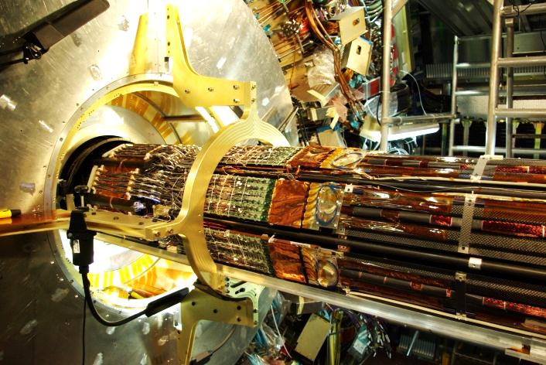
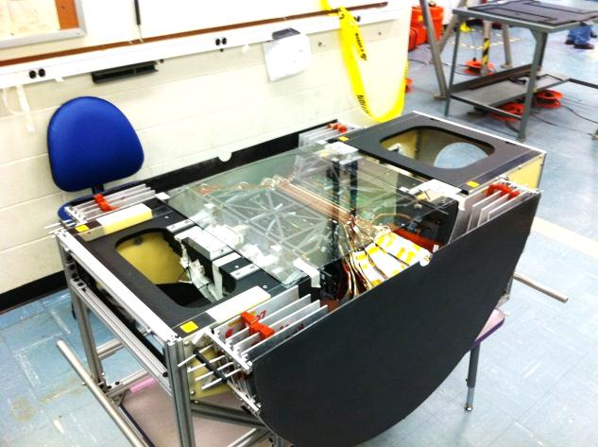
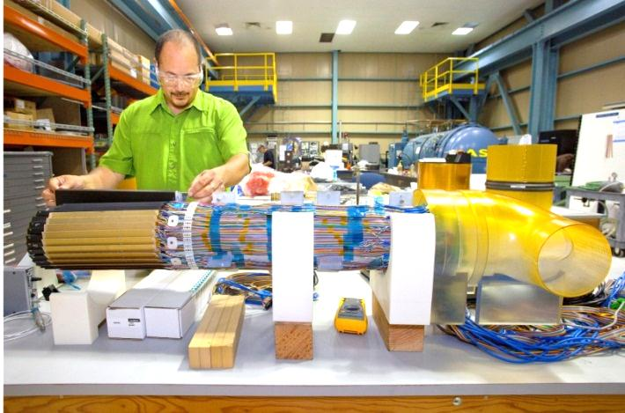
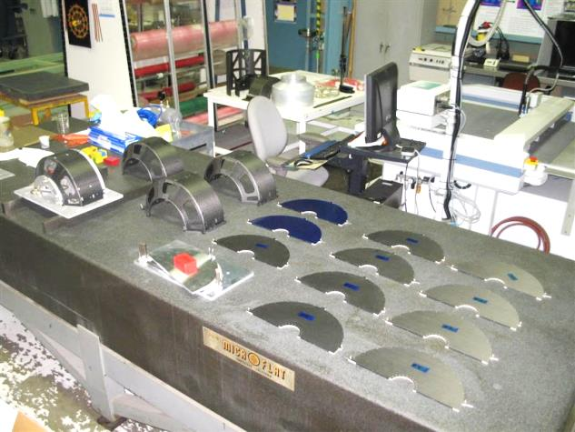
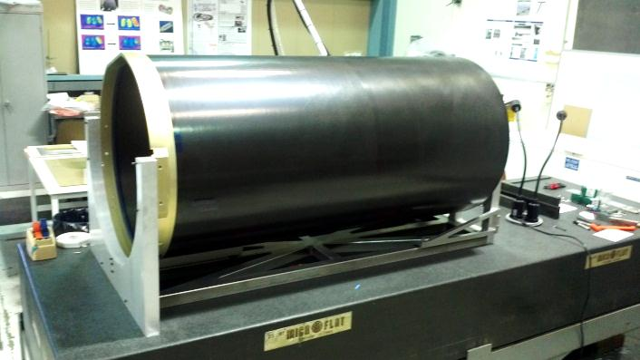
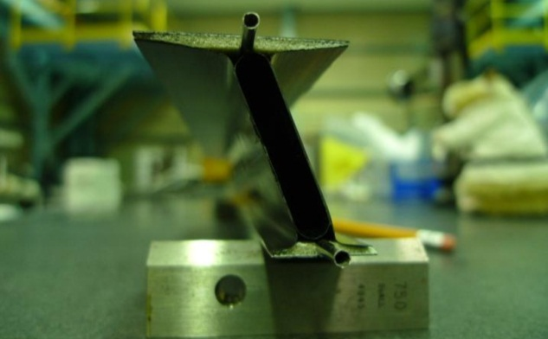
LBNL Composites Shop
ATLAS Pixel
PHENIX VTX
Capability established to support construction of ATLAS Pixel Detector
Have since delivered many detectors…
Synergy of project requirements and contiguous R&D allows for bootstrap technology development
Techniques developed for ATLAS used on STAR
Materials developed on STAR (30gsm FAW) now used on ATLAS
STAR PXL
PHENIX FVTX
STAR IDS
ATLAS Upgrade

Slide 26
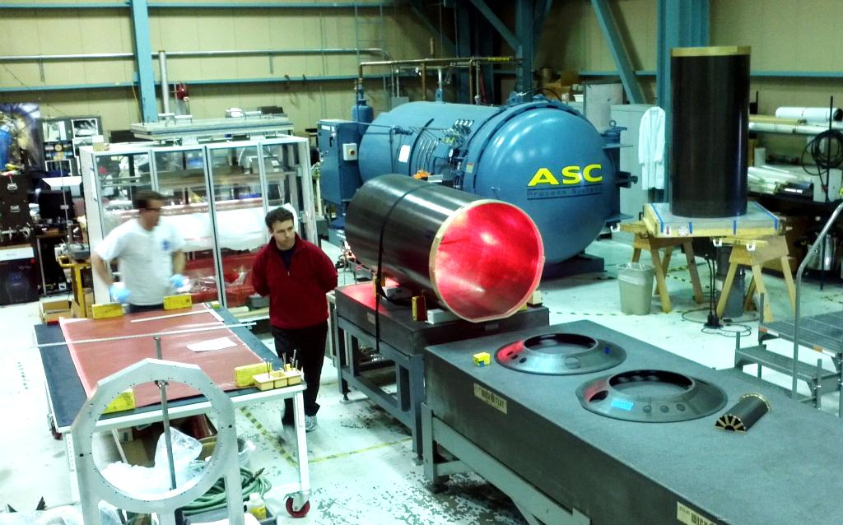
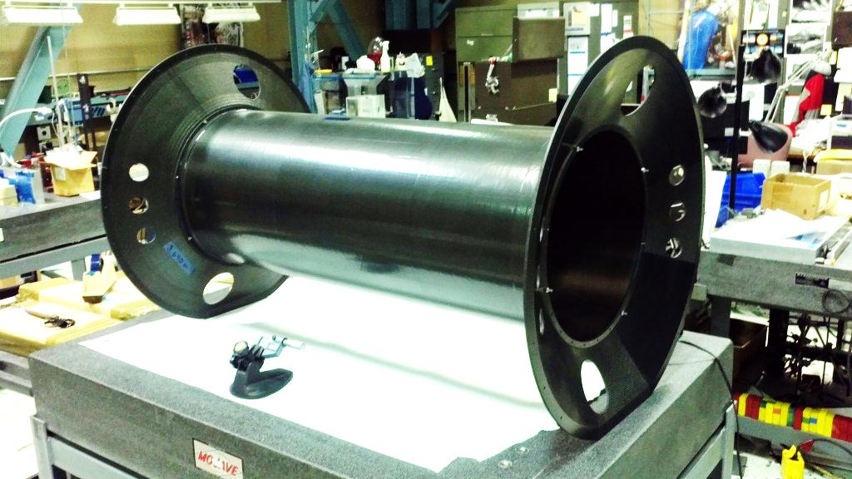
Shop capabilities (large structures)
Design and Fabrication
Low-mass, Stable Structures
Precision Assembly of large structures (4-8m)
Developed for Global Support Structures of High Energy Physics Detectors
Useful for any structure requiring high precision/stability

Slide 27
Composites are materials developed via a fabrication process
It is impossible to separate material properties from fabrication process in composites
Ability to close loop on design, fabrication, and test is an important capability to develop and maintain
It is important to understand aspects of fabrication at all stages, from pre-preg to layup to be able to properly specify design variables
Over-use of ‘nominal’ values in design is common in our field and is what is taught in typical courses

Slide 28
Part manufacture is material design
Each of the stages of manufacture have some inter-relation and affect the overall product as deviations from ideal
Understanding these deviations allows you to modify the design, tool, and processes to best achieve intent and goals
Part and Process Design together are best viewed holistically
Of course, design of the laminate can have some peculiar ramifications to the manufacturing process…
Ability to fabricate and test composite structures in-house is important to support the design process
Aim is to tie design and manufacture together both to show what’s easy to do/control and what’s difficult
Much of composite fab/design is simple, but tedious…

Slide 29
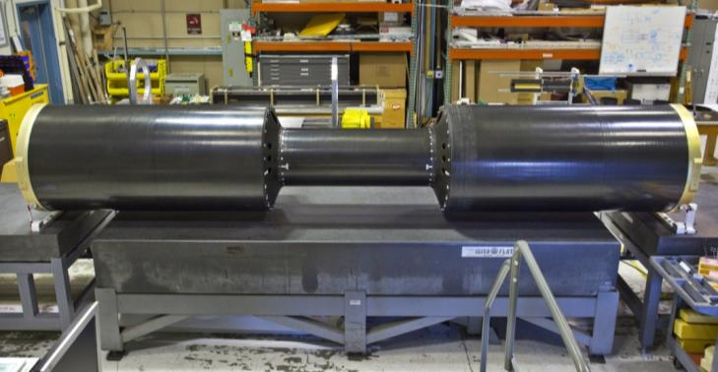
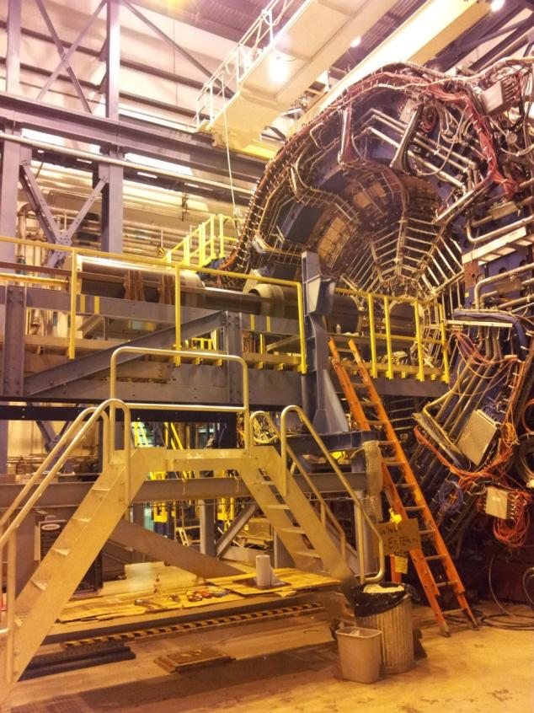
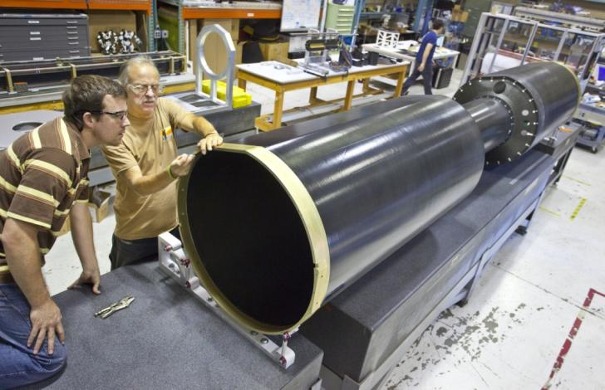
STAR HFT Inner Detector Support (IDS)
4.6 m
0.8 m
Structure Mass = 35kg
Applied Load = 200kg

Slide 30
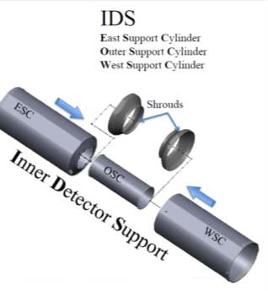
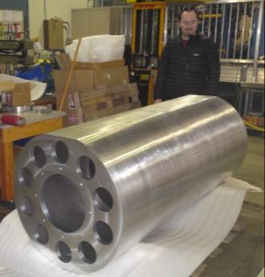
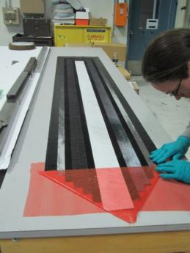
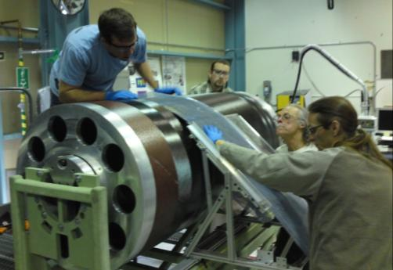
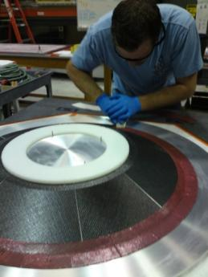
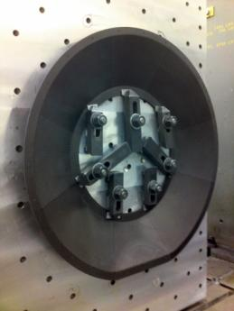
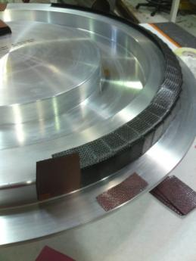
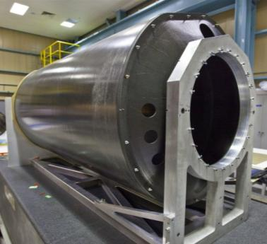
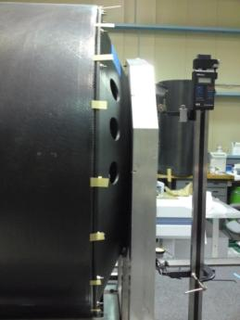
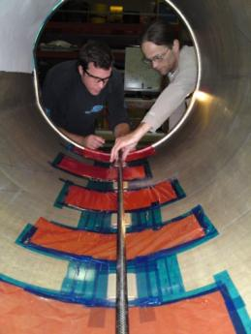
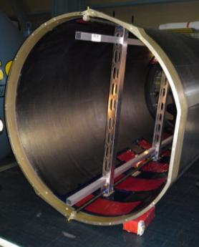
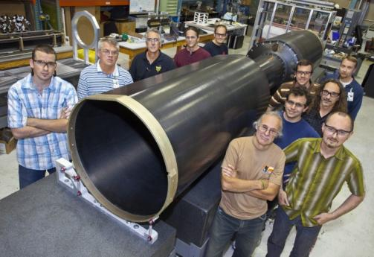
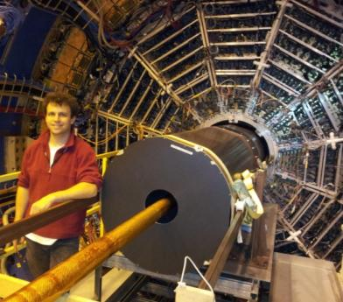
WSC/ESC Mandrel
WSC/ESC Layup
Cone Layup
Cone Machining
Flange Layup
Flange Bonding
Insertion Rail Bonding
Assembled Structure at LBNL
Just before insertion at BNL

Slide 31
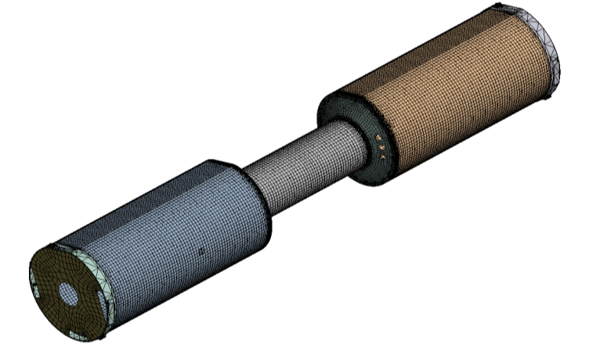

Initial FEA model
Careful accounting of masses
Modulus properties based on multiple tensile tests for the composite materials
Layered anisotropic composite properties fully specified, ply-by-ply
Quasi-kinematic BCs at designed locations
Face-face contacts at joints
Apparently good nominal performance:
607 μm max vert defl @ full load)

Slide 32

And yet…
Pre-test predictions
Measured deflections
5.23 mm @ 250kg central load
1.88 mm @ 250kg central load
Predicted deflection only 36% of actual measured value in the “model verification” test
(Note: the 250kg central load applied during test is equivalent to > 2x the distributed 194kg installed load.)

Slide 33

Load Test Setup
(Model Verification)
CENTRAL LOADING
THRU SADDLE
Kinematic turnbuckle supports
(same as used in final install)
Test does not use actual, distributed, installed loads.
Test has a significantly higher load, centrally located.

Slide 34

Many “DOF” measured during test
Dial test indicators were placed at 18 locations about the structure during test – avoiding prejudice as to which would be redundant, which important
Thus capturing a rich description of how the real object deforms
This data was invaluable in diagnosing the model, particularly because
  the angled flat feature of the ESC and WSC causes sideways coupling with the vertical deformation
  the mounting points are quasi-kinematic, due to constraints on assembly procedure
  multiple bolted joints, where bolt preload is necessarily non-optimal, due to material constraints
angled flat

Slide 35

Integration of the independent compliance sources
BC
Joints
Laminate

Slide 36
Testing informs future design(s)
Difference in BC from Test vs Analysis
Important to model supports of test fixtures
Joint Compliance—specifically Bolted Joints impacts global performance
Include bolts and preloads in structures if normally loaded
Laminate definition
CPT and Cloth compliance are now tested for all new materials

Slide 37
Conclusion
The material is intended to give an idea of whether composites are useful for a design
Also, with the limitation of when to seek experts
Hand Calculations will get you rather close and give input to FEM, but ultimately detailed FEA is required to ‘get to the next level’
Measurements of Structures including Joints is often required
Resources are available at LBNL, CERN

Slide 38
Backup

Slide 39



Composites Shop Process Equipment
Existing
Autoclave
Winder
7
Study to install Furnace and Autoclave
B77A Annex (Room 104)
1800sf addition to Composites Shop—space for Furnace and New Autoclave
No Crane
6

Slide 40


Autoclaves in the Composites Shop
5X10 450F 150psi
1.5X3 230C 10b
Typically used for Epoxies and Cyanate-Esters
3X16 850F 500psi
0.9X4.9 450C 34b
Same control system, more feedthrus
Can melt PEEK/ process PI
Next to Furnace

Slide 41

Auxiliary Equipment
ZUND automatic ply cutter 80cm wide, continuous feed
Thinky Centrifugal Mixer, ARE310 (qty 2)
https://www.thinkymixer.com/en-us/product/are-310/

