Slide 1
Overview of the upcoming HFVMTF Quench Protection System
Cristian Arcola
March 30, 2022

Slide 2
HFVMTF - Outline
HFVMTF Facility
Modes of Operation
  FES (Fusion Energy Science]
  HEP (High Energy Physics)
QPM Architecture
  Quench Detection & Management
  Quench Logic & Protection
  Trip Matrix
  PS Control & Monitoring
HFVMTF

Slide 3
HFVMTF Facility
HFVMTF is a test facility built with the funding from two DOE offices, the Office of High Energy Physics (HEP) and the Office of Fusion Energy Science (FES).
As today, it is assumed that the two offices will share the facility approximately equally.
The facility should support mainly two modes of operation with some common characteristics but differ by the goals of the testing.
The two modes are: HEP/MDP mode (coming from the Magnet Development Program) and FES modes.
HFVMTF

Slide 4
HFVMTF Modes of operation – FES (Main Sub-System)
FES mode:
- Magnet Power: Wide aperture Nb3Sn dipole (~ 110 mm in direction of the magnetic field) made by LBNL. This dipole is not a test object, it will be part of the facility. Its operational current will be on the level of 15 kA, the stored energy may approach 20 MJ.
The magnet will be powered with the 24 kA PS. The cost of the magnet is ~$10M and we have to protect it as best as we can. After being trained it will reach the operational field of 15 T.
Magnet Protection:
The assumption is that it will have the standard number of voltage taps, like other VMTF test objects.
The magnet can be protected by one protection system: either an energy extraction via a dump resistor or CLIQ (no heaters). But for redundancy, we will be asked to be able to control both systems simultaneously.
HFVMTF

Slide 5
HFVMTF Modes of operation – FES (Insert Sub-System)
FES mode:
- Test Sample Power: In aperture of the magnet, we will place a test sample well. In this well, investigators will place a loop of SC cable for testing in high magnetic field (up to 15T). This sample could be low temperature SC or high temperature SC. The idea is these samples to be powered with the 18kA PS, via SC transformer, placed in the well, to up to 100kA.
- Test Sample Protection: These samples will need some voltage taps (~32) but not for protection, but mostly for study the voltages in the samples. Full scheme of protection of these samples is not developed yet, but burning a sample during a test, is way less critical since they are a lot less expensive.
HFVMTF

Slide 6
HFVMTF Modes of operation – HEP/MDP
HEP mode (Hybrid): A single magnet built with both LTS and HTS coils powered by two independent power systems.
- Outer Coil LTS Power: Powered with a 24 kA PS.
- Outer Coil LTS Protection: Protected in the standard way like we do now for VMTF (Energy extraction via dump resistor, CLIQ, heaters)
- Inner Coil HTS Power: Powered with an 18 kA PS.
- Inner Coil HTS Protection: Protection not well defined yet. Assuming the same number of protection devices as the Outer Coil LTS for now.
A quench in a system must switch off current on the other non-quenching coils to avoid induction of large voltage.
HFVMTF

Slide 7
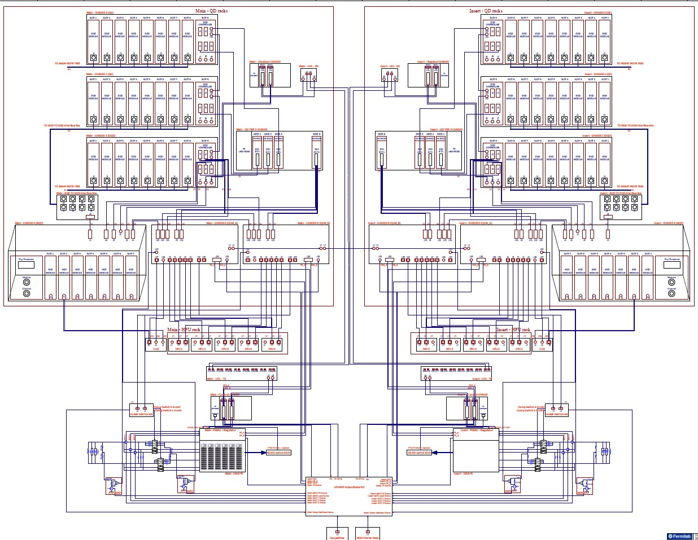
HFVMTF QPM Architecture
Quench Detection & Management
Quench Logic &Protection
PS Cntrl and Monitoring
HFVMTF

Slide 8
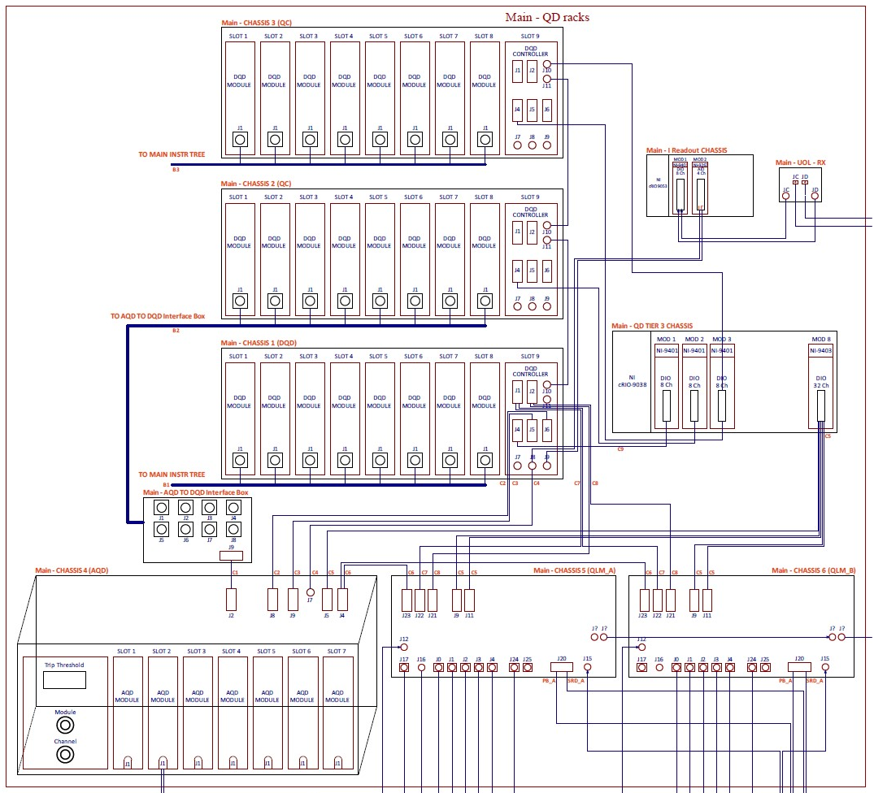
HFVMTF QPM Details – Quench Detectors & Management
The HFVMTF QPM system is based on a QD system developed for the Mu2e experiment.
Primary Custom Digital Quench Detection System (DQD)
Redundant Custom Analog Quench Detection System (AQD)
Quench management system, based on National Instruments C-RIO (Tier III ). Provides quench configuration, control and monitoring, and quench data management.
HFVMTF

Slide 9
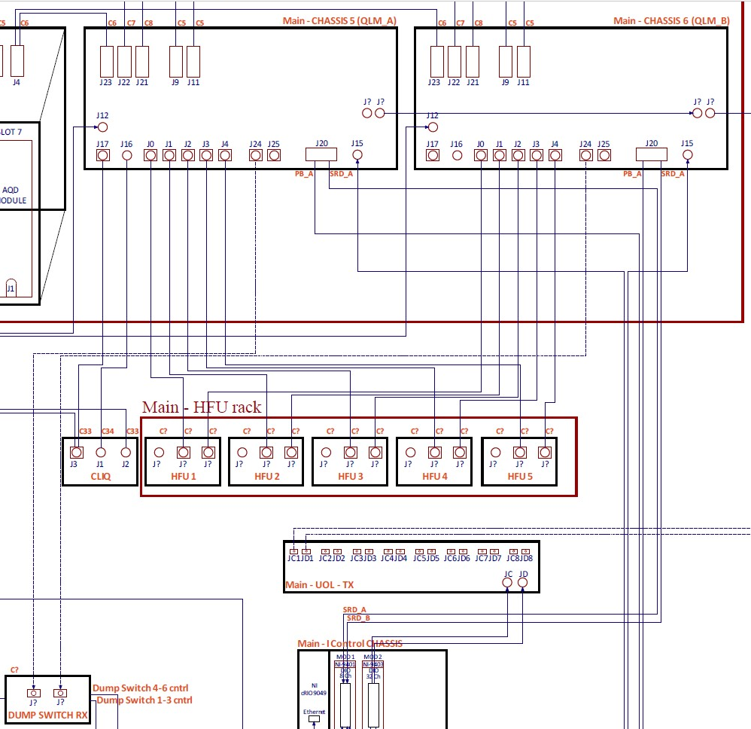
HFVMTF QPM Details – Quench Logic & Protection
A set of two custom Quench Logic Modules (QLMs) carry out the critical hardware-based quench logic, such as:
- Heater control logic
- CLIQ control logic
- Energy extraction system enable and discharge control
- Power system Enable, Phase Back, and Slow Ramp Down.
HFVMTF

Slide 10
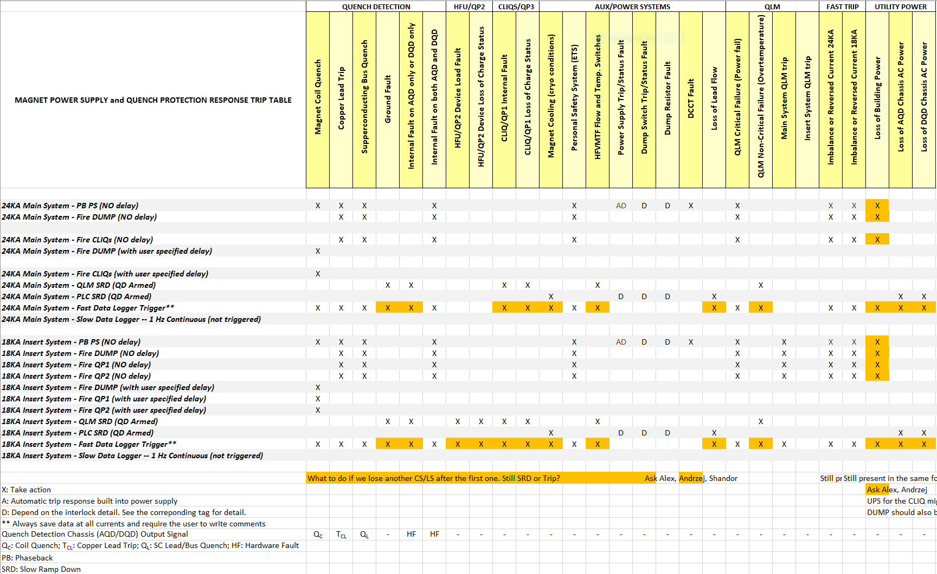
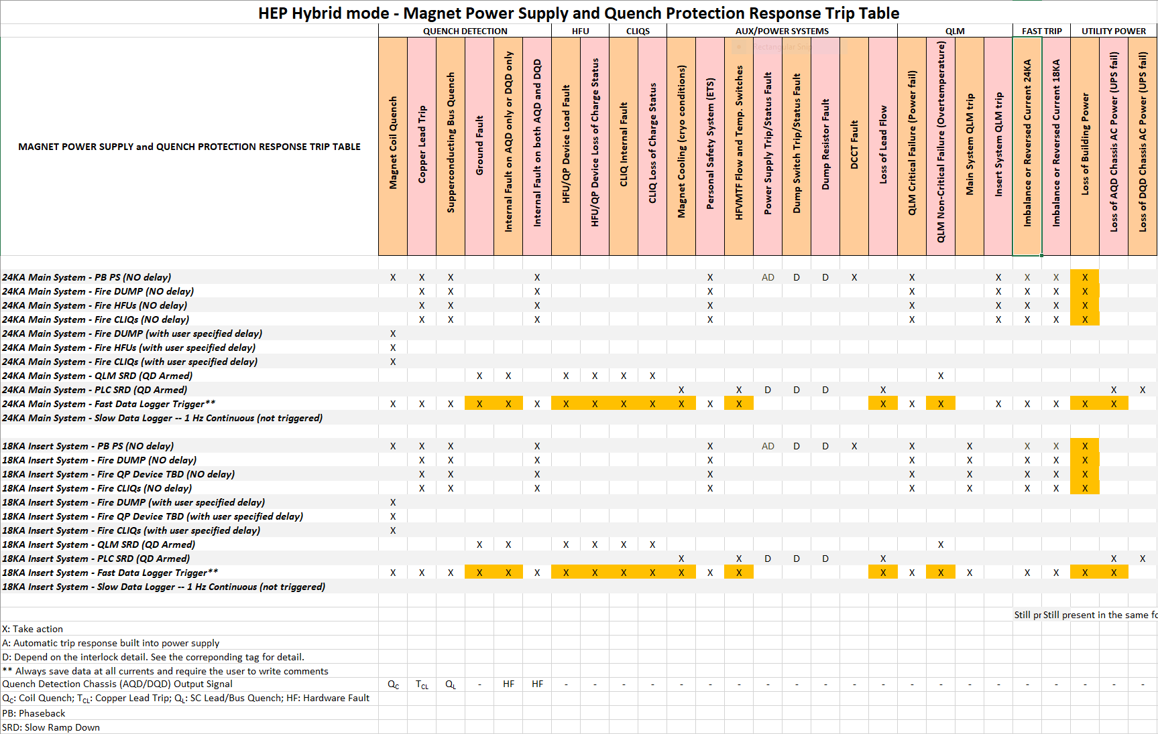
HFVMTF Trip Matrix – FES/HEP
HFVMTF

Slide 11
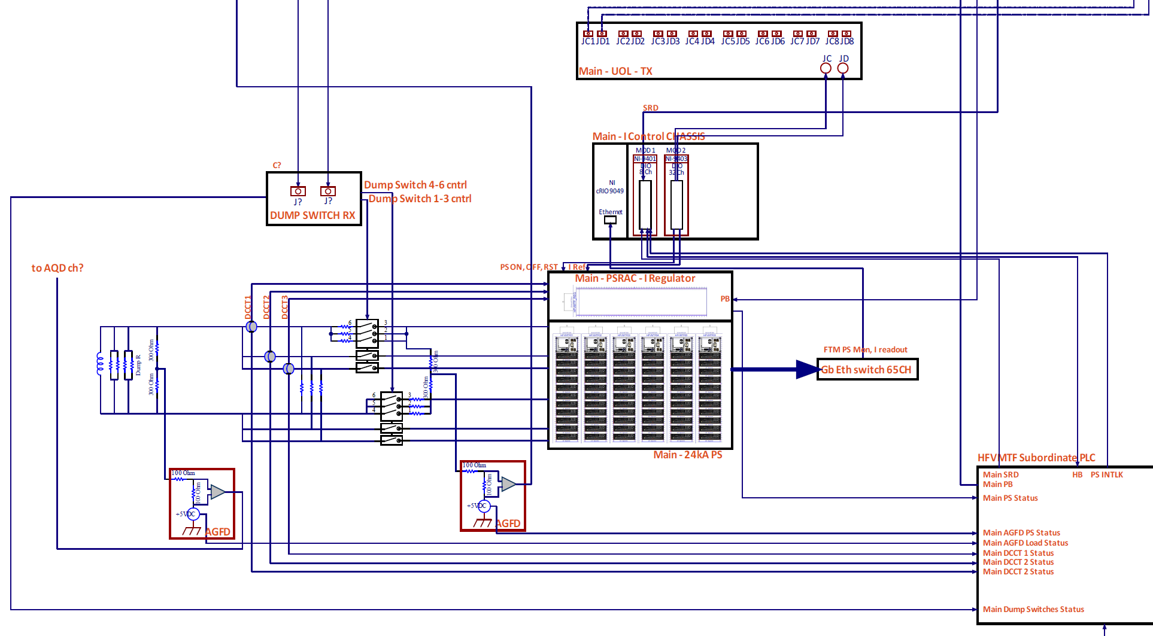
HFVMTF QPM Details – PS Control and Monitoring
Subordinate PLC to monitor temp, water pressure, DCCTs and Dump Switches status
2x Active Ground Fault Detectors
PS consists of Switching Power Supply modules and I-regulator
NI c-RIO based I-control produces open loop Current set-point (Custom profile or periodic waves)
PS Ethernet monitoring for Fast Trip Module and Imbalanced Current protection
Current readout and optical fiber-based distribution for the Current dependent threshold on QDs
HFVMTF

