Slide 1
20 T Common Coil Hybrid Magnet
FE Analysis – Ver. 6
J. Cozzolino 4/18/22

Slide 2
20 T Common Coil Magnet FE Analysis
Goals
  To develop the conceptual design. To study coil stresses and deflections at 20 T and determine the amount and location of reinforcement bridging with stainless steel spacers.
Features
  Each conductor is modeled separately. This way HTS and/or LTS can be replaced with SST to simulate bridging in the static structural model. The corresponding forces from Maxwell are turned off.
  Spacers are only 2 conductors wide and slide relative to the collar.
    This needs further investigation as a single spacer may be more effective if it bridges two, three, or even four coils.
  HTS/LTS current densities = 373/488 A/mm² . Material properties for all conductors are that of NB₃Sn. Isotropic E = 20 GPa. Cool-down effects not yet studied.
  The SST collar is solid, and all contacts are line-to-line with no preloading.
    Conductor-to-conductor contacts are bonded. All other contacts are frictional (µ = 0.2).
  All boundary conditions are frictionless. The yoke is modeled as full-circle.
    Actual collar design and assembly considerations are to be dealt with at a later date.

Slide 3
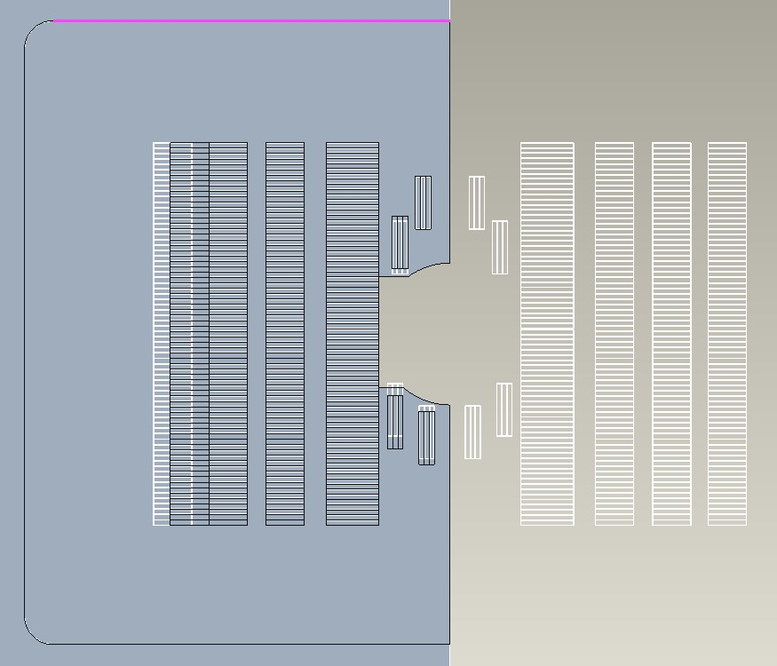
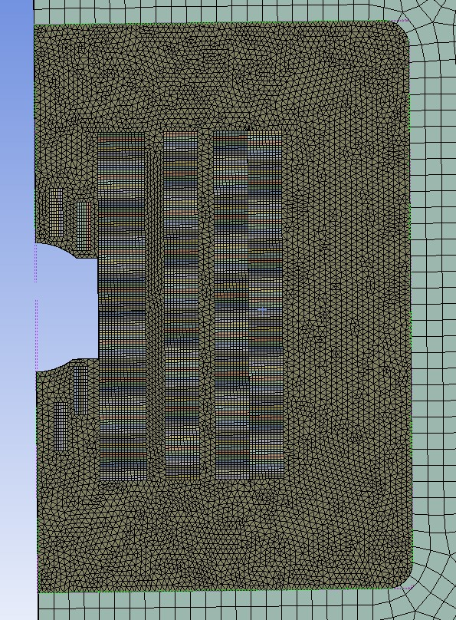
3D Creo Model from DXF File
Structural Mesh
First revision for 50 mm aperture
Original DXF file

Slide 4
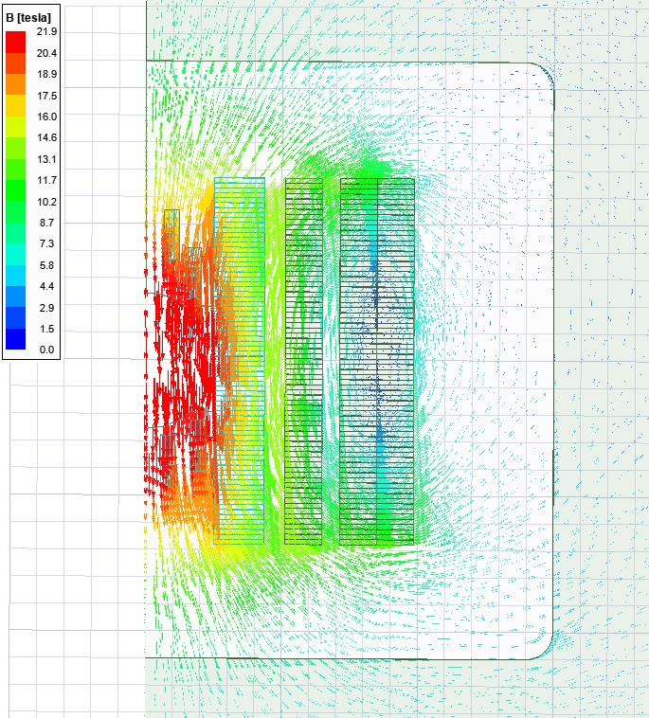
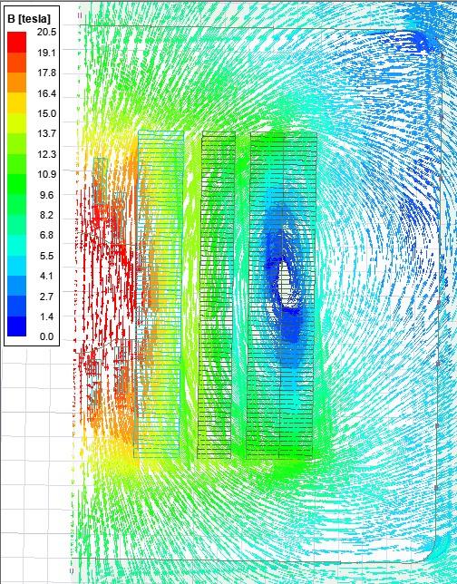
Flux Density Vectors (views 1 & 2)
21.9 T Peak Field
Flux Density Vectors (view 3)
20.5 T Peak Field

Slide 5
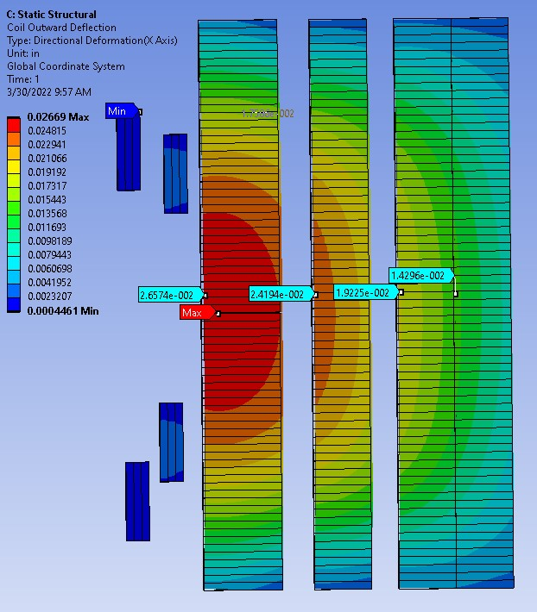
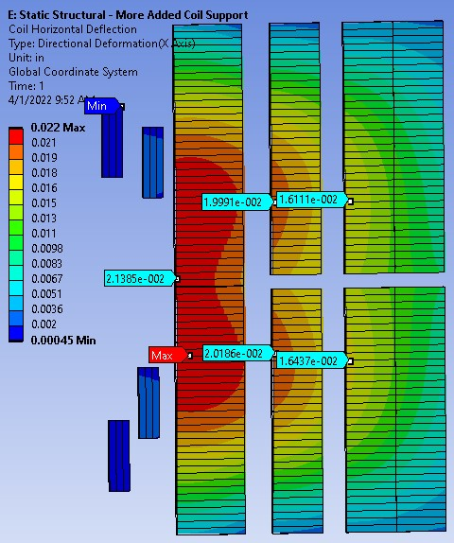
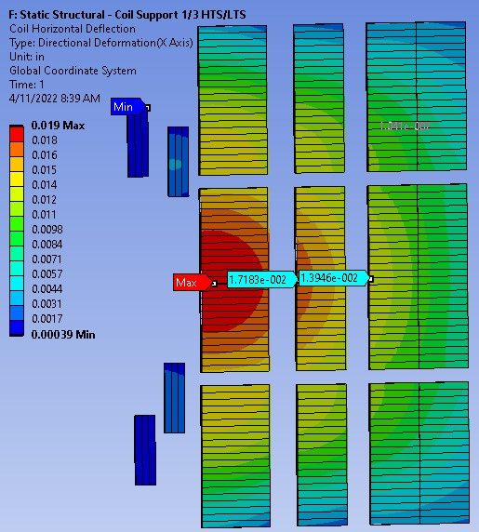
Horizontal Deflection
Horizontal Deflection with
Offset Support (incl. HTS)
Horizontal Deflection with Mid Support
Horizontal Deflection reduced from .027 to .019 inch (.7 to .5 mm). Lowering the current also contributed to this reduction.

Slide 6
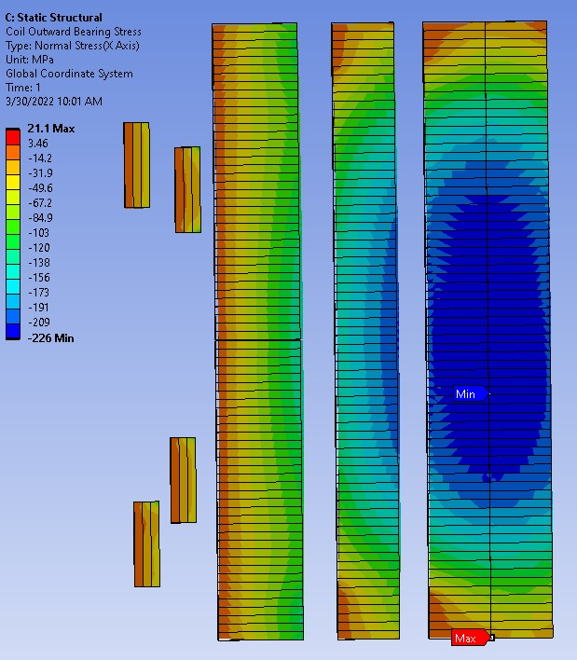
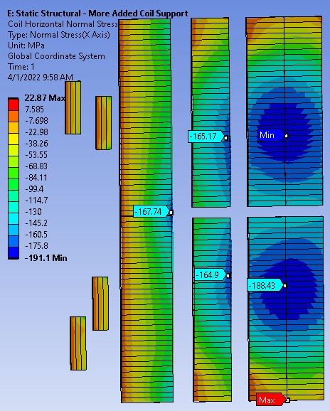
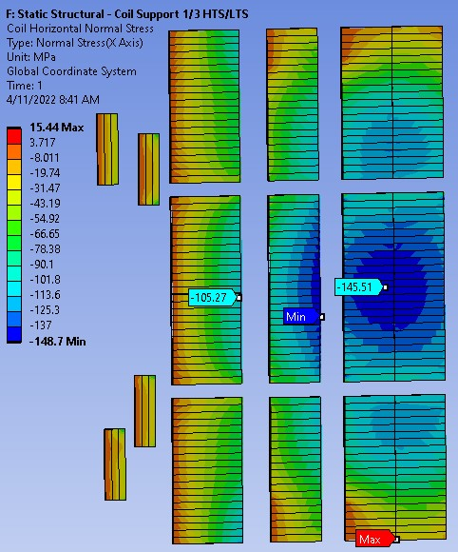
Horizontal Normal Stress with
Offset Support (incl. HTS)
Horizontal Normal Stress
Horizontal Normal Stress with Mid Support
Peak horizontal normal stress reduced from -226 to -149 MPa. Note: Safe stress limits for HTS/LTS are -120/-180 MPa.

Slide 7
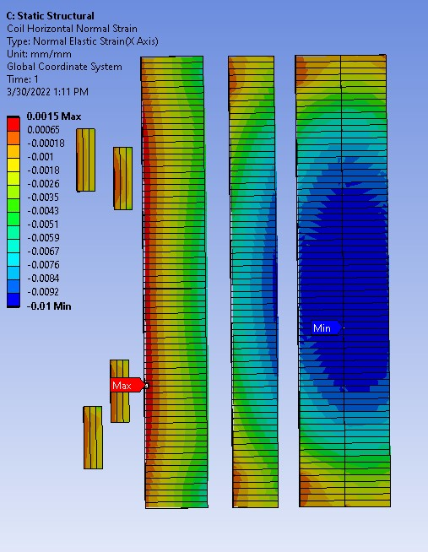
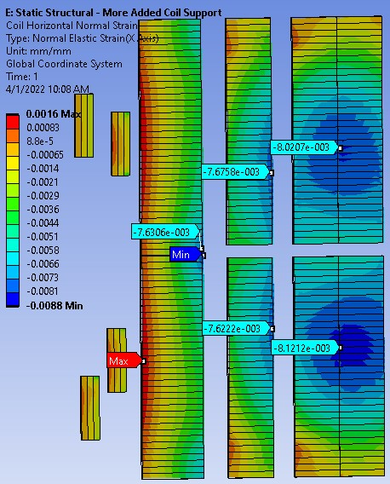
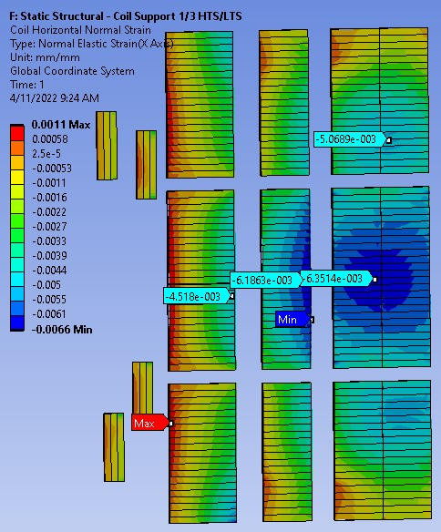
Horizontal Normal Strain with
Offset Support (incl. HTS)
Horizontal Normal Strain
Horizontal Normal Strain with Mid Support
Horizontal normal strain reduced from -1.0% to -0.66%

Slide 8
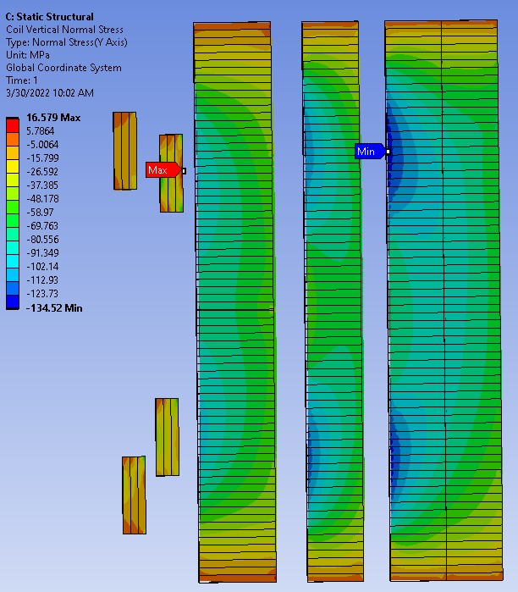
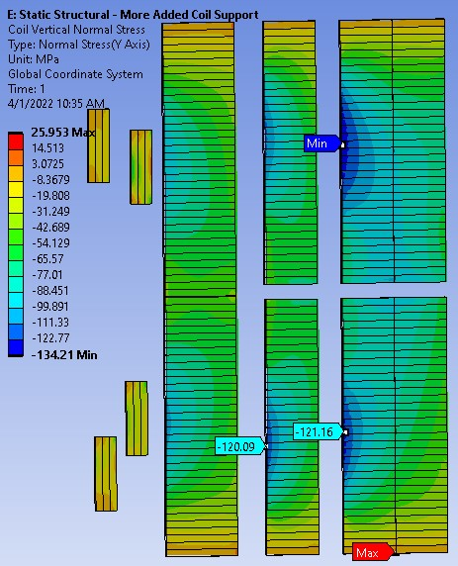
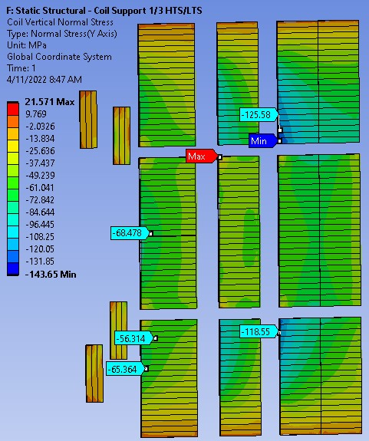
Vertical Normal Stress
Vertical Normal Stress with Mid Support
Vertical Normal Stress with
Offset Support (incl. HTS)

Slide 9
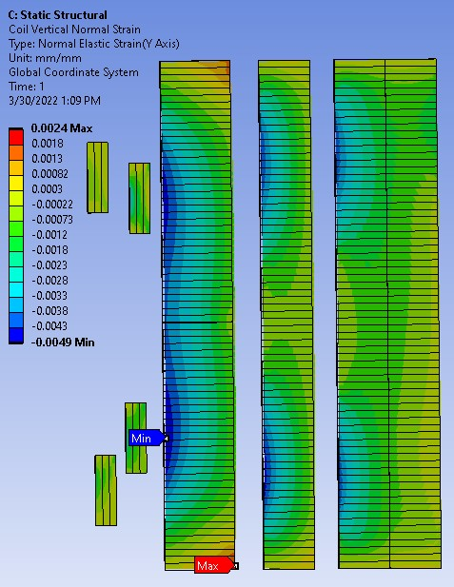
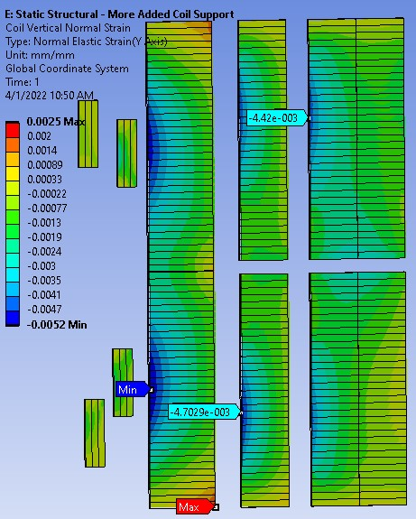
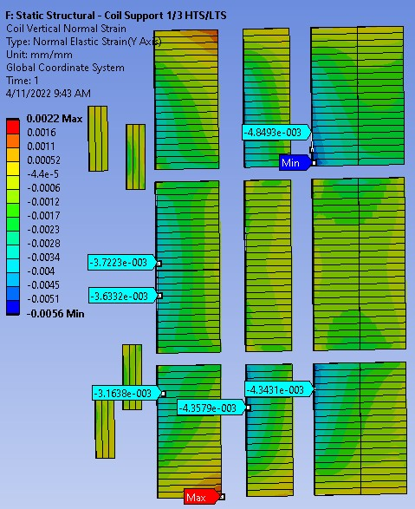
Vertical Normal Strain with
Offset Support (incl. HTS)
Vertical Normal Strain
Vertical Normal Strain with Mid Support

Slide 10
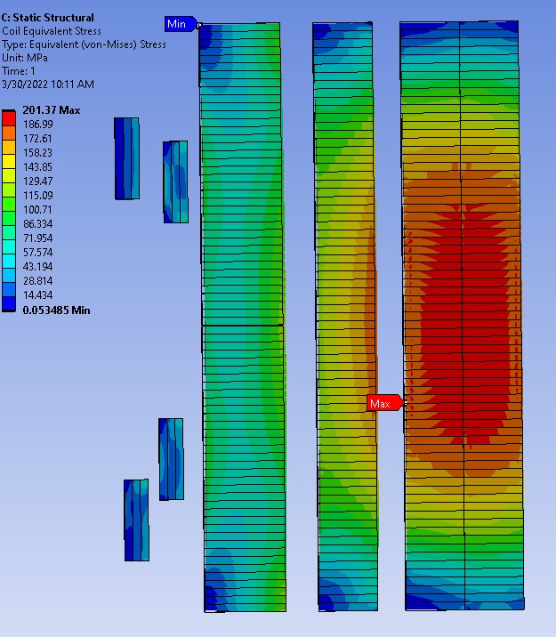
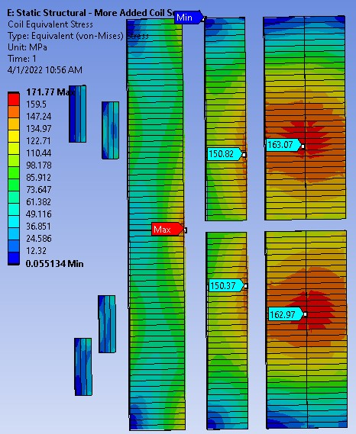
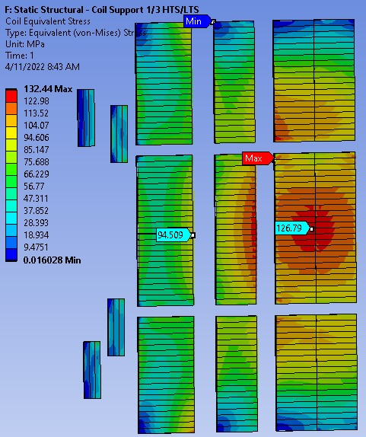
Coil Equivalent Stress
Coil Equivalent Stress with Mid Support
Coil Equivalent Stress with
Offset Support (incl. HTS)

Slide 11
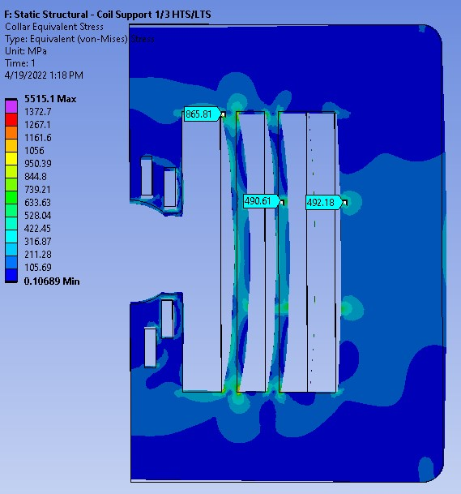
Collar Equivalent Stress

Slide 12
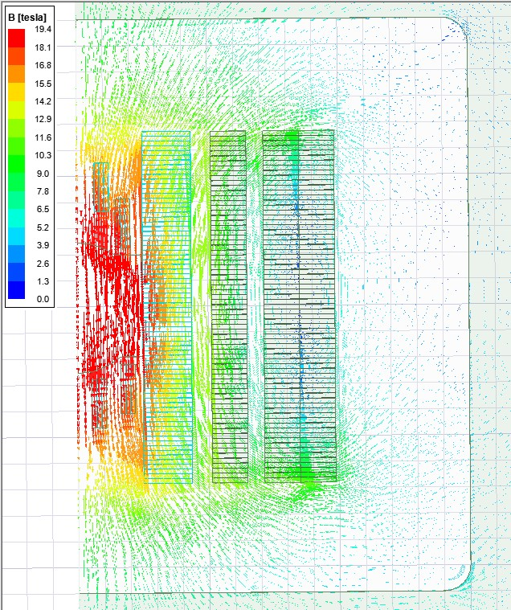
Flux Density Vectors
Sixteen turns were replaced by spacers in Maxwell directly to see the effect on magnetic flux density (it dropped from 20.5 to 19.4 T peak field). However, this case was not mapped to the static structural model.

Slide 13
20 T Common Coil Magnet FE Analysis
Conclusions
  This conceptual design is becoming better understood.
    Coil lateral bridging has been used successfully in common coil magnet DCC-017. It would be far more critical in this application and will be developed accordingly.
    It is clear that conductor movement under very high forces will be a major challenge to contain. This analysis helps affirm that we are on the right track. The containment design itself is beyond the scope of this first set of analyses and will begin in the future.

