Slide 1


Discovery of jet suppression by PHENIX*
schematic view of jet production
vacuum
hadrons
leading
particle
QGP
q
q
hadrons
leading particle
* Talk in honor of Xin-Nian Wang
Barbara Jacak, UCB & LBNL
August 18, 2022

Slide 2
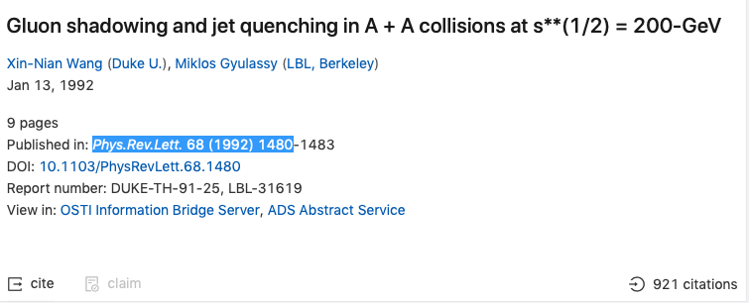

Jet suppression was predicted by
Xin-Nian and Miklos

Slide 4
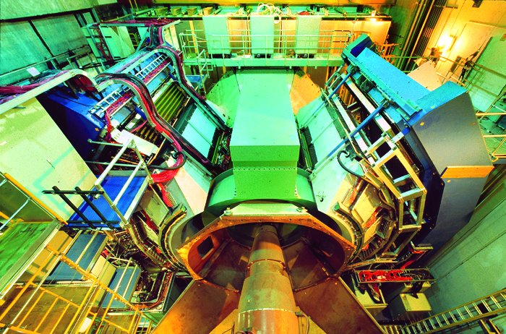
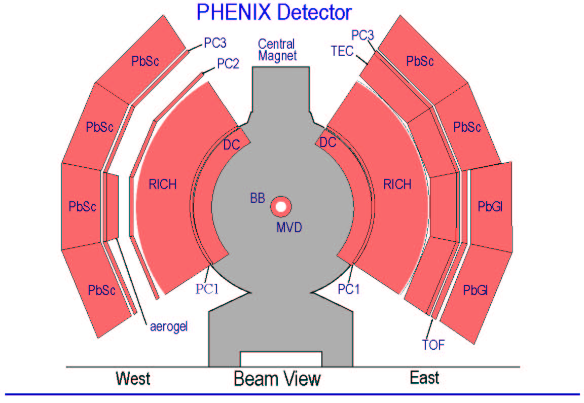
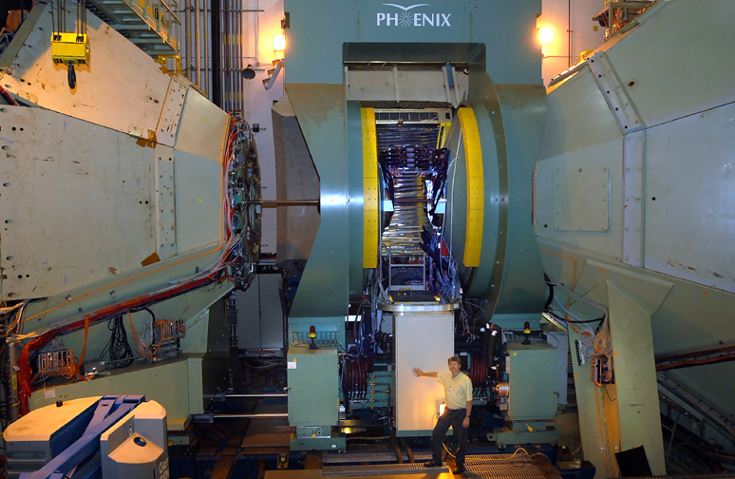
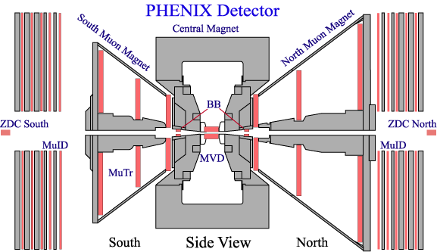
The PHENIX Detector
  Detector Redundancy
  Fine Granularity, Mass Resolution
  High Data Rate
  Good Particle ID
  Limited Acceptance
γ, e, μ, identified h
Charged Particle Tracking:
  Drift Chamber
  Pad Chamber
  Time Expansion Chamber/TRD
  Cathode Strip Chambers(Mu Tracking)
Particle ID:
  Time of Flight
  Ring Imaging Cerenkov Counter
  TEC/TRD
  Muon ID (PDT’s)
  Aerogel Cerenkov Counter
Calorimetry:
  Pb Scintillator
  Pb Glass
Event Characterization:
  Multiplicity Vertex Detector (Si Strip,Pad)
  Beam-Beam Counter
  Zero Degree Calorimeter/Shower Max Detector
  Forward Calorimeter
SMD/
FCAL
FCAL
Slide from Bill Zajc

Slide 5
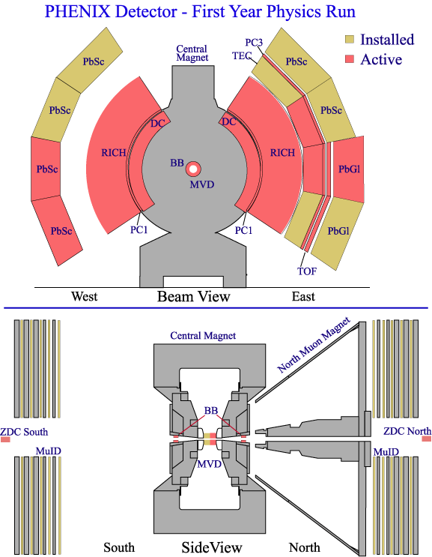
PHENIX Run-1 Configuration (2000)
Two central arms
  Mechanically
  ~complete
  Roughly half of aperture instrumented
Global detectors
  Zero-degree Calorimeters (ZDCs)
  Beam-Beam Counters (BBCs)
  Multiplicity and Vertex Detector
  (MVD, engineering run)
Slide from Bill Zajc

Slide 6
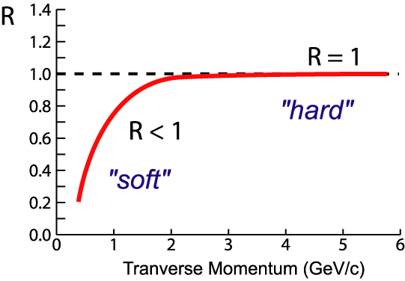
Look for jet suppression
1. Compare Au+Au to nucleon-nucleon cross sections
2. Compare Au+Au central/peripheral
Nuclear
Modification
Factor:
nucleon-nucleon
cross section
AA
<N_{binary}>/σ_{inel}^{p+p}
AA
If no “effects”:
R_{AA} < 1 in regime of soft physics
R_{AA} = 1 at high-p_{T} where hard
scattering dominates
Suppression:
R_{AA} < 1 at high-p_{T}
AA

Slide 7

PHENIX found: h± & π⁰ below p+p*N_{coll}
PRL 88, 022301 (2002)
1147
citations
Peripheral (60-80% of σ_{geom}):
<N binary collisions> = 20 ± 6
central (0-10%): <N bin coll> = 905 ± 96

Slide 8
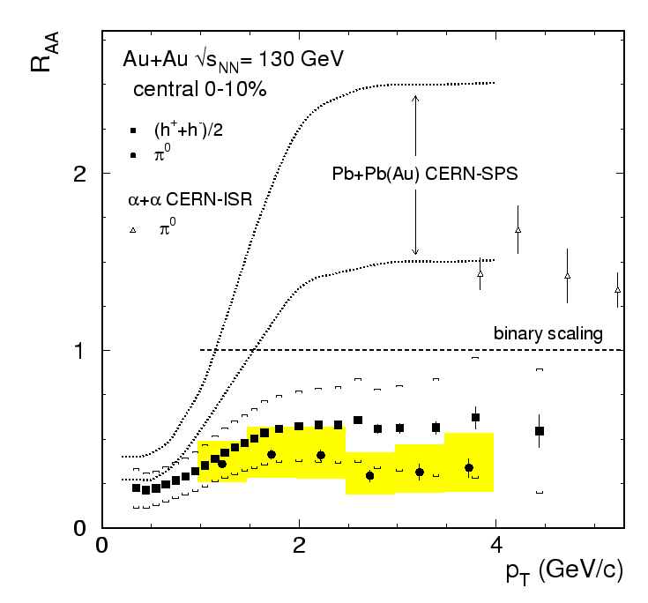
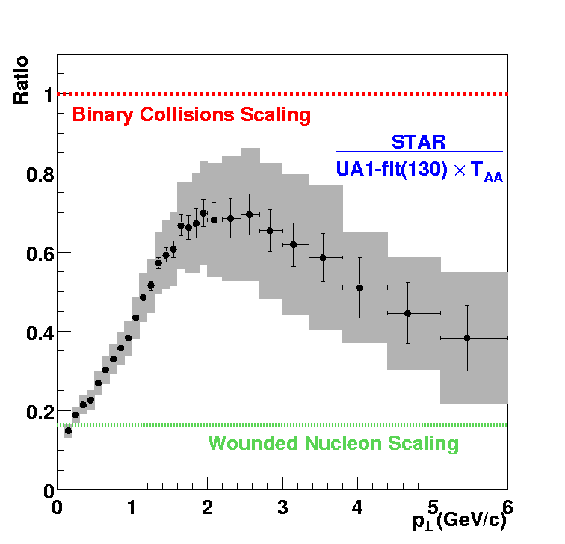
Jet suppression in 1st RHIC data!
Phys. Rev. Lett. 88, 022301 (2002)
charged
π⁰ lower
NB: h±
is ½ baryons
Charged deficit
seen by both
PHENIX & STAR
STAR
preliminary

Slide 9
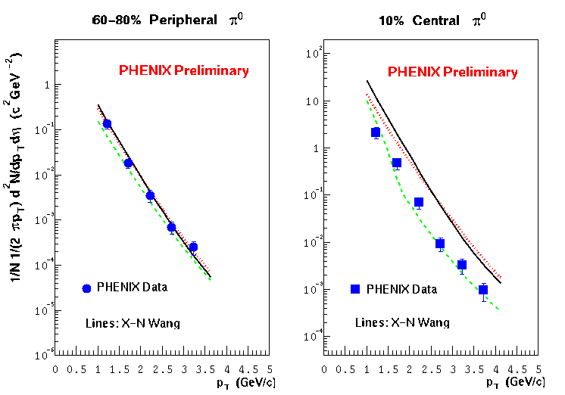
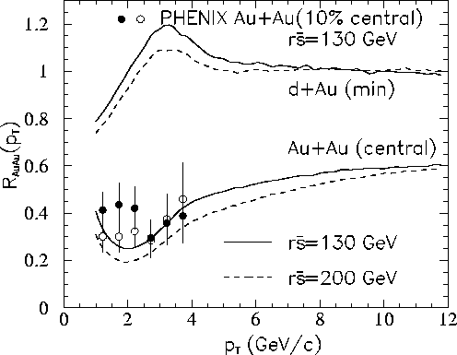
How much energy loss at RHIC?
scaled pp
energy
loss
shadowing + initial multiple scattering
We know system is not static!
including expansion:
<dE/dx> ∼7.3 GeV
for 10 GeV/c jets
X.N. Wang & E. Wang,
hep-ph/0202105

Slide 10
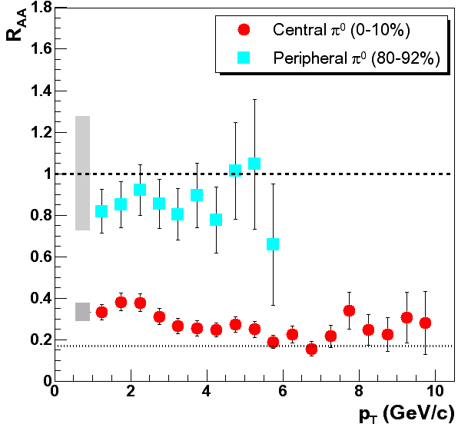
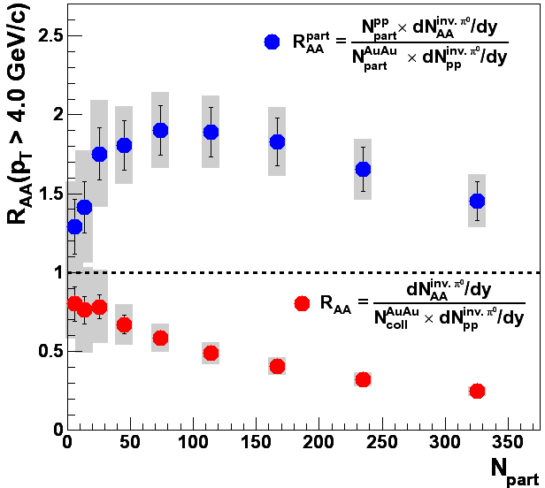
Au-Au √s = 200 GeV: high p_{T} suppression!
PRL91, 072301(2003)

Slide 11
To be sure – turn off the QGP*
* Make sure there is no significant volume

Slide 12
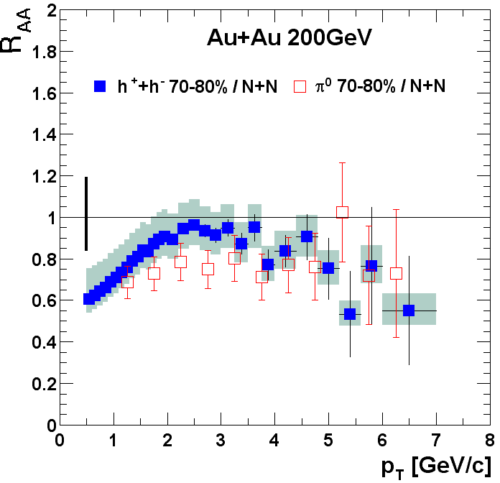
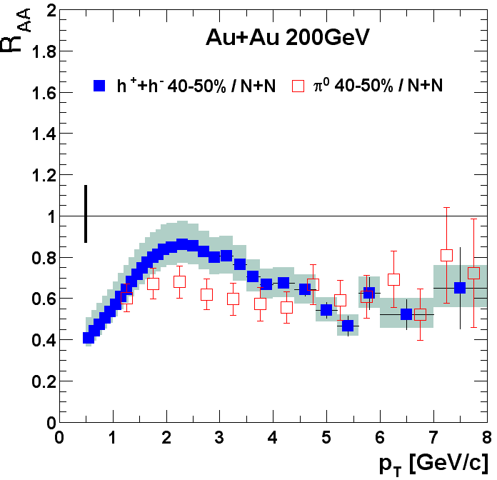
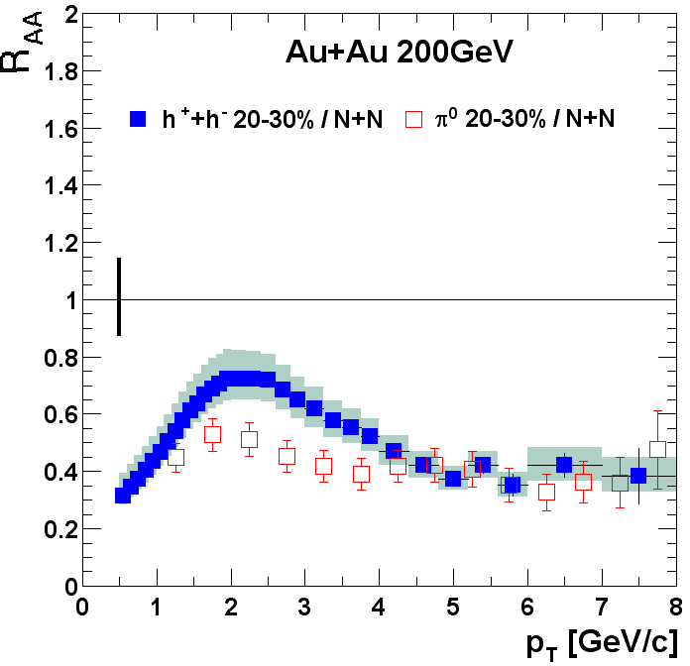
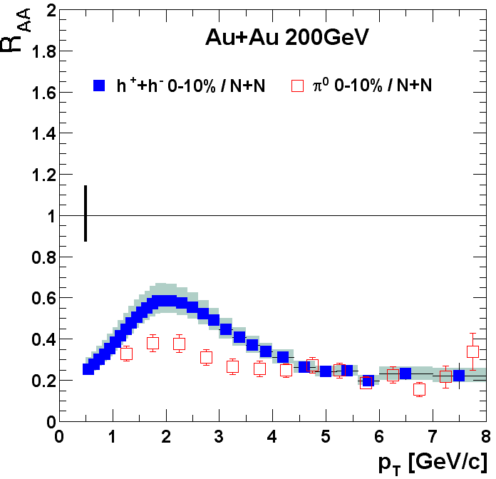
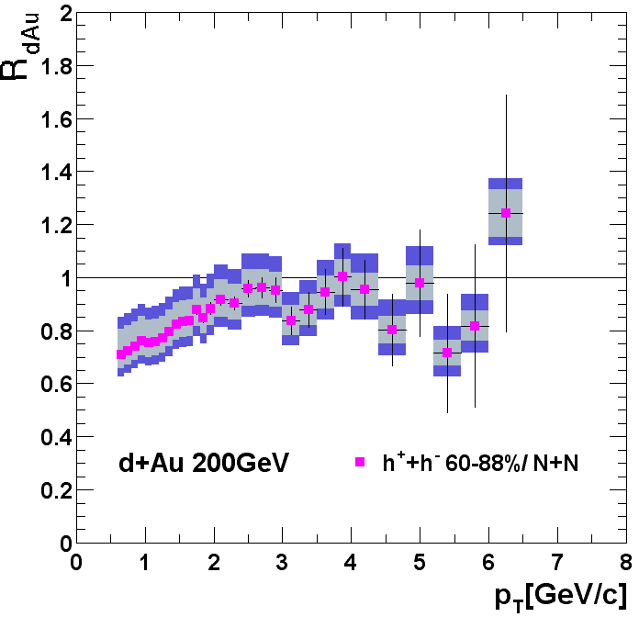
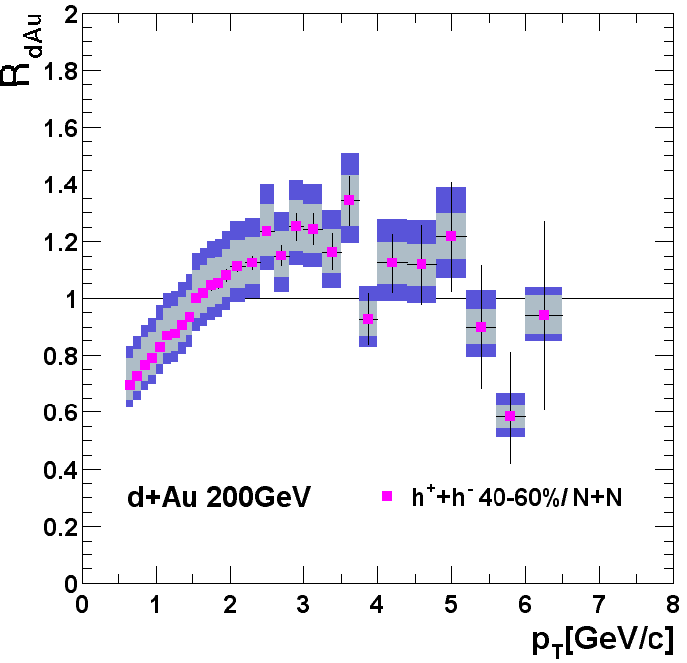
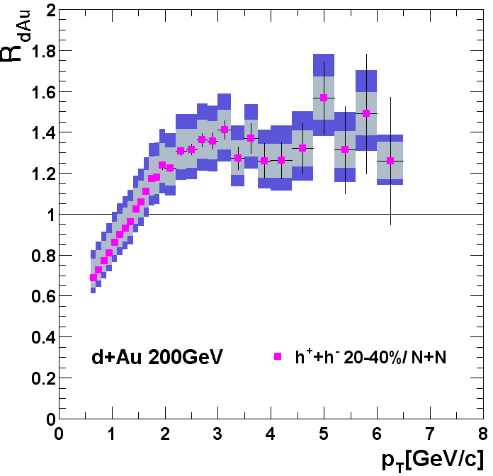
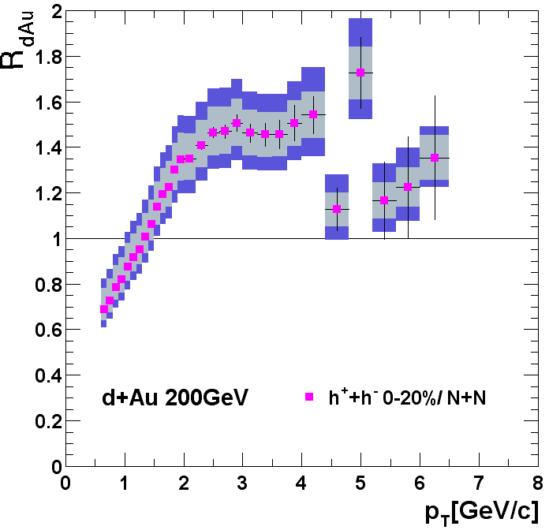
Cold nucleus provided a control
Au + Au Experiment
d + Au Control
PHENIX
preliminary
Dramatically different and opposite centrality evolution of AuAu experiment from dAu control.
Jet suppression is clearly a final state effect.

Slide 13
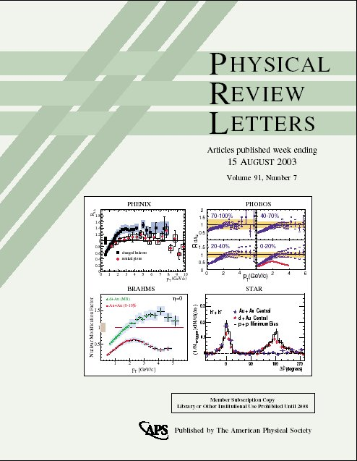
d+Au central to the discovery!

Slide 14
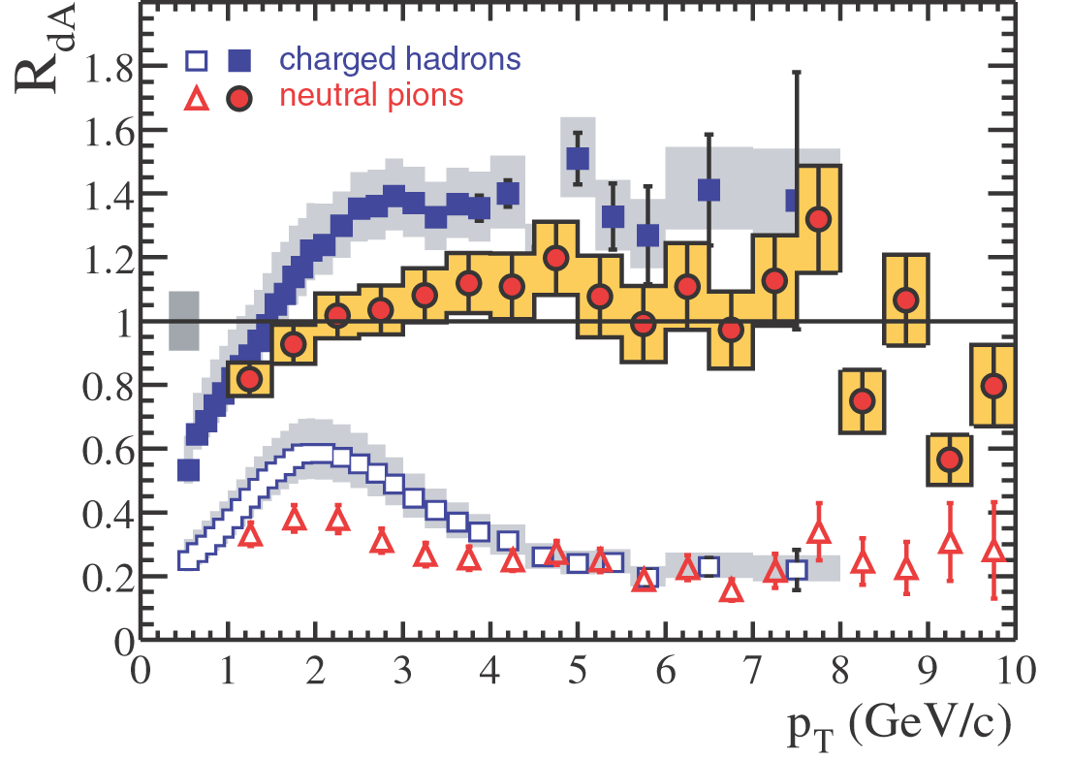
Charged hadrons & π⁰
Phys.Rev.Lett. 91 (2003) 072303
599 citations

Slide 15
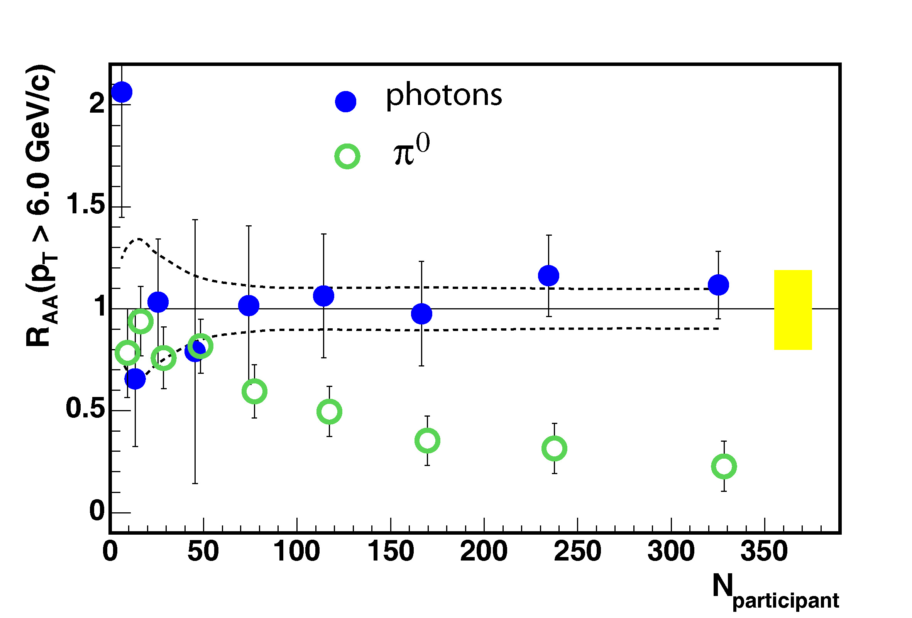

Yes, we know N_{coll}

Slide 16
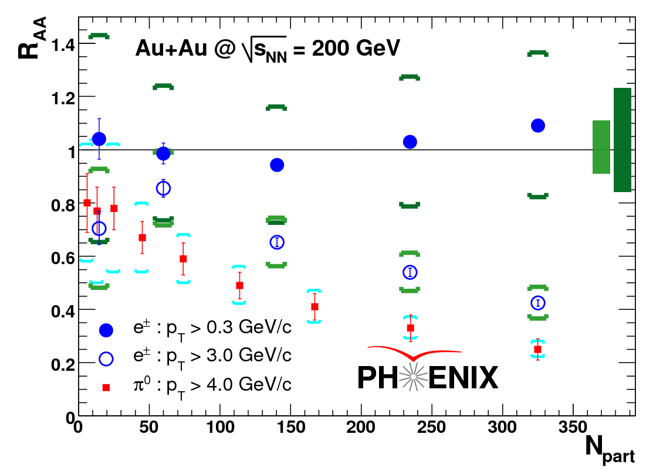
medium opacity to heavy quarks
Phys.Rev.Lett. 98 (2007) 172301
764 citations
single electrons from heavy mesons
R_{AA} nearly same as for light quarks!
gluon radiation suppressed by phase space (dead cone)
Collisional energy loss…

Slide 17
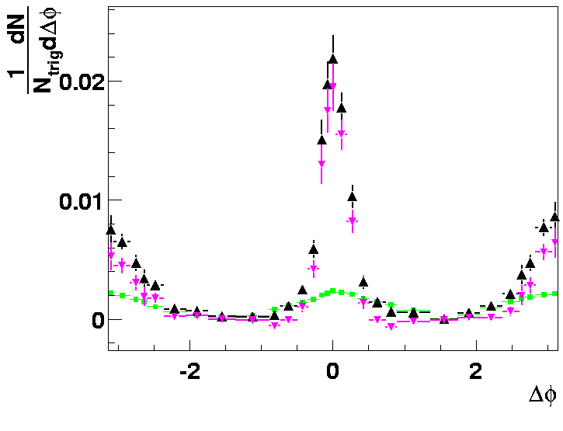
Identifying Jets - Angular Correlations of hadrons
Remove soft background
  by subtraction of mixed event distribution
Fit remainder:
  Jet correlation in Δφ
  Additional v₂ component
  to correct flow effects
More on this from Peter
  STAR result is very cool
raw differential yields
PHENIX Preliminary
2-4 GeV
Early result

Slide 18
But we aren’t done yet!
Xin-Nian still has work to do
And so do the experiments
Jets are suppressed, but what’s the mechanism?
  Gluon radiation is important
  But heavy quarks show it’s not the whole story
Turn to jet substructure

Slide 19


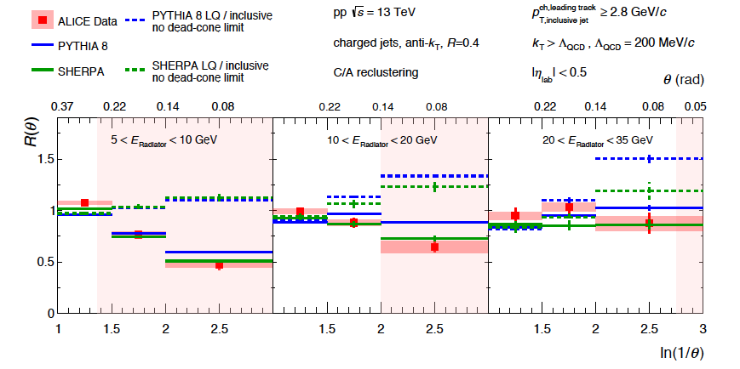

ALICE observed the dead cone effect
Soft gluon radiation spectrum
Large M suppresses small angle radiation (phase space effect)
Dokshitzer, et al. J.Phys.G17,1602 (1991)
Dokshitzer & Kharzeev, PL B519, 199 (2001)
D-tagged vs. inclusive jets in p+p
θ_{g}
HF/ inclusive
arXiv:2106.05713

Slide 20
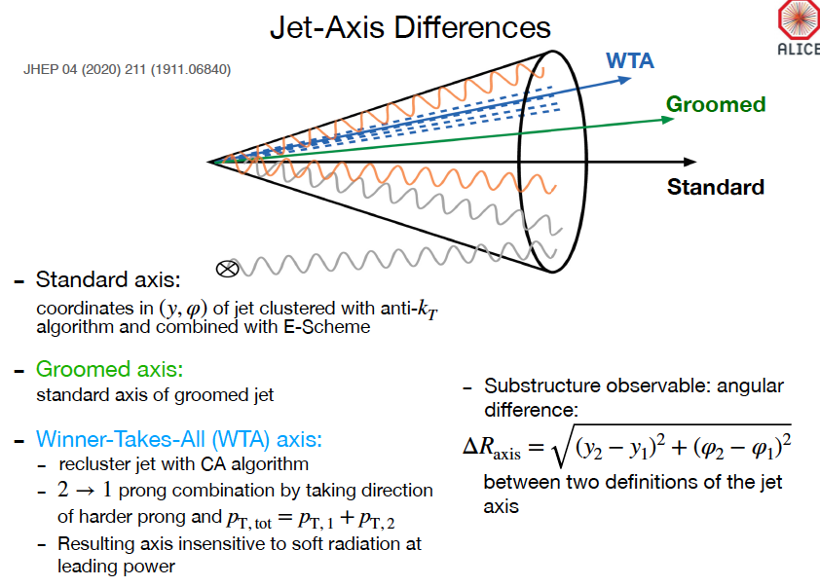
Rey Cruz Torres
How aligned is hardest fragment with the jet axis?

Slide 21
Rey Cruz Torres
Jets narrow in PbPb
Larger effect in softer jets
Quark jets are narrower. Are the gluon jets more modified?
LBT + matter gets this right
Models vs. data allow us to quantify the processes in jet evolution!

Slide 22



We have an exciting future ahead
From PHENIX to ALICE to EIC with Xin-Nian!
Congratulations on your birthday
  and looking forward to many more!

Slide 23
Backup

Slide 24
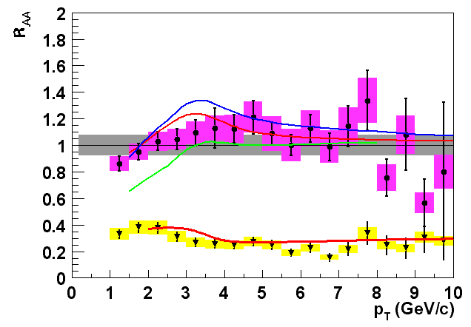
π⁰ R_{AA} vs. predictions
Theoretical predictions:
d+Au: I. Vitev, nucl-th/0302002 and private communication.
Au+Au: I. Vitev and M. Gyulassy, hep-ph/0208108, to appear in Nucl. Phys. A; M. Gyulassy, P. Levai and I. Vitev, Nucl. Phys. B 594, p. 371 (2001).
Initial state: mult. scatt.,shadowing + final state dE/dx (Au+Au)
Also: Kopeliovich, et al (PRL88, 232303,2002)
predict R_{pA}~1.1 max at p_{T}=2.5 GeV projectile as color dipole
PHENIX Preliminary
anti-shadowing
shadowing

Slide 25
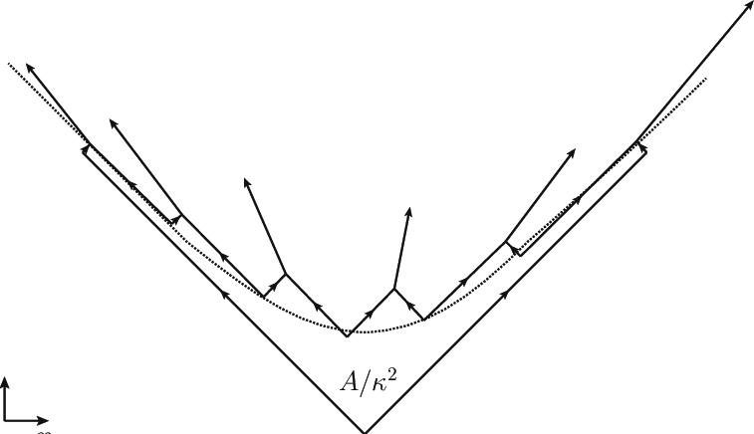
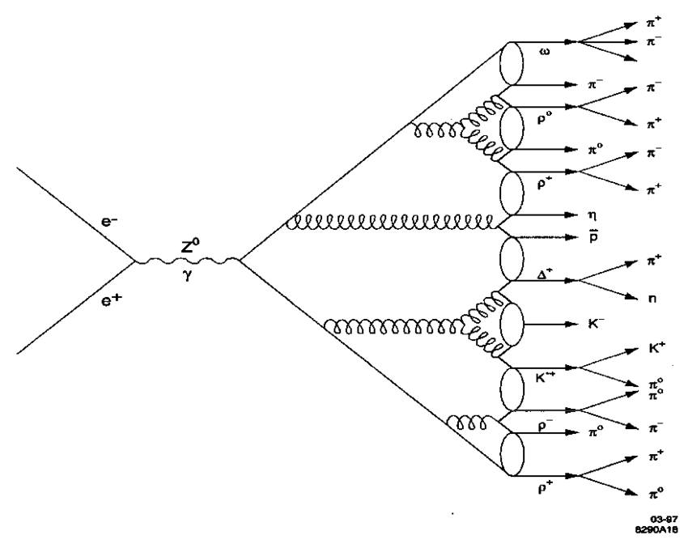
Hadronization
String breaking (e.g. Pythia)
Cluster hadronization (e.g. Herwig)
Coalescence or Statistical Hadronization?

Slide 26
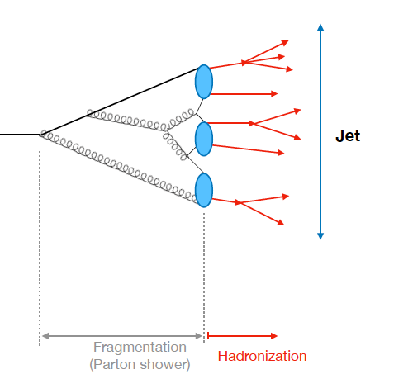
Transition to hadrons is non-perturbative
Rey Cruz Torres
Calculable in pQCD
Not calculable in pQCD
Scale of jet:
p_{T} ~ 20-500 GeV
Scale of transition: Λ_{QCD} ~ 0.5 GeV

Slide 27
Groomed jets well described by NLL QCD

Slide 28
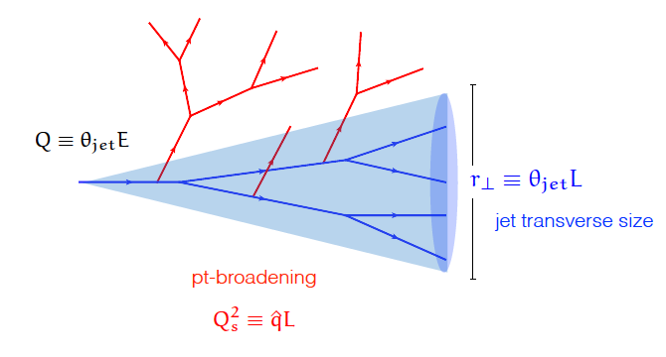
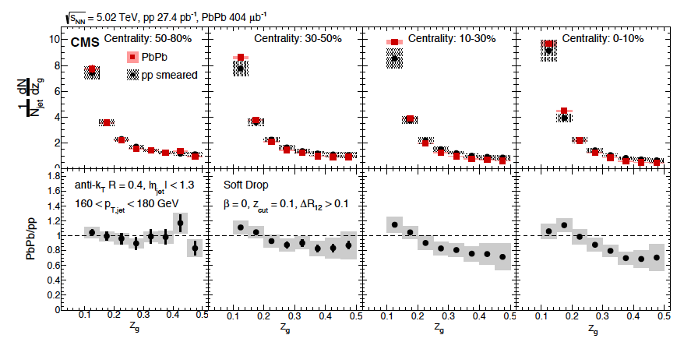
  Probe early gluon splitting
Recluster & groom jet
Use 2 leading clusters
Data to quantify energy, p_{T} transport.
See significant dependence on jet E, grooming.

Slide 29
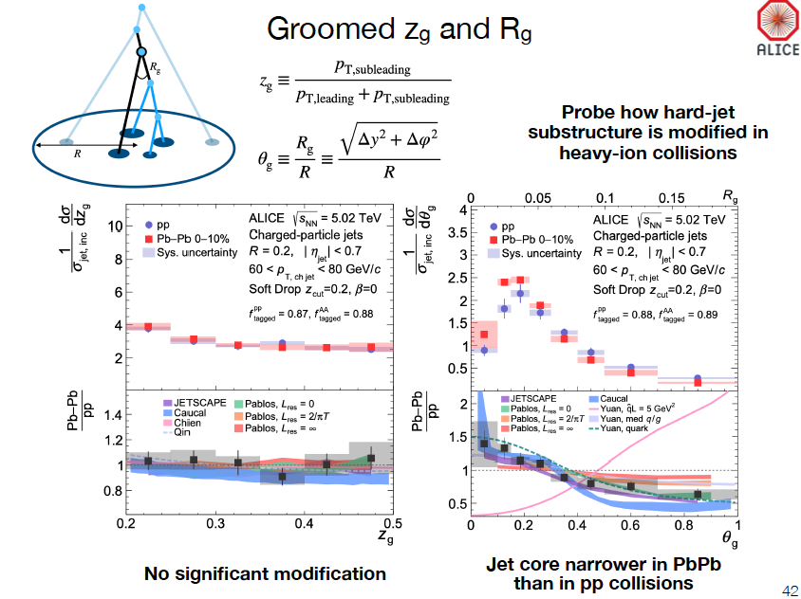

Slide 30
Why measure this observable?
Axis difference can be calculated perturbatively
Especially if jets are groomed to remove the soft particles at large angles.

Slide 31

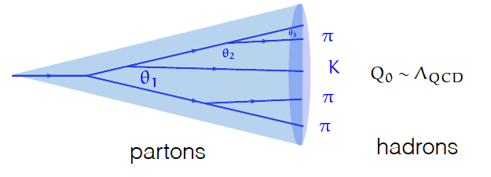
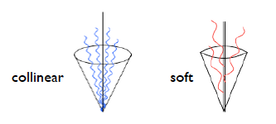
What’s in a jet?
  q,g undergo probabilistic cascade of g emissions
  Total color charge & flavor are conserved
  Successive branchings are ordered in angle
  Color coherence suppresses large angle soft radiation
Modified by color exchange with QGP

Slide 32
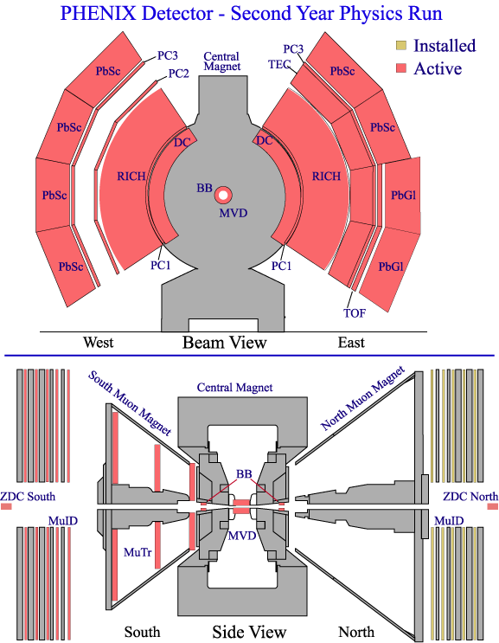
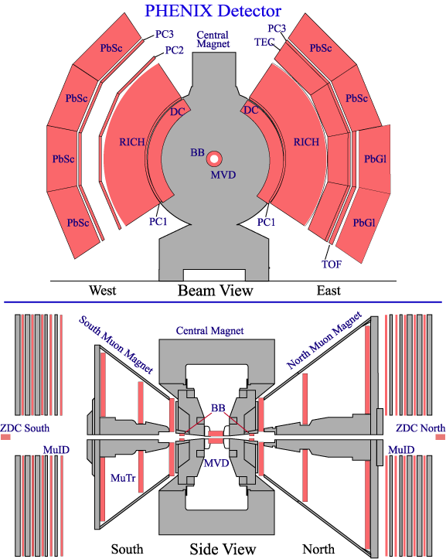
Run-2 and Beyond
Slide from Bill Zajc
2nd muon arm

