Slide 1
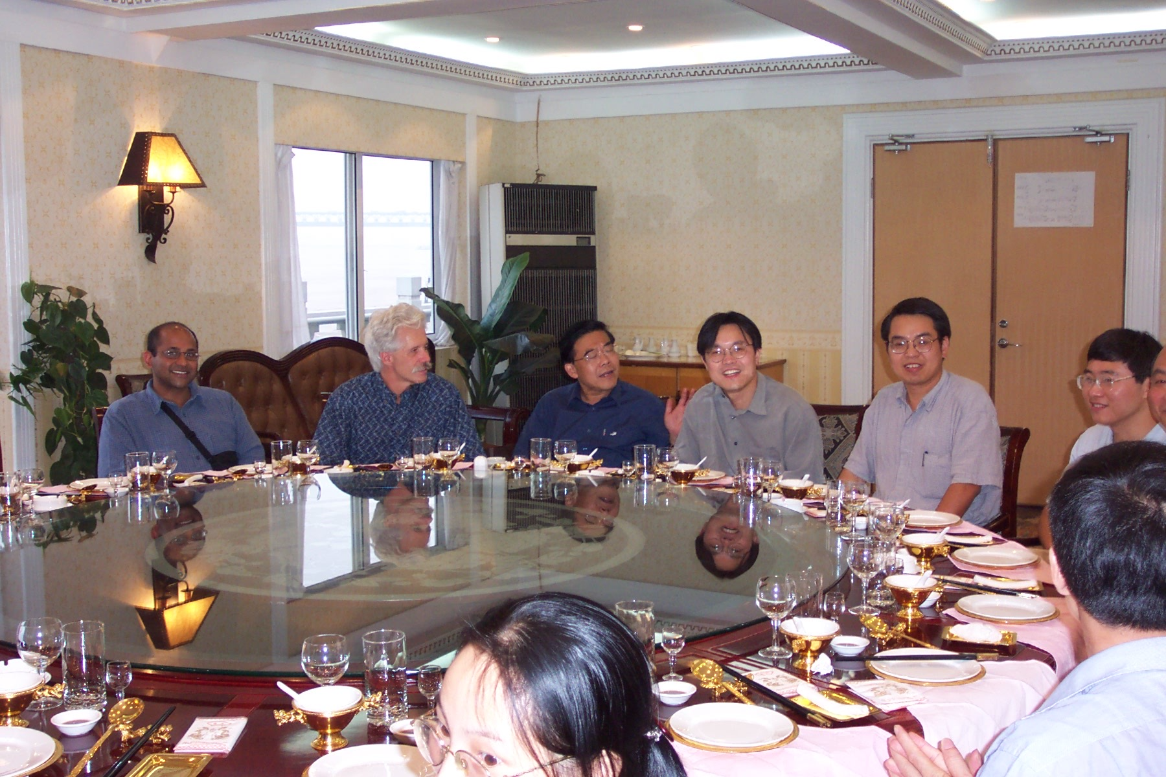
Xin-nian at 40…

Slide 2


Slide 3


Slide 4


Slide 6


Slide 7
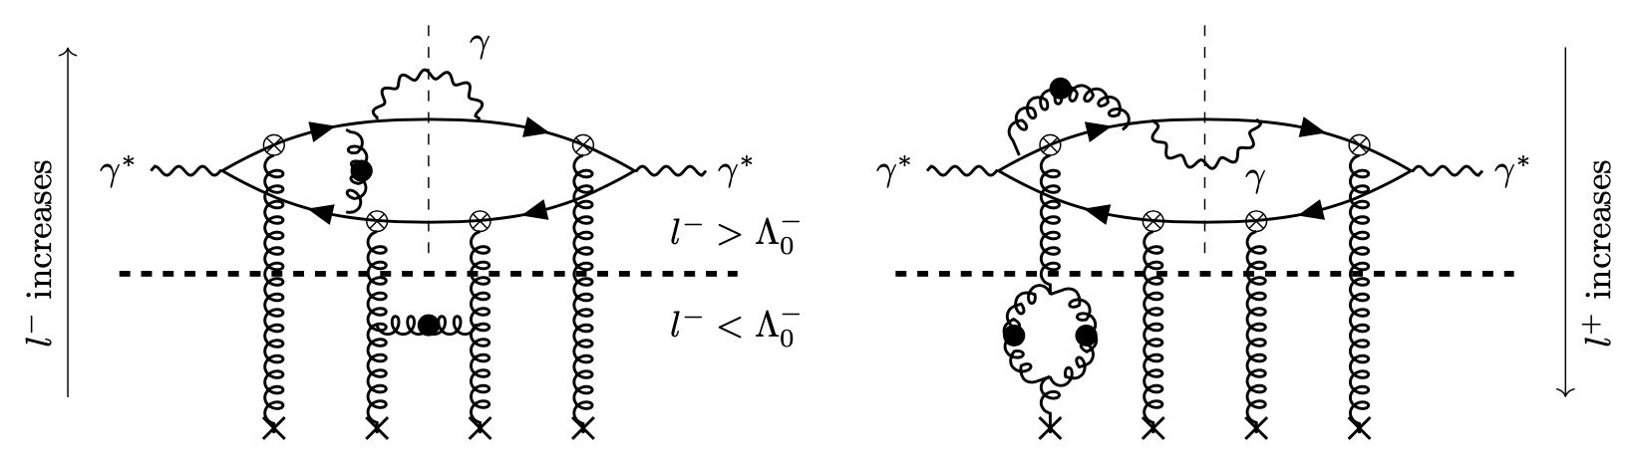
Di-jets+photons from the Color Glass Condensate at NLO
Fig. from Roy, RV, arXiv:1911.04530
Raju Venugopalan
Brookhaven National Lab
Based on
Roy, RV: 1802.09550, 1911.04519, 1911.04530
Caucal,Salazar, RV: 2108.06347
Caucal,Salazar,Schenke,RV, 2208.XXXXX
Berkeley Symposium on Hard Probes and beyond, August 18-19, 2022

Slide 8
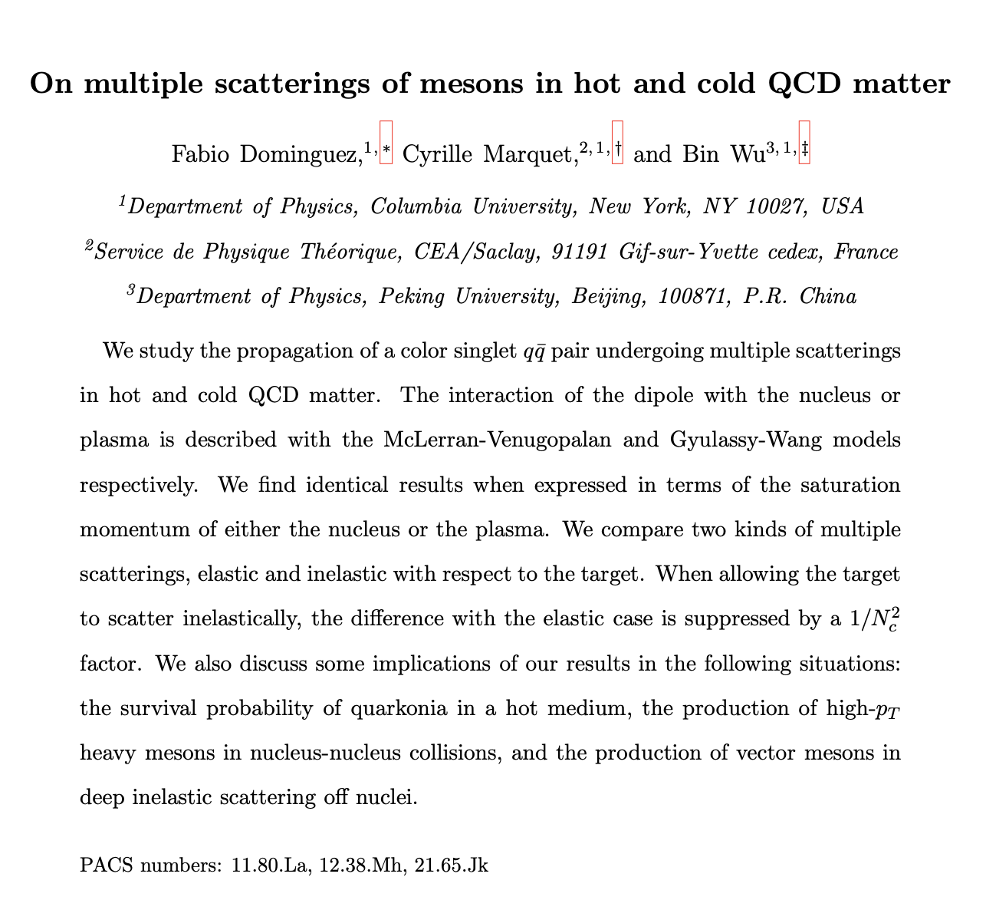
NPA 823 (2009) 99

Slide 9
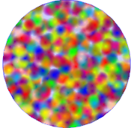
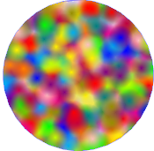
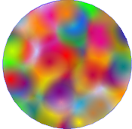
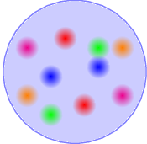
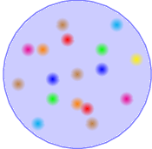

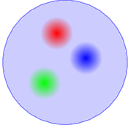
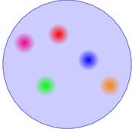
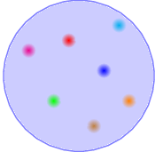
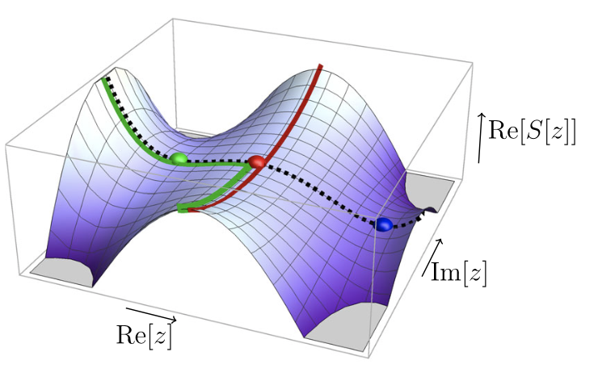
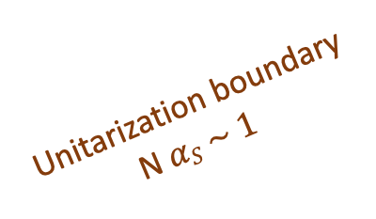


Classical lumps in $2→N scattering and unitarity$
Gluon Saturation
Unitarization boundary
N$αS \sim 1$
Boost
BFKL
DGLAP
Resolution
False vacuum decay of field configurations $φ(z)$
Saturation of Bekenstein’ entropy bound
Langer; Coleman; …
Fig. from Andreassen,Frost,Schwartz, PRD97 (2018)
Dvali,RV, arXiv:2106.11989, PRD (2022)

Slide 10
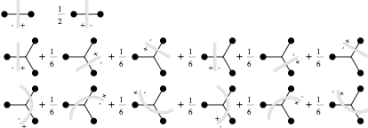
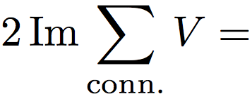

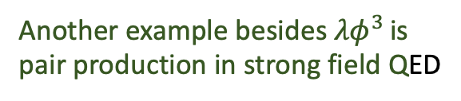
Cutkosky’s rules for particle production in strong fields
Propagators on Schwinger-Keldysh contour
+
Another example besides ${λφ}^{3 }$is
pair production in strong field QED
-
Simple understanding of such ”AGK cutting rules” in terms of combinatorics
of cut and uncut sub-graphs contributing to a given multiplicity
Very general consequence of unitarity in strong fields
Gelis,RV: hep-ph/0601209,hep-ph/0608117

Slide 11
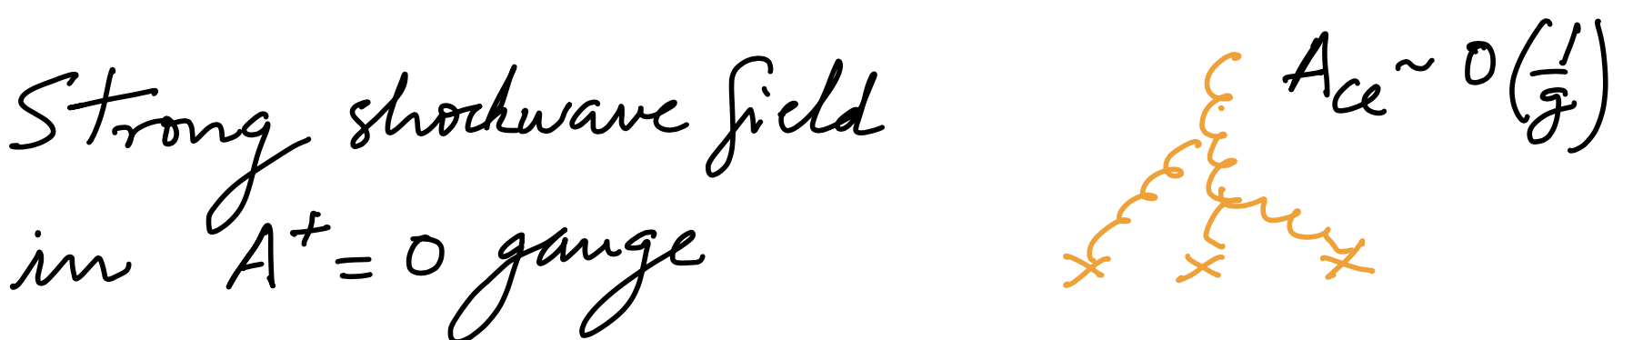
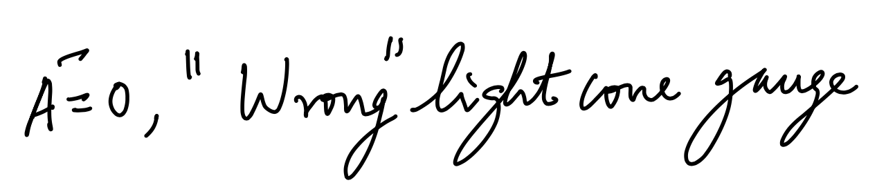
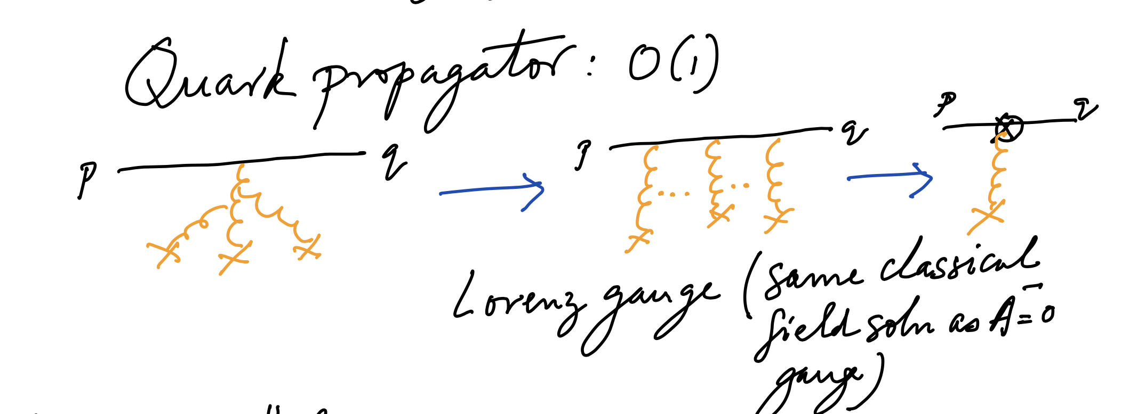
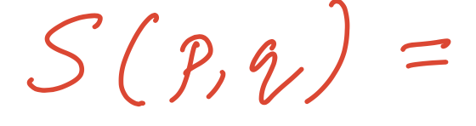
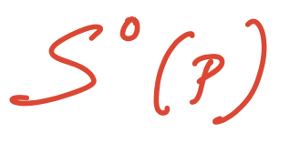
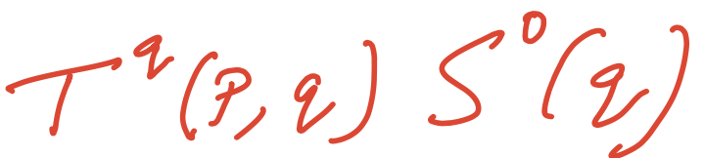
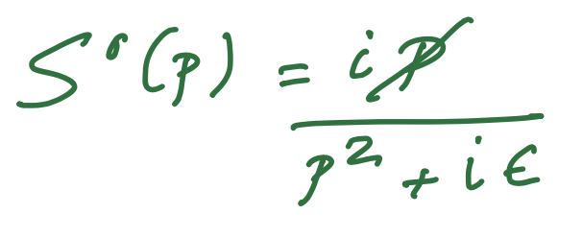
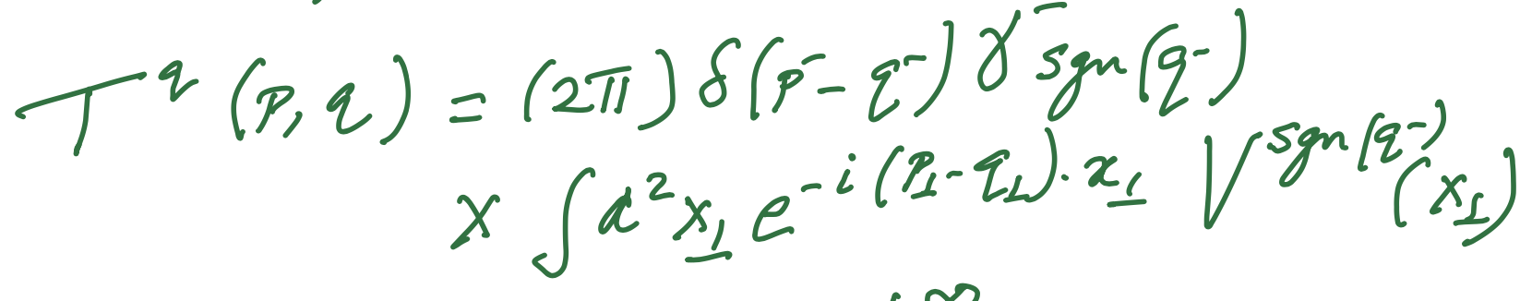
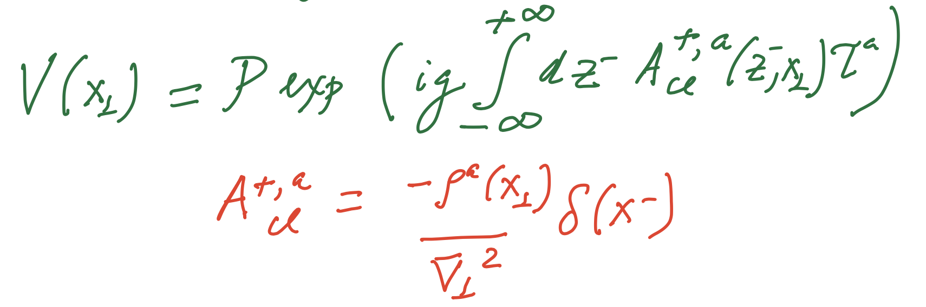
Ingredients for high-order computations: “Shockwave” propagators
Effective vertex
with
McLerran, RV: hep-ph/9809427

Slide 12
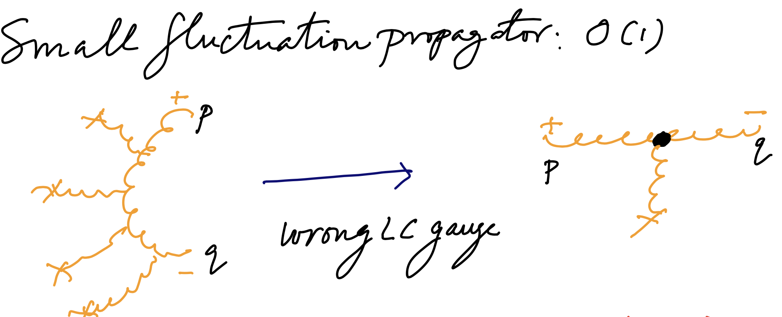
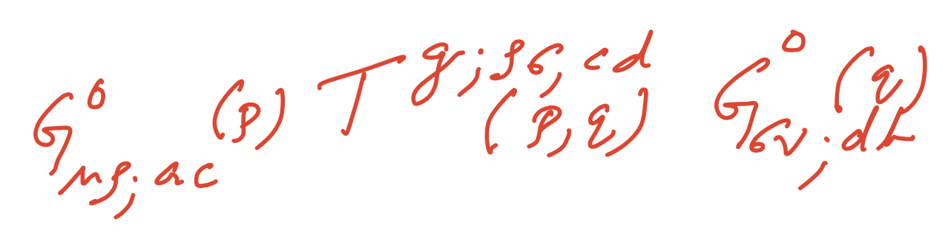
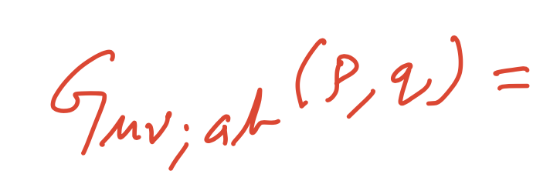
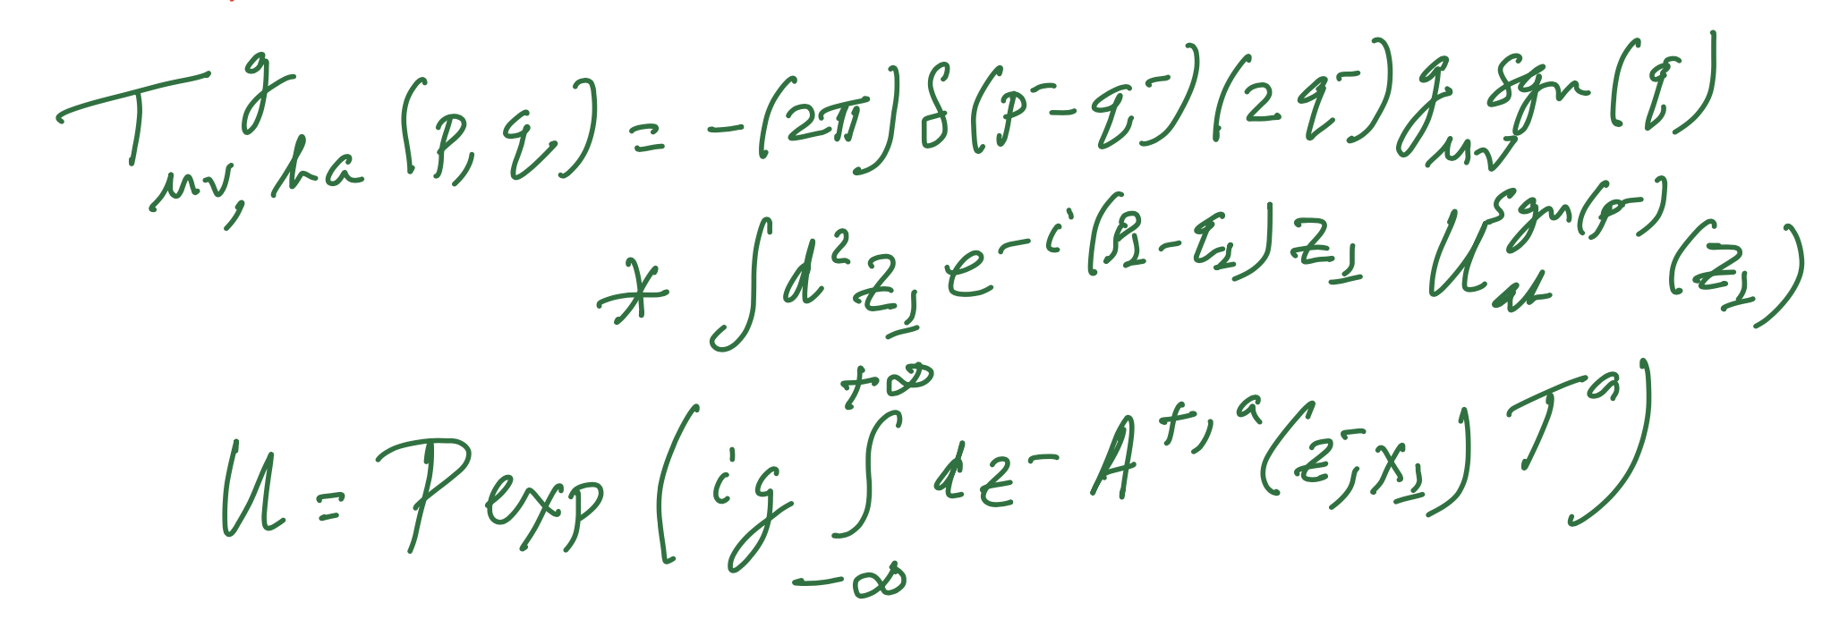
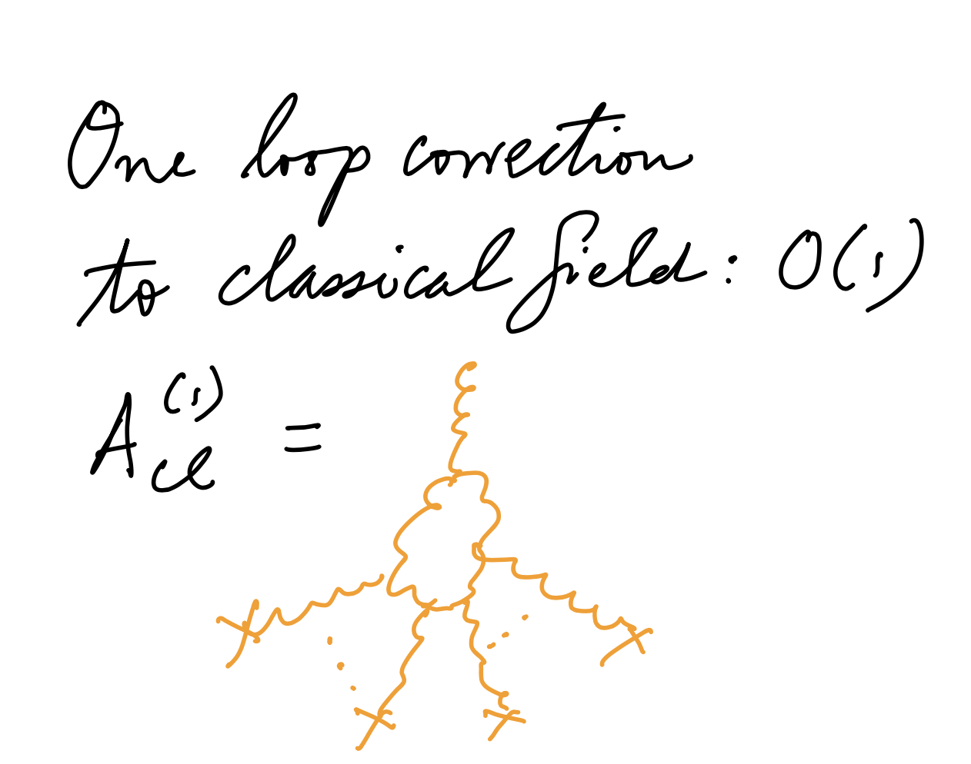
Ingredients for high-order computations: “Shockwave” propagators
Effective vertex
Ayala,Jalilian-Marian,McLerran,RV (1995)
Balitsky, Belitsky (2001)
Iancu,Leonidov,McLerran (2001)
Effective vertices identical to quark-quark-reggeon and gluon-gluon-reggeon vertices
in Lipatov’s Reggeon EFT
Bondarenko,Lipatov,Pozdynyakov,
Prygarin, arXiv:1708.05183
Hentschinski, arXiv:1802.06755

Slide 13
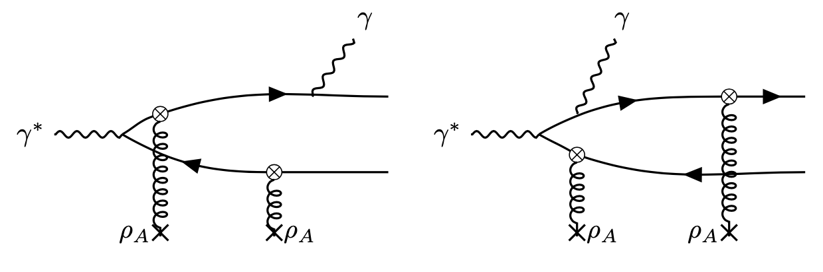
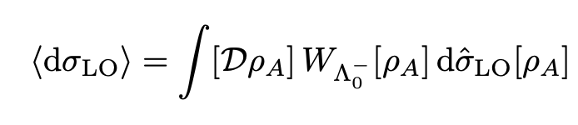
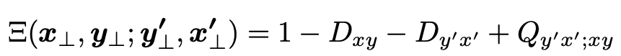
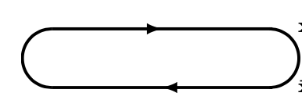
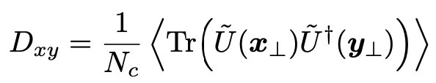
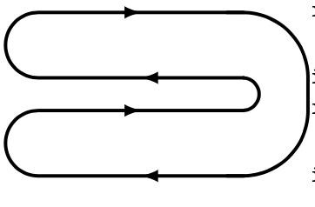
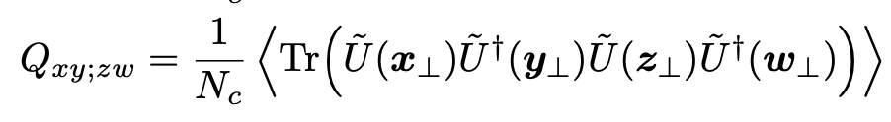


Photons+di-jets in DIS at small x
LO: O($α_{EM}^{2}$)
$$∝$$
Dipole:
Quadrupole:
Universal building blocks of high energy QCD

Slide 14
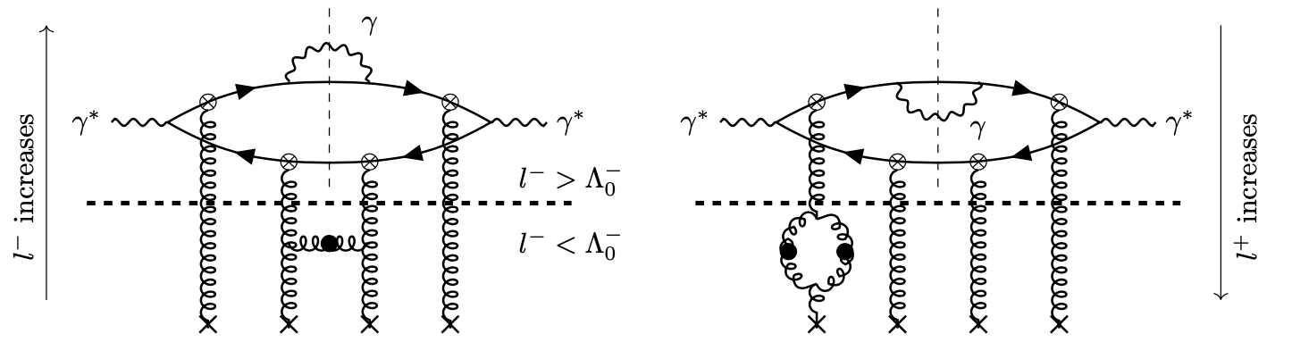
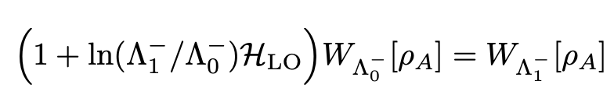

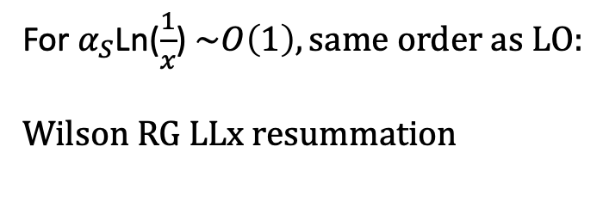
Photons+di-jets in DIS at small x
NLO: O($α_{EM}^{2}α_{S}$)
For $α_{S}$Ln($\frac{1}{x}$) $\sim O\left(1\right), same order as LO:$
Wilson RG LLx resummation
JIMWLK “Hamiltonian”
JIMWLK :Jalilian-Marian,Kovner,Leonidov,Weigert (1997); Iancu,Leonidov,McLerran (2001);
Independent and equivalent formulation: Balitsky (1996)

Slide 15
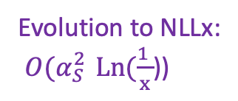
From LO+LLx to NLO+NLLx
State of the art:
Small x evolution:
NLO BFKL: Fadin, Lipatov (1998)
NLO JIMWLK: Balitsky, Chirilli, arXiv:1309.7644, Grabovsky, arXiv:1307.5414 Caron-Huot, arXiv:1309.6521, Kovner,Lublinsky,Mulian, arXiv:1310.0378, Lublinsky, Mulian, arXiv:1610.03453
NNLO BK (SYM): Caron-Huot, Herranen (2018)
Resummed NLLx:
Salam (1999); Ciafaloni,Colferai,Salam,Stasto (1999-2004)
Ducloue,Iancu,Madrigal,Mueller,Soyez,Triantaffyllopoulos (2015-2019)
Impact factor to NLO:
NLO impact factors:
Evolution to NLLx:
${O(α}_{S}^{2 }Ln(\frac{1 }{x}$))
Inclusive DIS: Balitsky,Chirilli (2013)
Diffractive DIS: Boussarie,Szymanowski,Wallon (2016)
Massive quarks: Beuf,Lappi,Paatelainen (2021)
p+A forward di-jets: Iancu,Mulian (2021)
Photon+di-jet in DIS: Roy,RV (2020)
DIS di-jets/di-hadrons: Caucal,Salazar,RV (2021); Taels, Altinoluk,Beuf, Marquet, arXiv:2204.11650;
Bergabo, Jalilian-Marian, arXiv:2207.03606

Slide 16
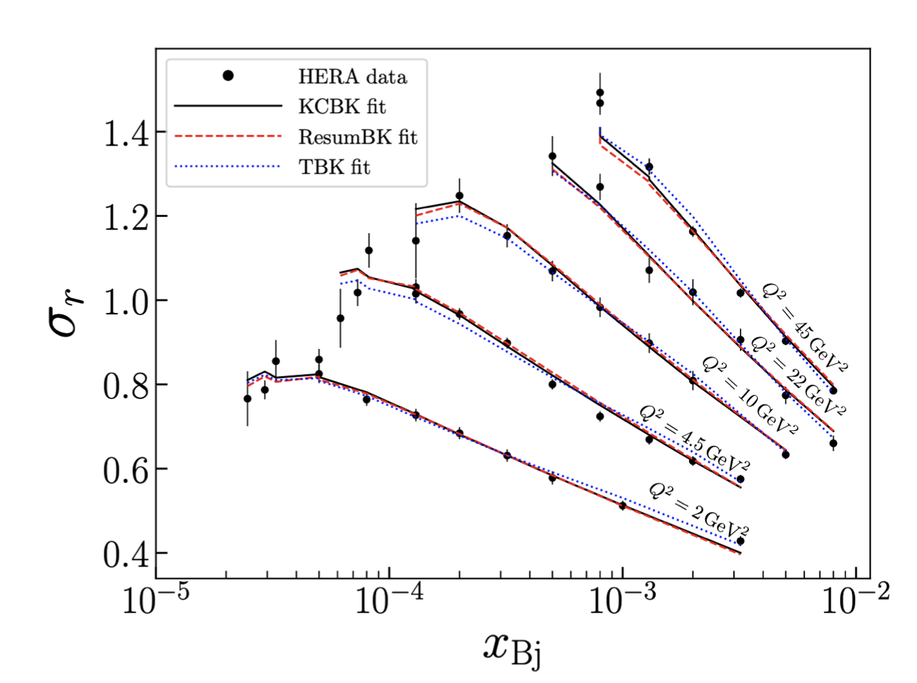
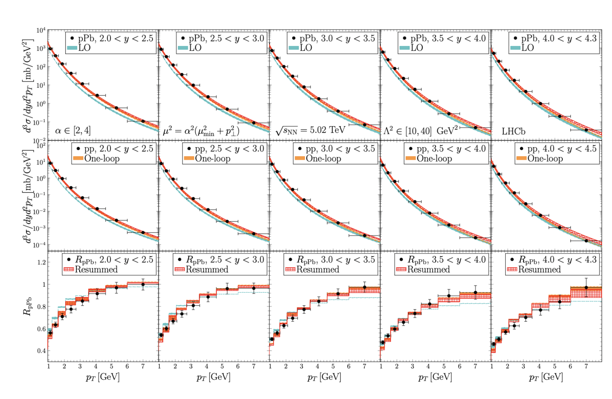
From LO+LLx to NLO+NLLx: phenomenology
Beuf,Hanninen,Lappi,Mantysaari, arXiv:2007.01645
Shi,Wang,Wei,Xiao, arXiv:2112.06975

Slide 17
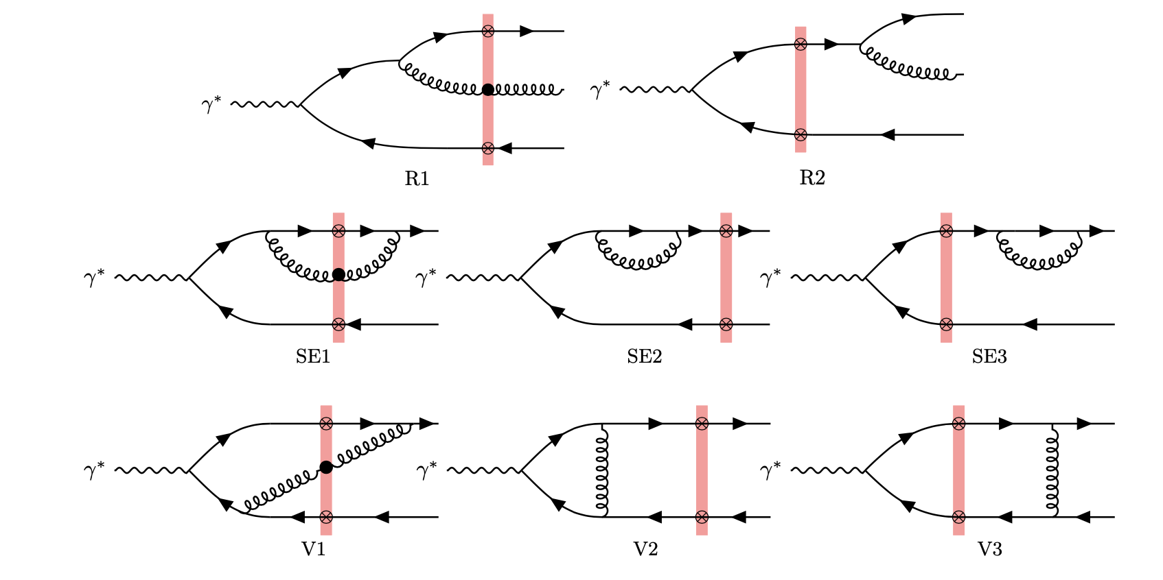
NLO impact factor for inclusive di-jet production in e+A
Caucal,Salazar,RV, JHEP 11 (2021) 222

Slide 18
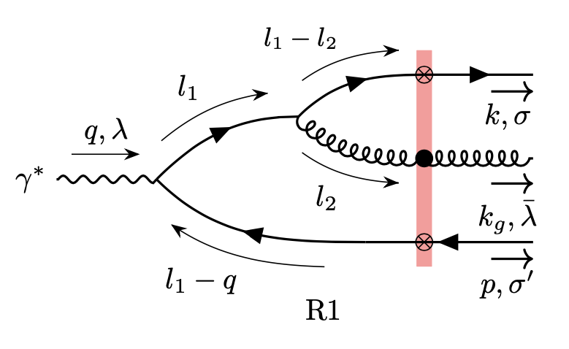

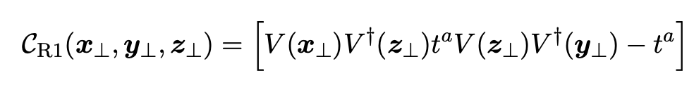

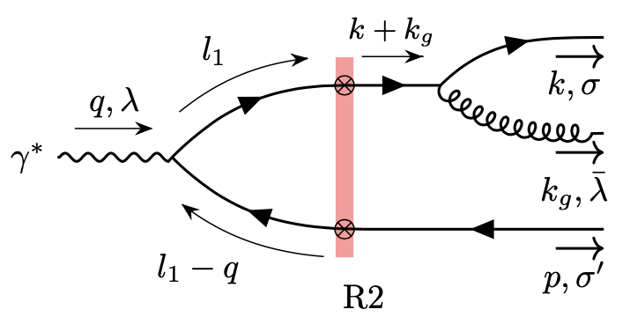
NLO impact factor for inclusive di-jet production in e+A
Real contributions:
Caucal,Salazar,RV, JHEP 11 (2021) 222
with color structure
and perturbative factor (eg., long. polarized photon)
spin-helicity-dependent
splitting vertex
Very compact expression since transverse momentum integrals can be performed analytically…
Beuf, arXiv:1112.4501
“R2” can be obtained from “R1”
with appropriate coordinate replacements

Slide 19
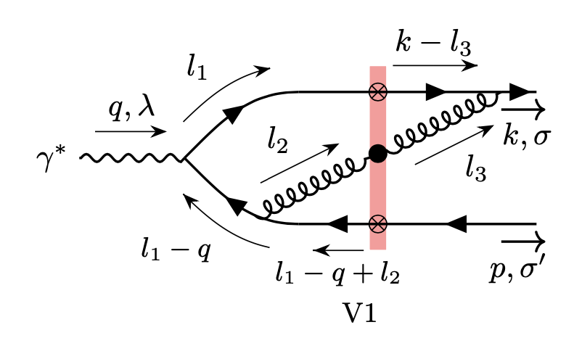
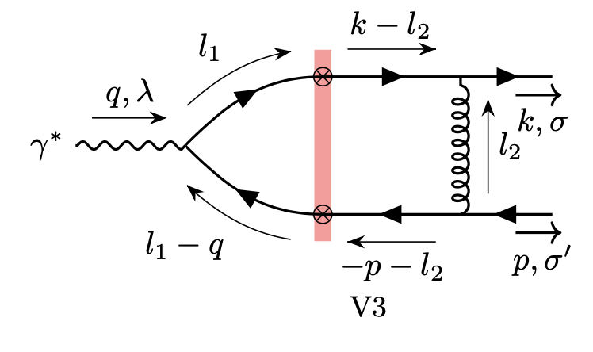
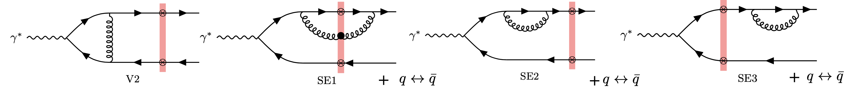




NLO impact factor for inclusive di-jet production in e+A
Virtual contributions:
UV finite contributions:
IR divergent contributions:
How SE3 vanishes in dim.reg for massless quarks
requires one to interpret the $ε$pole as IR

Slide 20








Slow gluon limit: JIMWLK factorization
$z_{g}$= $\frac{k_{g}^{−}}{q^{−}}$
$$→0$$
In this limit, the contribution from all real and virtual
diagrams apparently has a very complex structure
However this is nothing but the result of
the JIMWLK Hamiltonian acting on the LO
color structure…

Slide 21


Cancellation of soft and collinear divergences in the di-jet cross-section
This collinear pole cancels with the IR pole left over from the virtual contributions

Slide 22


NLO + NLLX di-jet cross-section
Assuming rapidity factorization, we can promote LL JIMWLK $→NLL JIMWLK$
This includes all finite terms to
accuracy

Slide 23



Sudakov logarithms from di-jets in back-to-back kinematics
The back-to back kinematics of inclusive DIS di-jets/di-hadrons is
especially sensitive to many-body saturation effects
that suppress the cross-section
But there is a similar suppression from soft gluon radiation
– enhanced at NLO by large “Sudakov” logarithms
These can be treated systematically to understand their interplay

Slide 24



Sudakov logarithms from di-jets in back-to-back kinematics
LO: TMD factorization
Access to Weizsacker-Williams and linearly polarized gluon TMDs:
Dominguez,Marquet,Xiao,Yuan, arXiv:1101.0715
NLO:
Large Sudakov logs and small x logs
Mueller, Xiao, Yuan, arXiv:1308.2993

Slide 25





Sudakov logarithms from di-jets in back-to-back kinematics
“v_{n}”: moments of azimuthal anisotropy
Sudakov double and single logarithms in curly brackets – exponentiate to all orders
with
Dependence on
factorization scale in x

Slide 26


Complete back-to-back result for inclusive dijets:
NNLx + Sudakov double+single logs+finite pieces
Summary:
Key terms agree with recent work
by Hatta, Xiao, Yuan, Zhou, arXiv:2106.0537
Essential to impose ”lifetime” ordering” on
BFKL/BK/JIMWLK evolution to recover
correct sign of Sudakov suppression!
See also Taels, Altinoluk, Beuf, Marquet, 2204.11650
TMD factorization only holds if
Numerical evaluation underway
Similar expressions for higher moments
of both longitudinal and transverse photons

Slide 27
Happy 60th Xin-Nian !

Slide 28



2-D Classical EFT
Saddle-point configs: Yang-Mills in IMF (P+ $→∞)$. Solutions: pure gauges separated by shockwave discontinuity
$A_{i }$=0
$A_{i }$= -$\frac{−1}{ig }$ U$∂_{i}$ $U^{†}$
A⁺= 0
A⁻= 0
$x^{−}$= 0
with the solution
U = P exp ( i$∫_{y}^{∞}$d$y^{′}$ $\frac{ρ(x_{t, }y^{′})}{∇_{t}^{2}}$ )
rapidity y=ln(x⁻/x₀⁻ )
Non-Abelian
Weizsacker-Williams dist.
For A >>1 (Gaussian W), can compute arbitrary
n-point Wilson line correlators: dipoles,quadrupoles,…

