Slide 1
US Magnet Development Program
CCT and CT in Utility Structure
With closed yoke
Mariusz Juchno
US Magnet Development Program
Lawrence Berkeley National Laboratory

Slide 2
Structure with octagonal coil-pack
Structure with octagonal coil-pack
  Improves yoke stress distribution and rigidity
  Coil-pack horizontal and vertical size = 320 mm
    Smaller coil – axial rods in the coil-pack
    Bigger coils – axial rods in the yoke
Three load-keys
  Horizontal
    Pre-load function
  Diagonal = ~0.707*Hor
    Stress distribution and rigidity
  Vertical
    Alignment
Bladders
  Mid-plane (2)
  Diagonal (8)
  Yoke (4 or 6)
  Vertical (2)

Slide 3
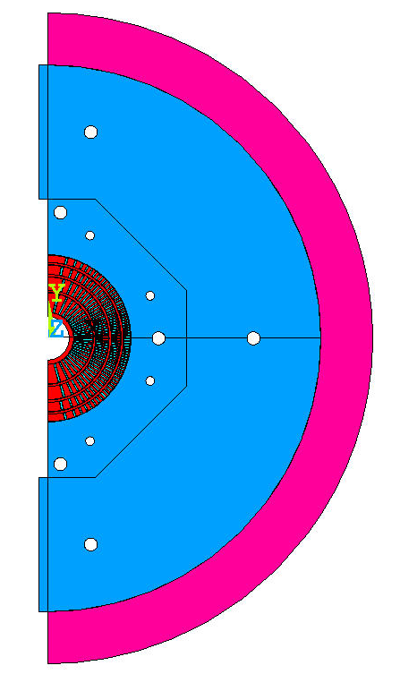
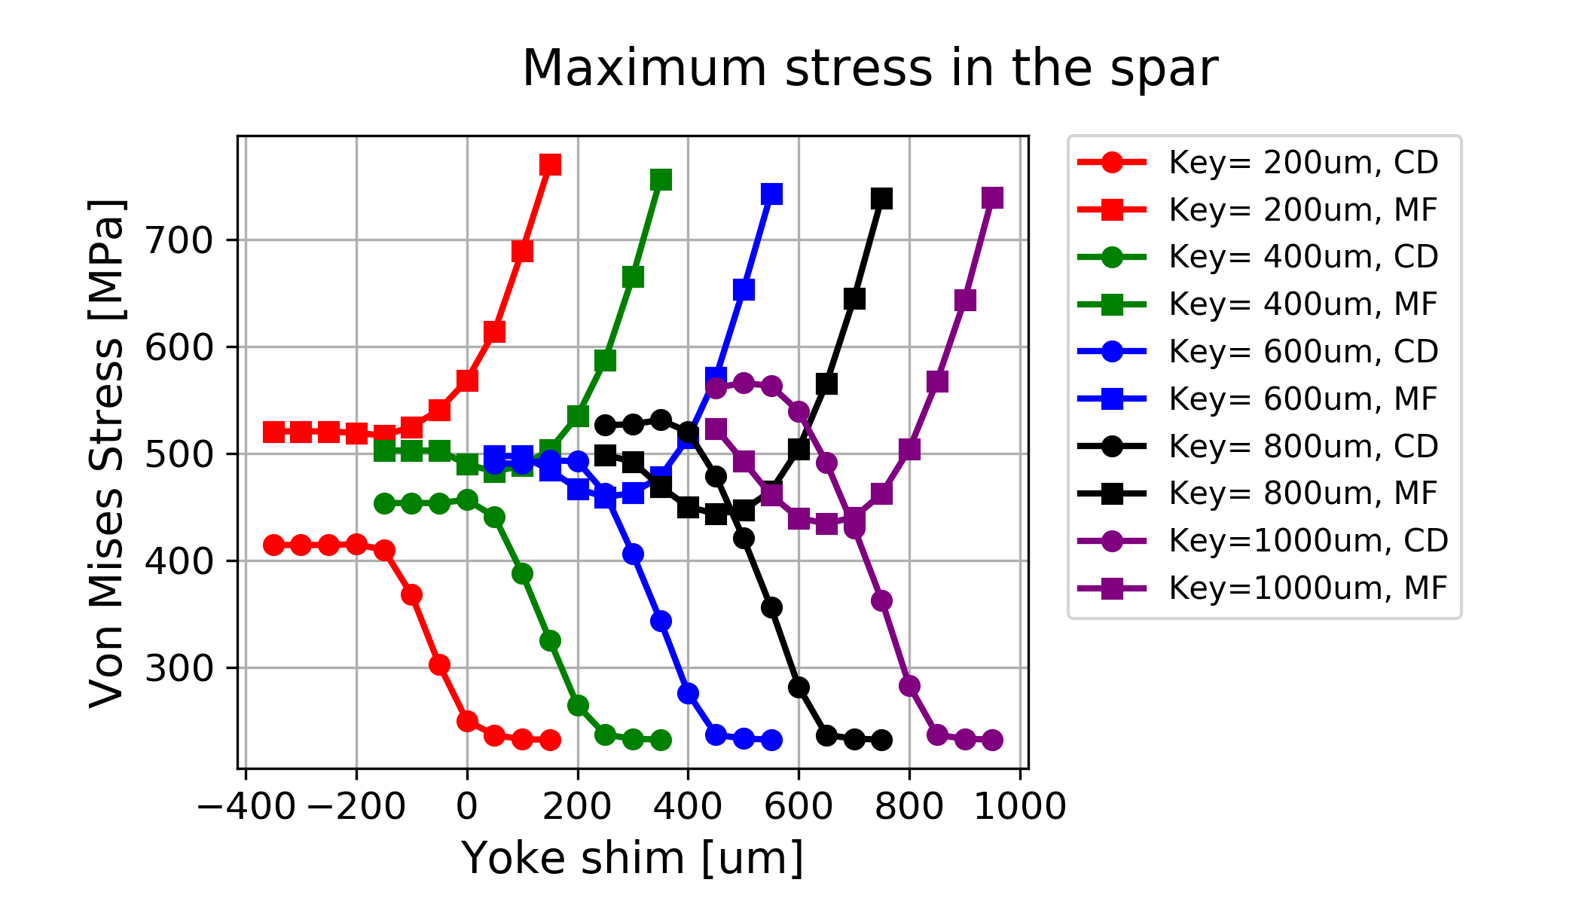
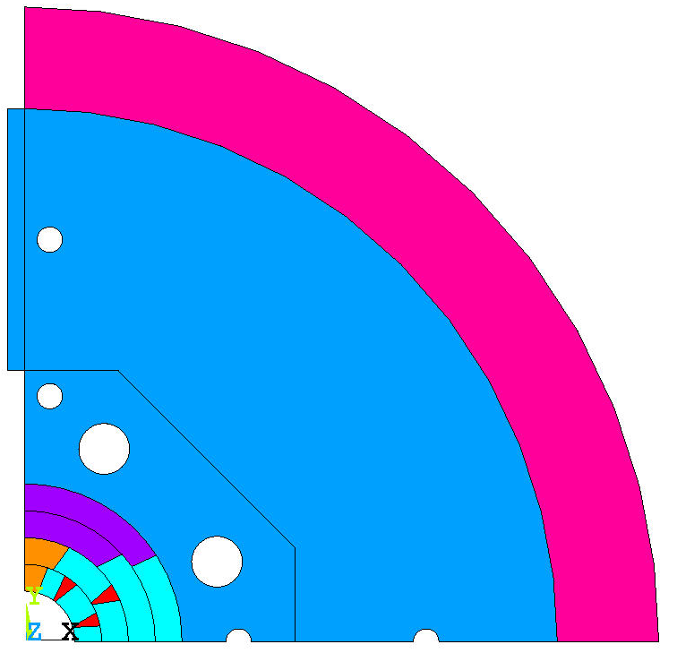
Example plot explained
Markers:
RT – Room temp.
CD – Cool-down
MF – Mag. Forces
Sometimes:
IR – inner radius
MR – mid. radius
OR – outer radius
Others as described
Colors:
Always horizontal key shim
Can be negative because yokes geometrically modelled to the vertical axis
Always on the horizontal axis

Slide 4
CCT case
Geometry with closed yoke gap
Shell OD 750 mm
Shell TH 60 mm
Bore field 17.3 T
Closing the yoke gap
  Iron block only for meshing
    Displacement UX=0
  Shim using contact element offset
    Infinite rigidity
    No thermal contraction
Aluminum bronze spar

Slide 5
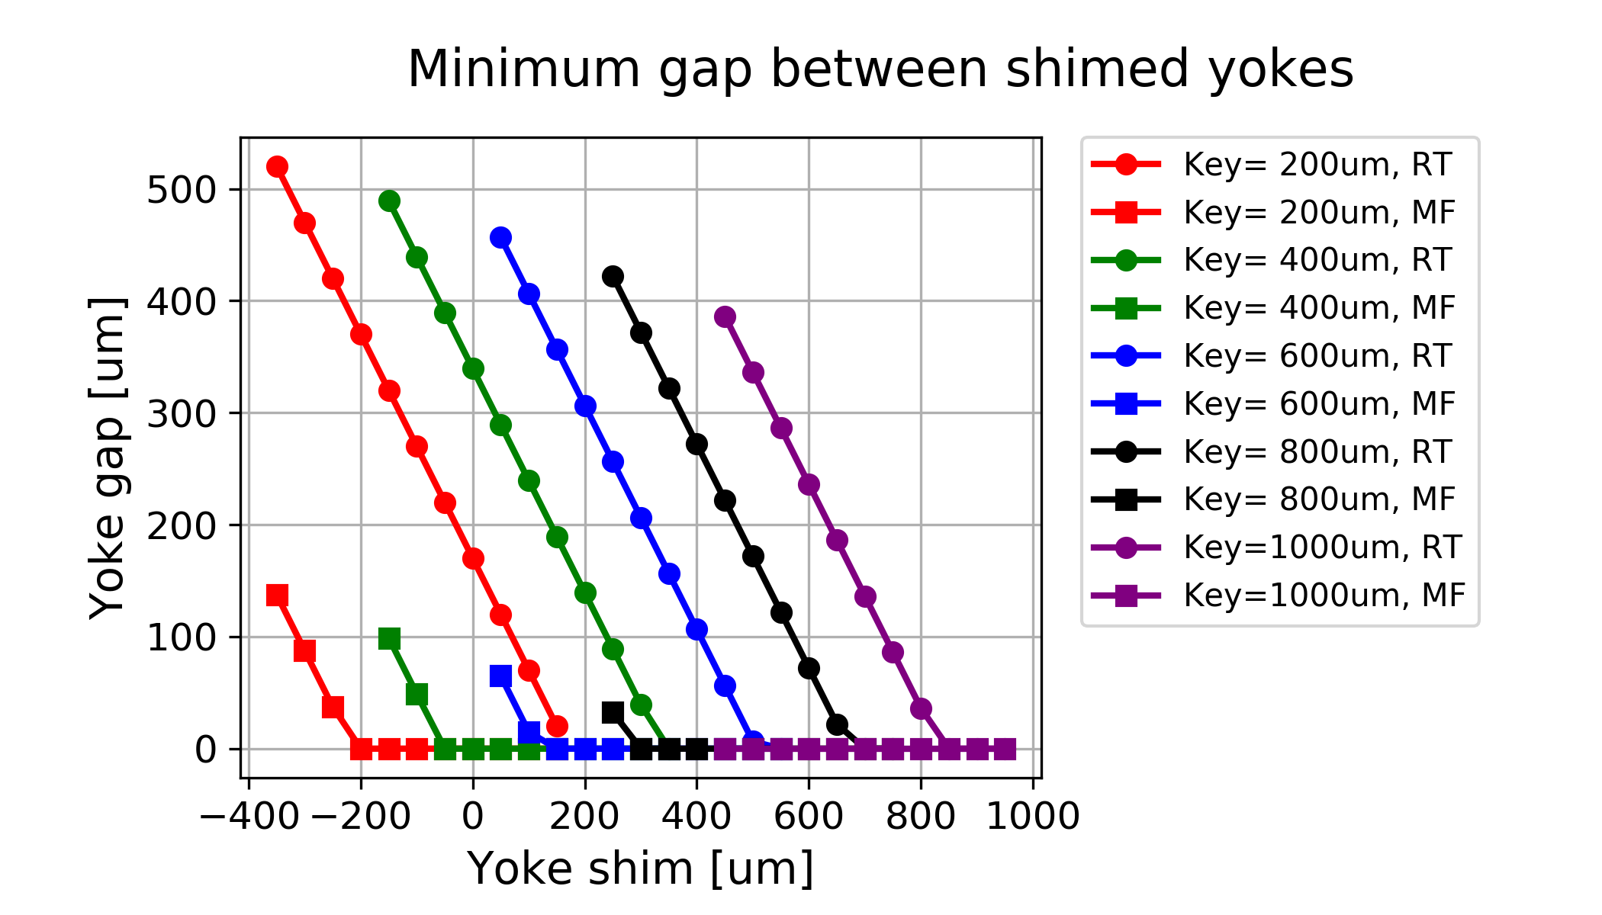
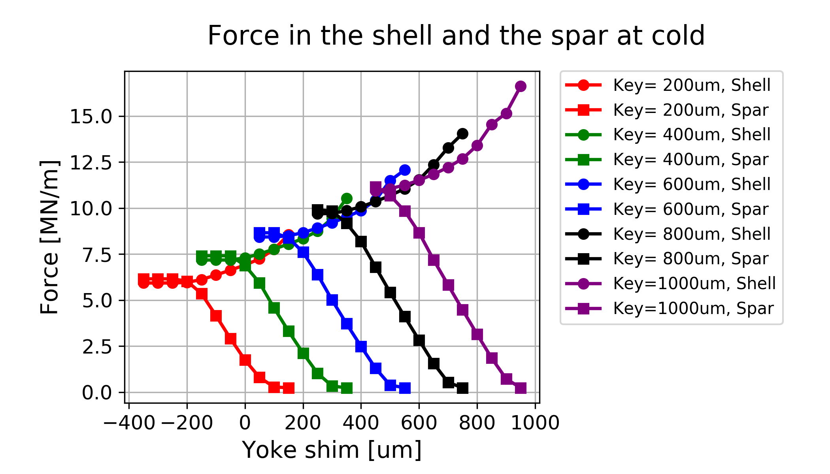
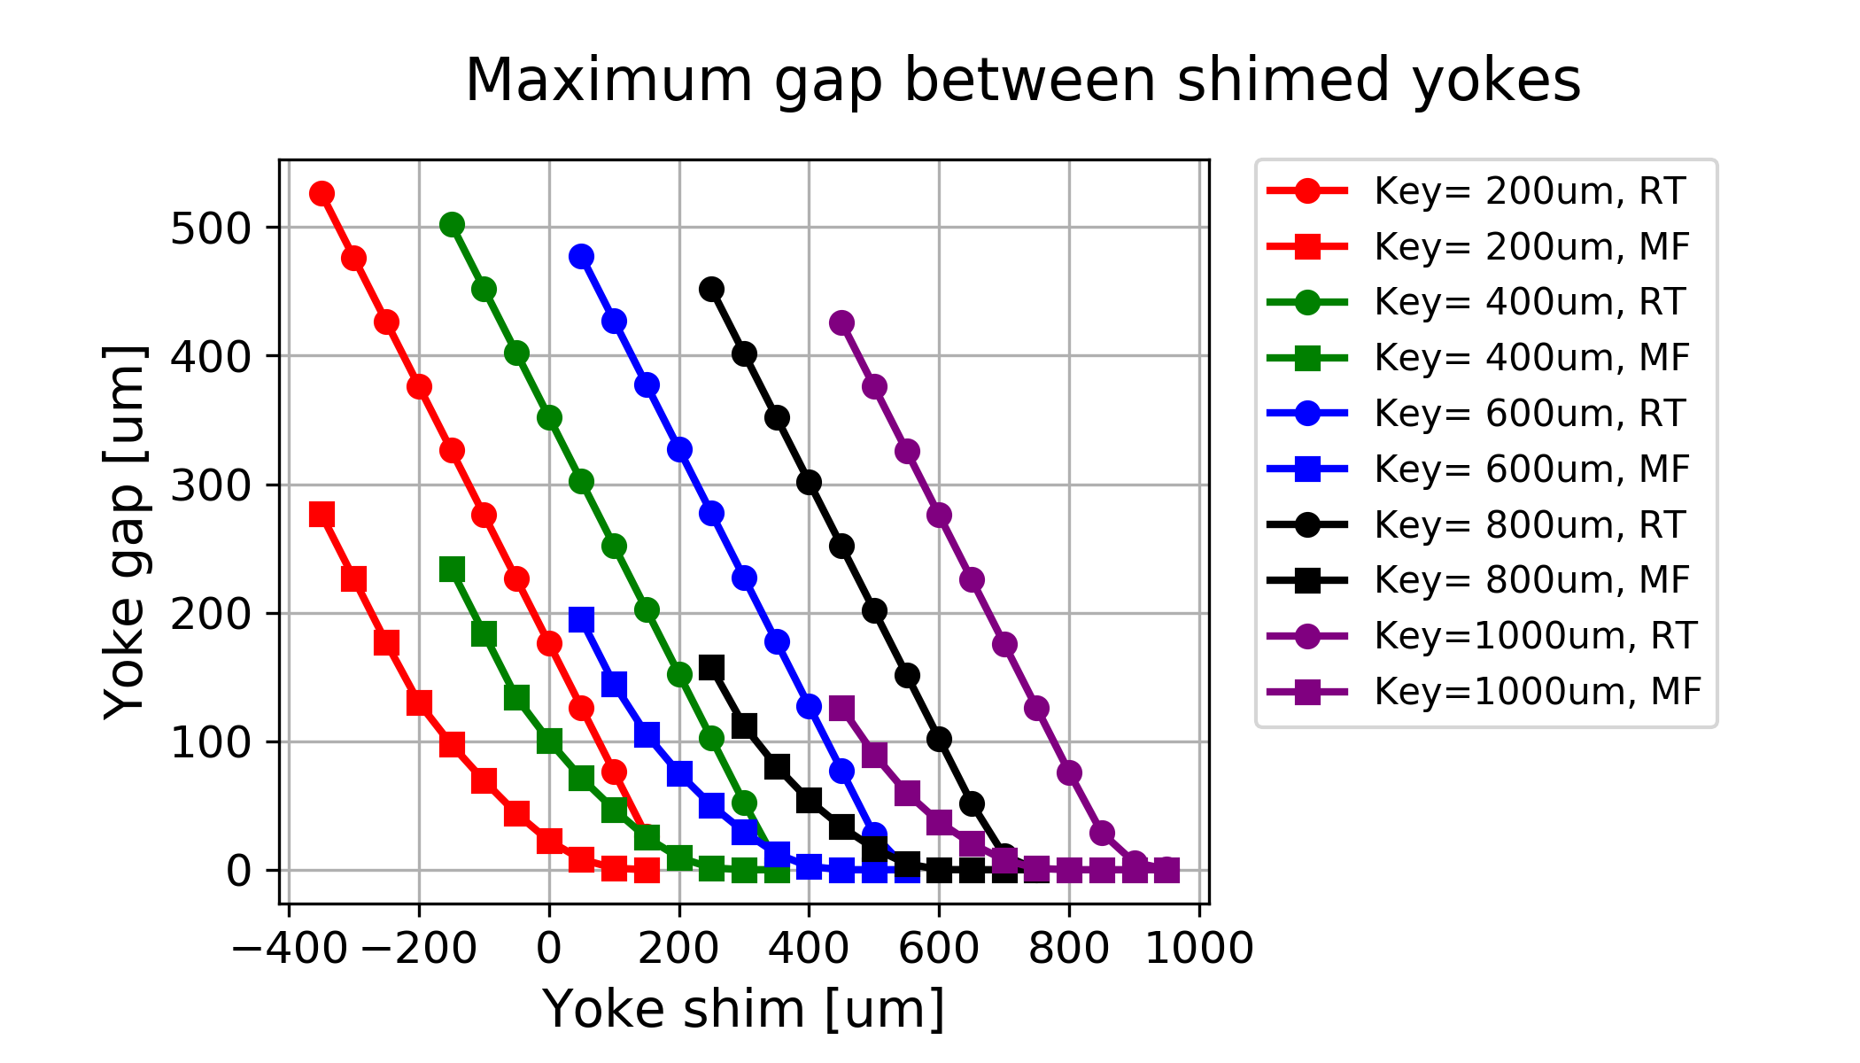
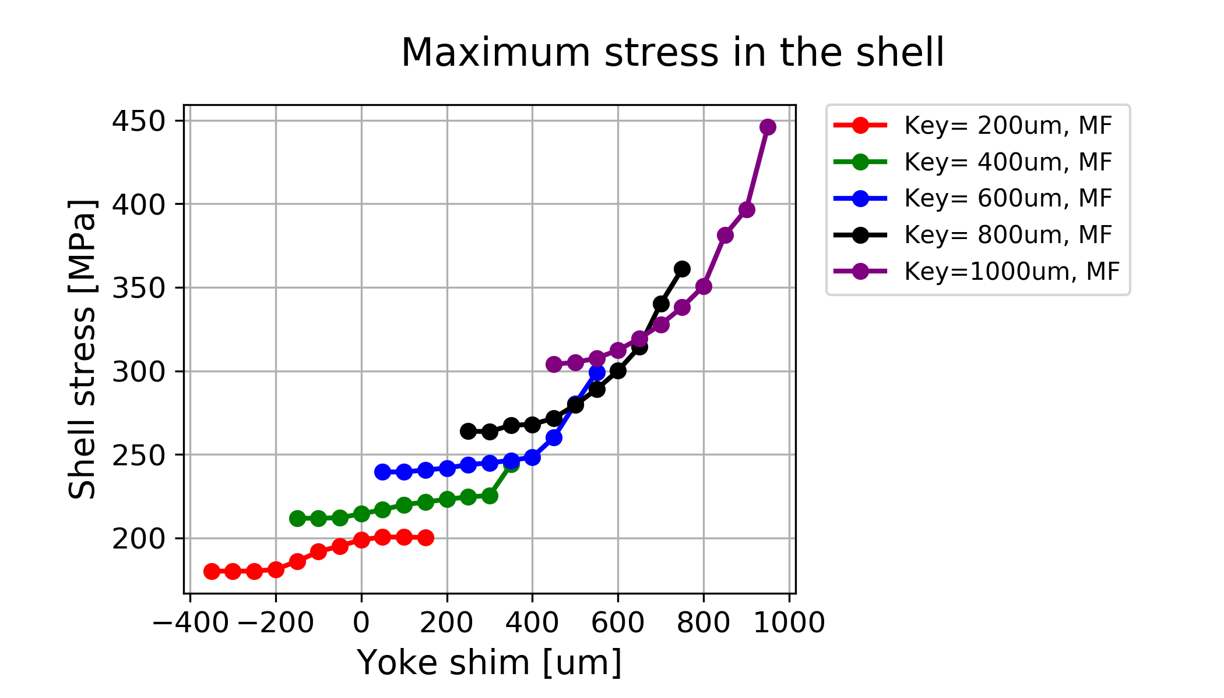
Yoke gap vs shell state
Gap stays open at RT in most of the cases
Max force with yokes open
Coil partially shielded
Cases with gap open with MF
Coil un-loaded
Fully closed with MF

Slide 6
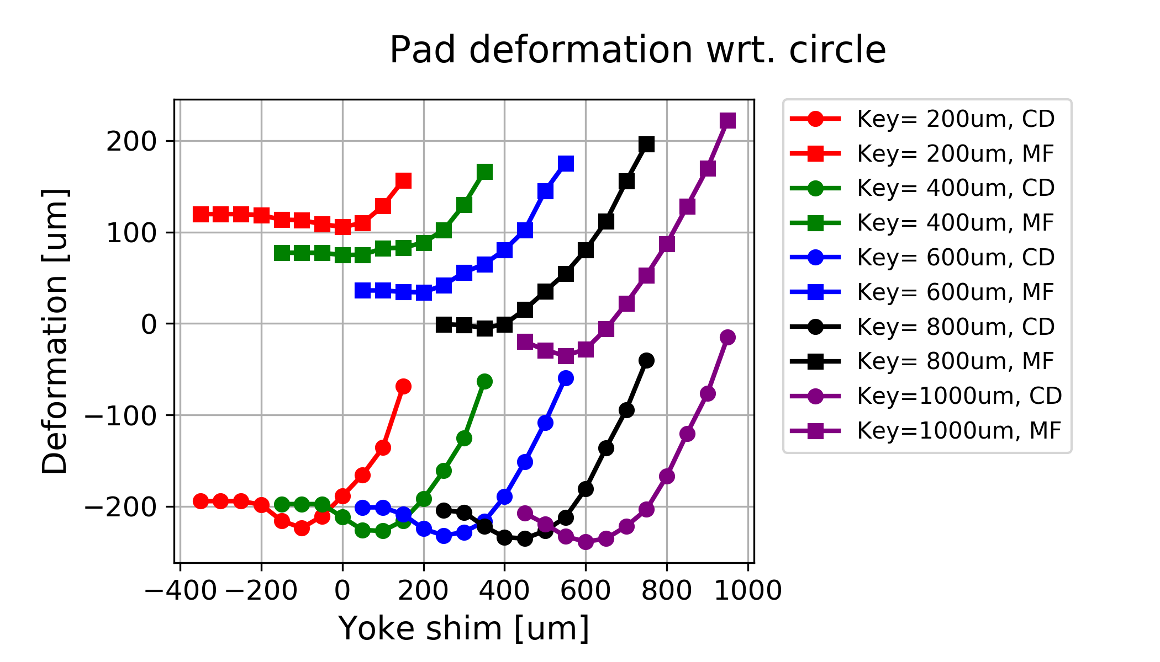
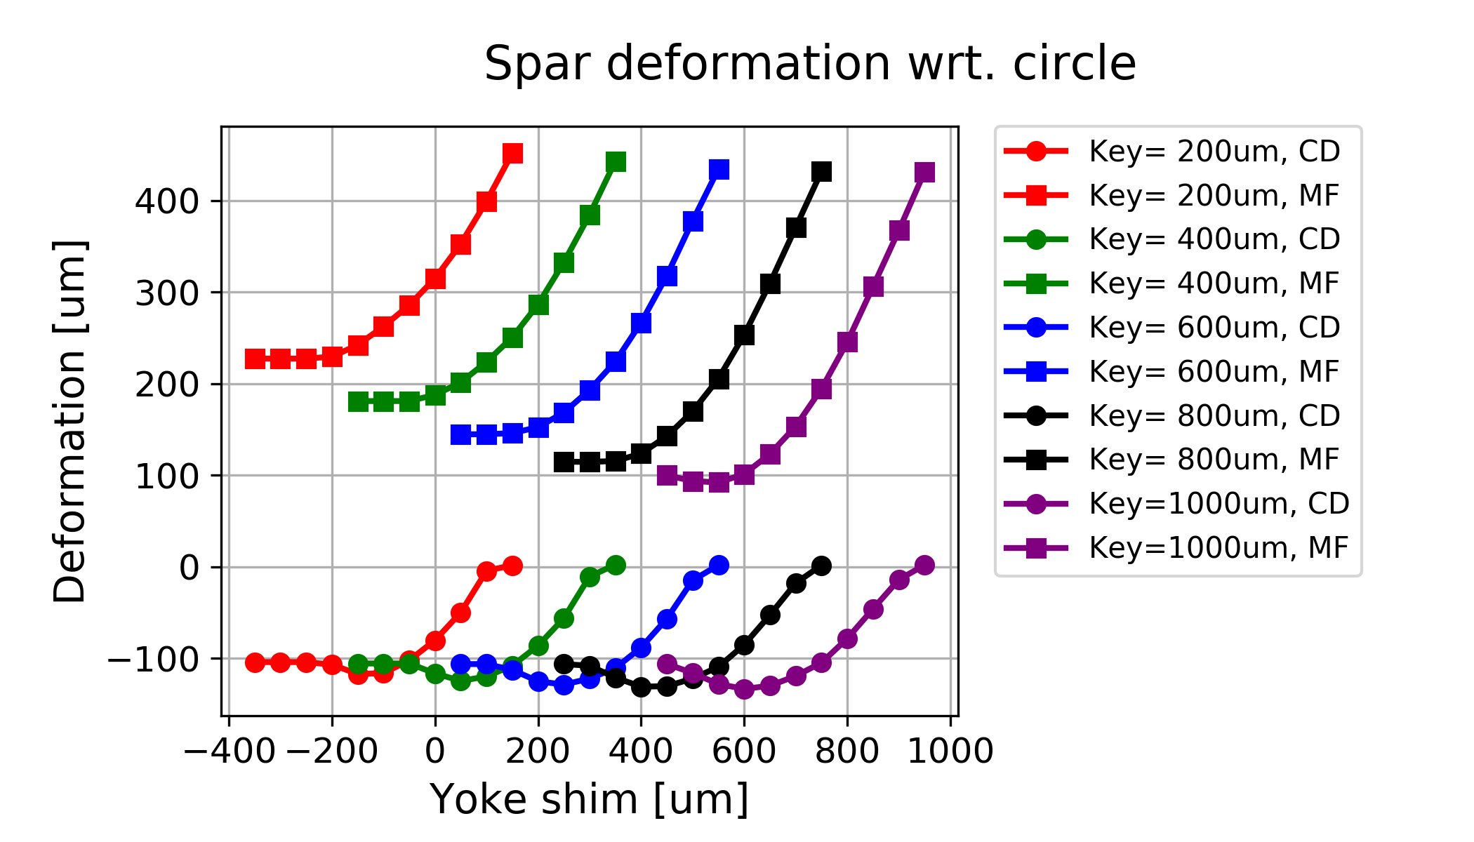
Pad and spar deformation
Spar stress
Deformation
  dU=Ux_{mid-plane} – Uy_{vert-plane}
600um key
Yoke gap open
~500 MPa
Balanced spar deformation
800um key
450um yoke shim
Yoke gap closed
~450 MPa

Slide 7
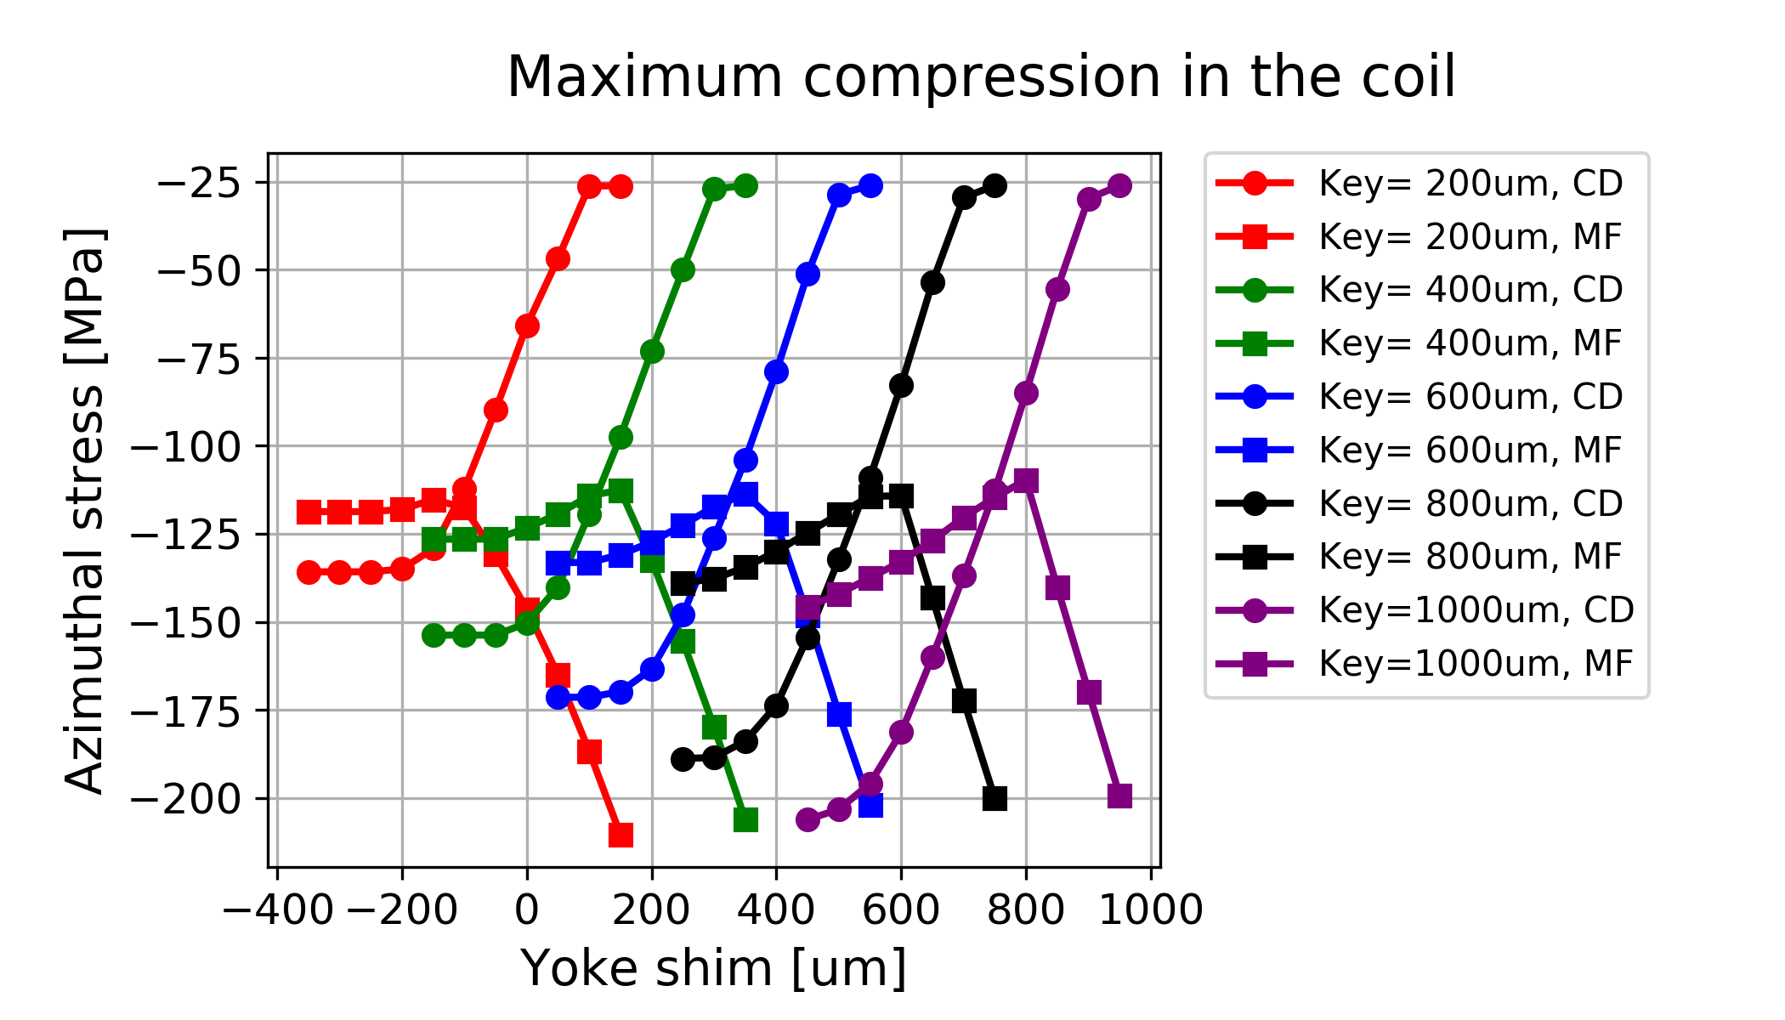
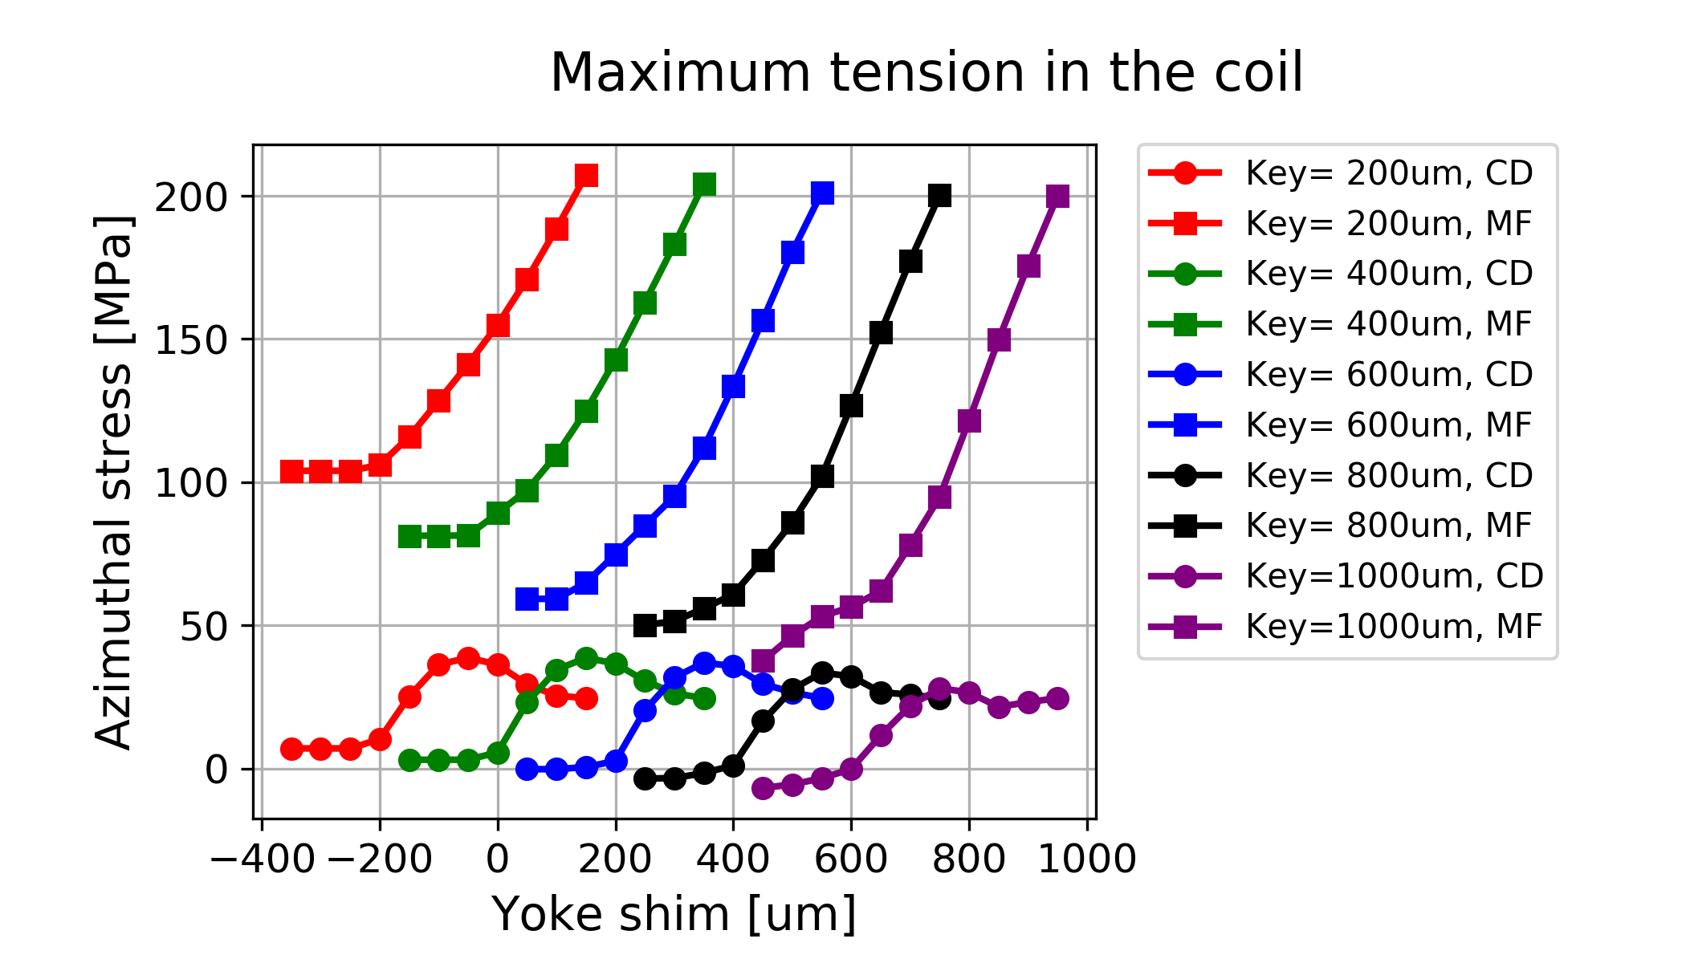
Coil stress
(Spar deformation)
Tension 50-100 MPa
2D model
800 um key
450 um shim
120-130 MPa
Yoke open
170 MPa

Slide 8
Cos-Theta case
Geometry with closed yoke gap
Shell OD 750 mm
Shell TH 60 mm
Bore field 15 T
Closing the yoke gap
  Iron block only for meshing
    Displacement UX=0
  Shim using contact element offset
    Infinite rigidity
    No thermal contraction
No pole cut!!
Titanium (L1&2) and Stainless (L3&4) poles
Aluminum bronze wedges

Slide 9
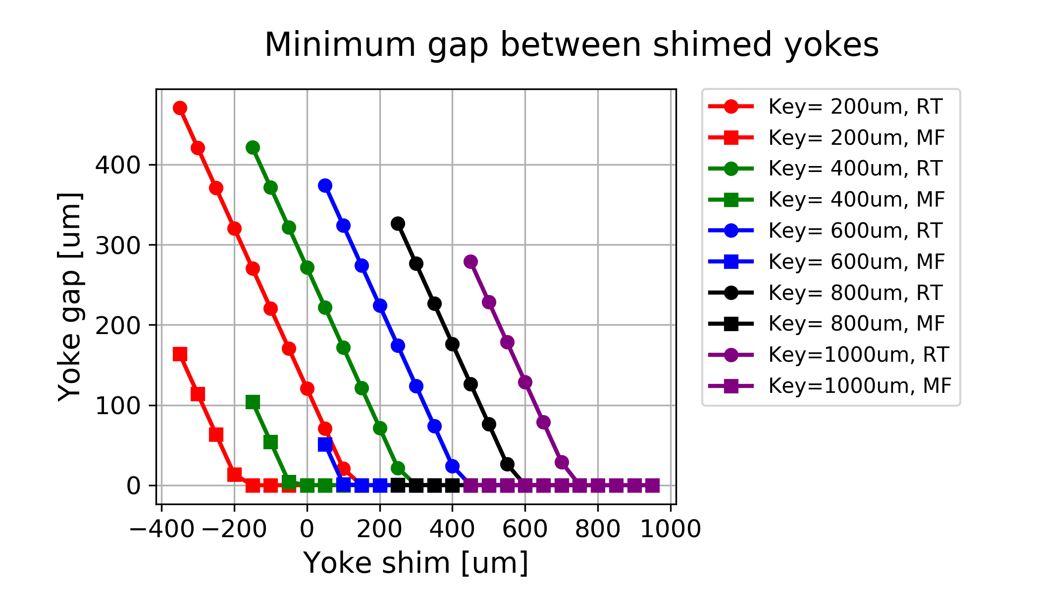
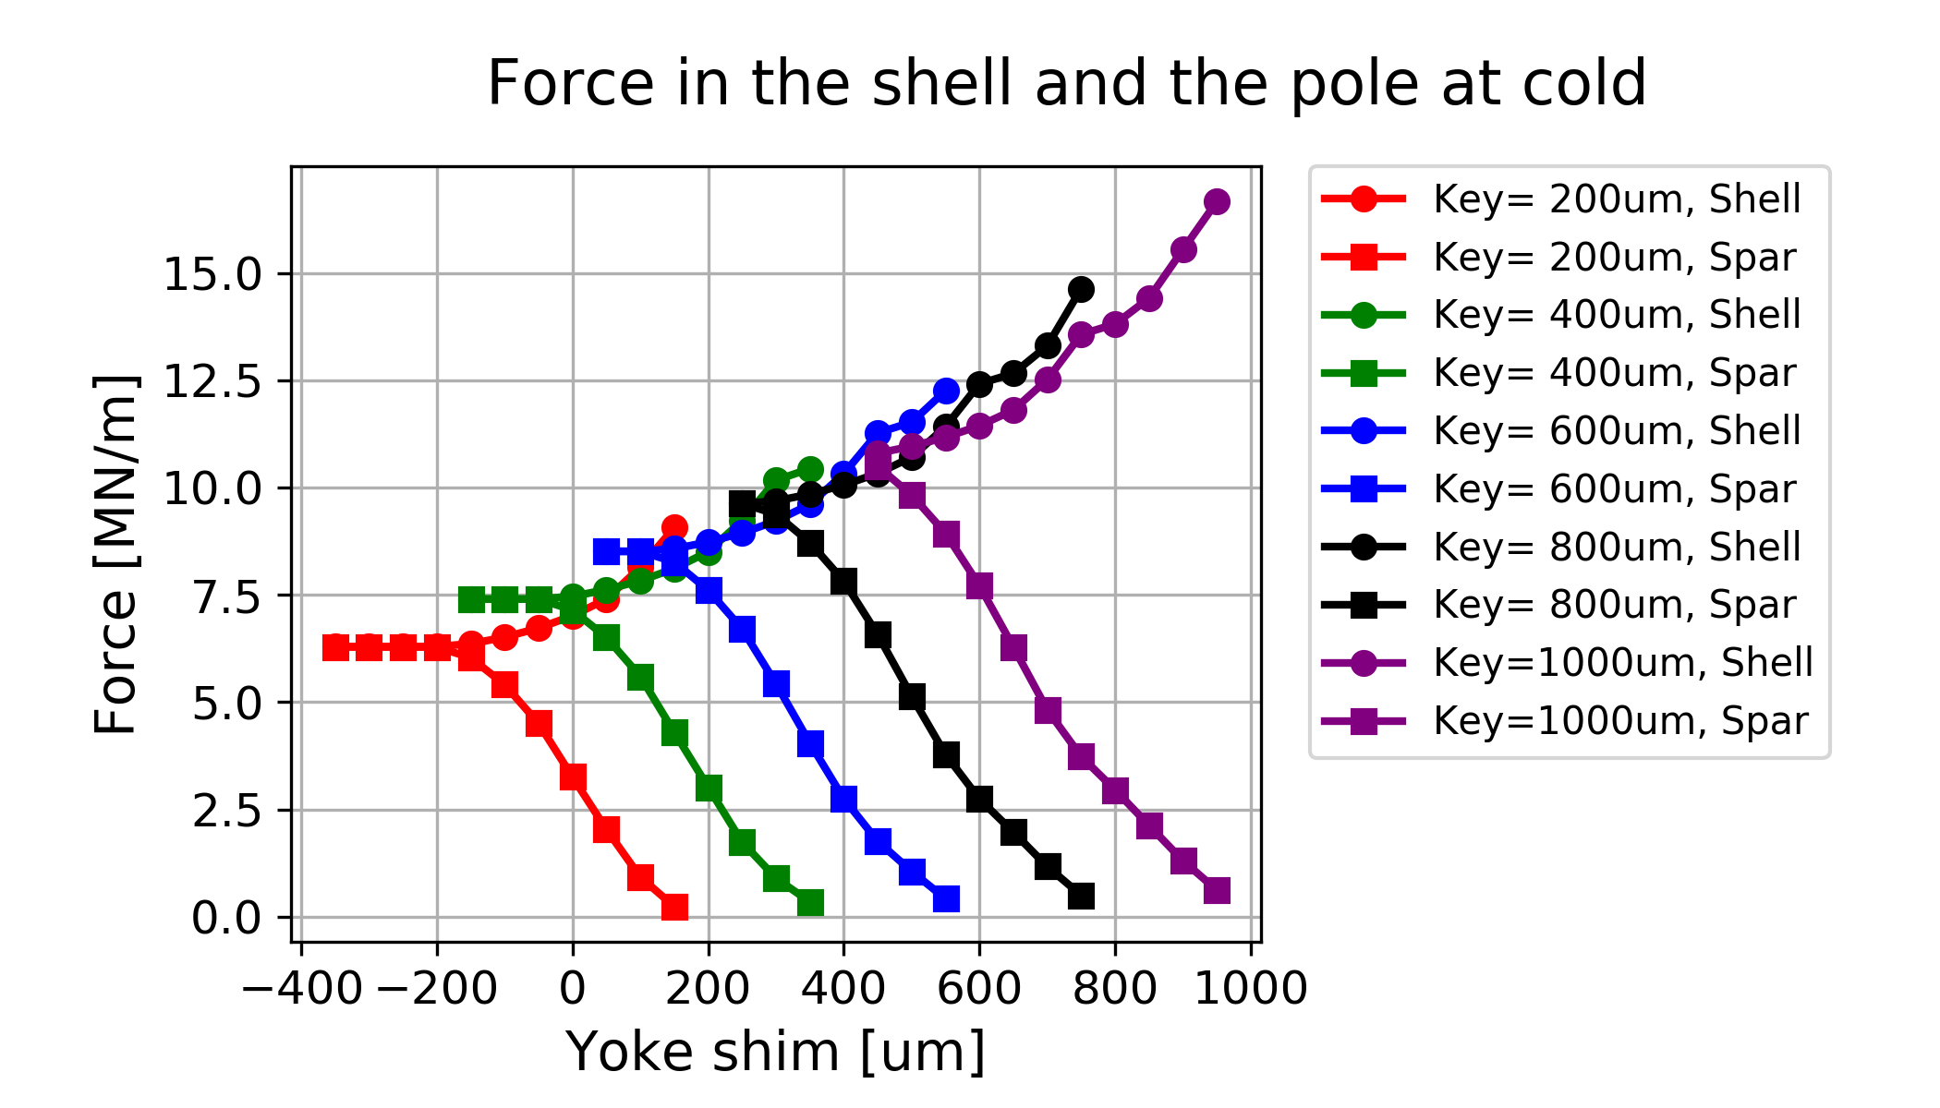
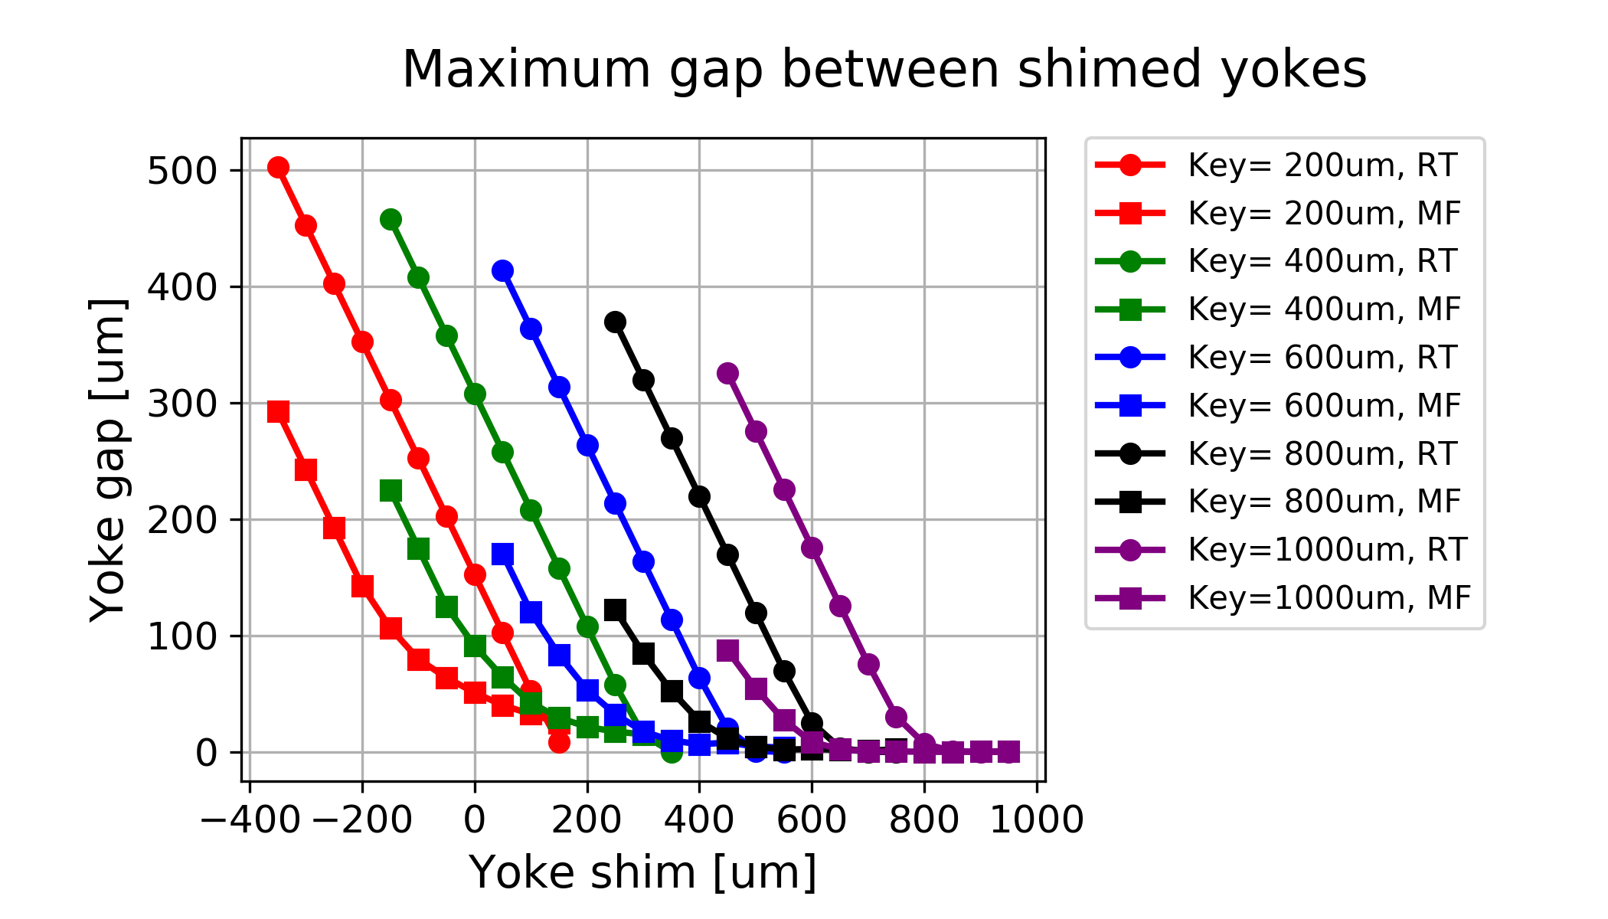
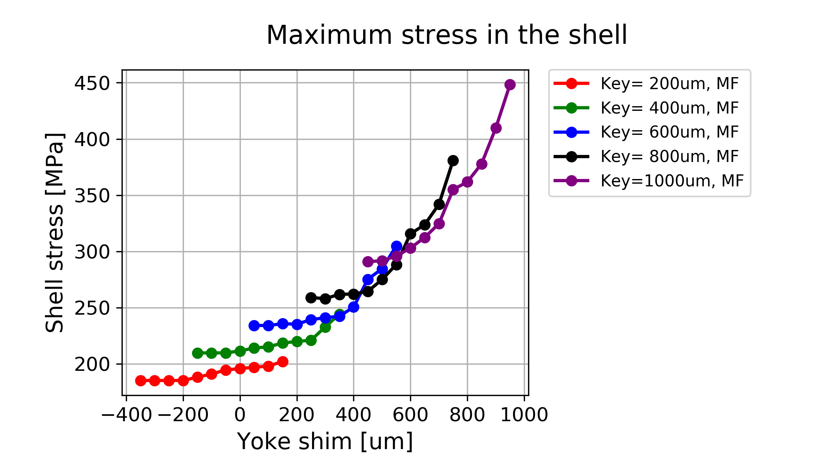
Yoke gap, forces and shell stress

Slide 10
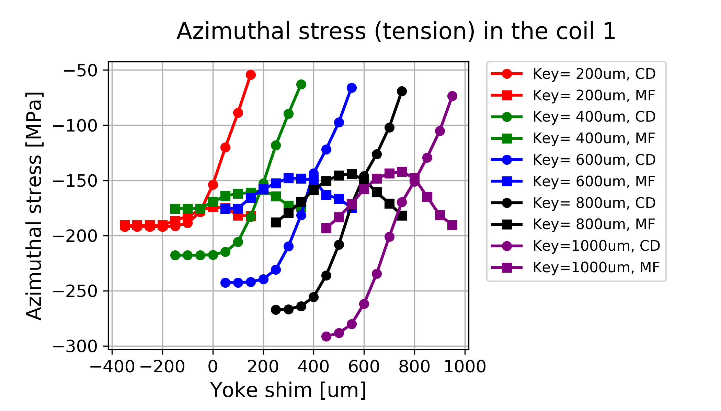
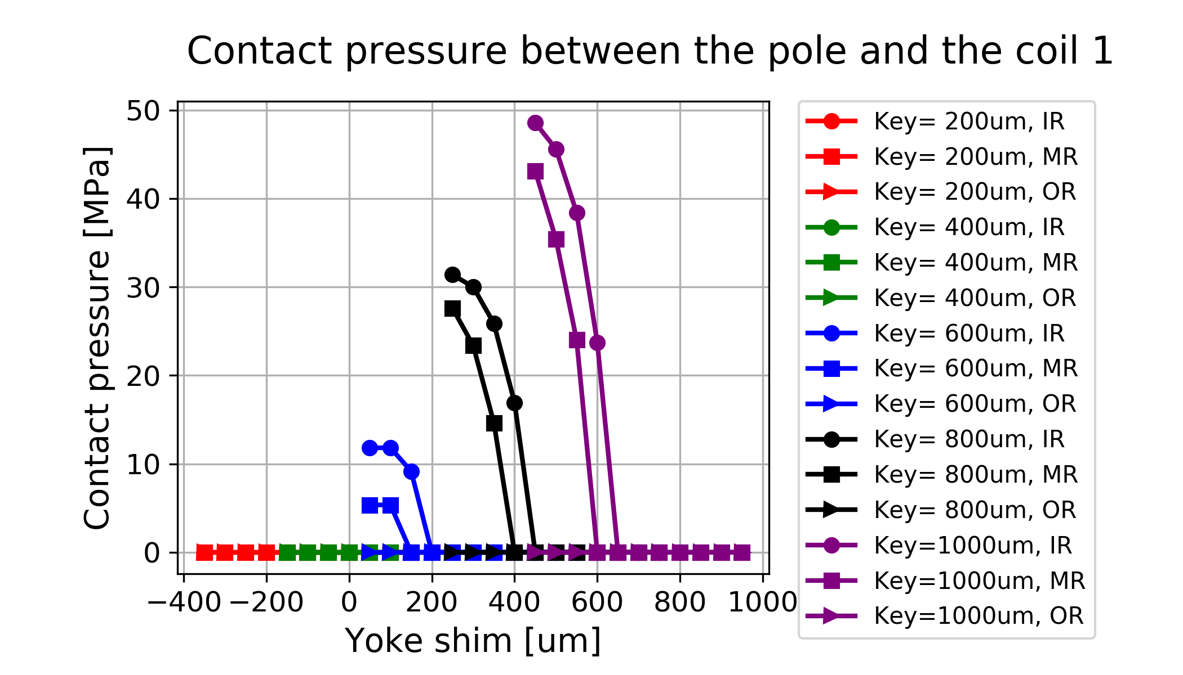
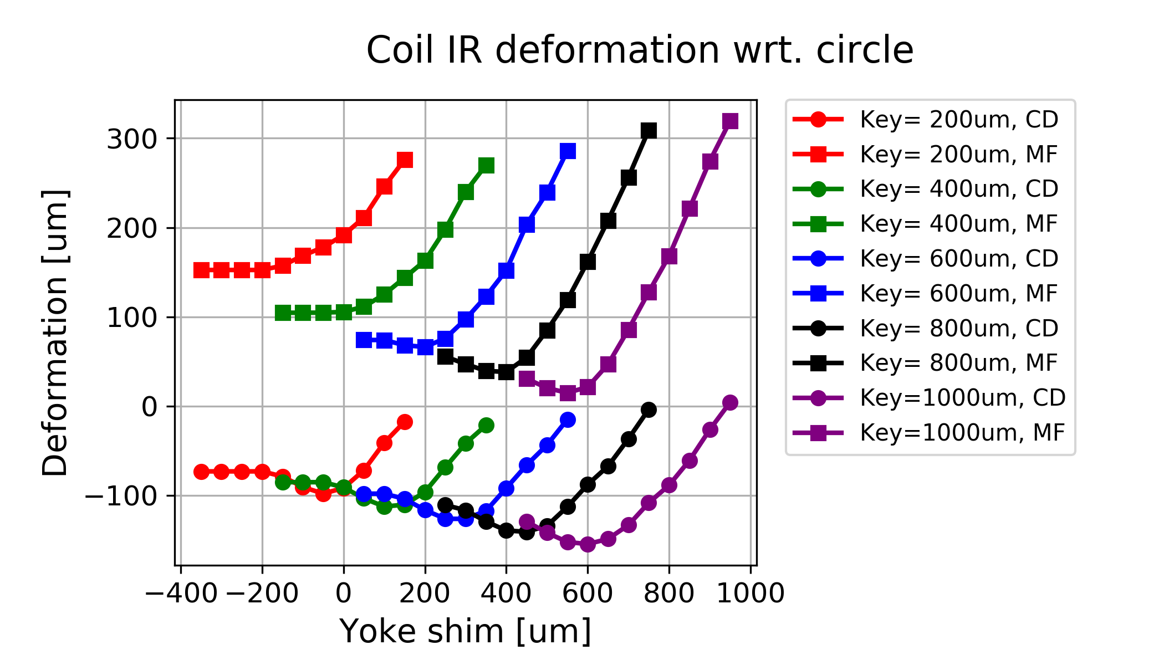
Coil stress, contact and deformation
Contact lost before stress reduced noticeably
Using pole stress relief reduces stress at CB by 20-25 MPa
Peak stress value shown, excluding corners reduces value by ~20 MPa more at CD

Slide 11
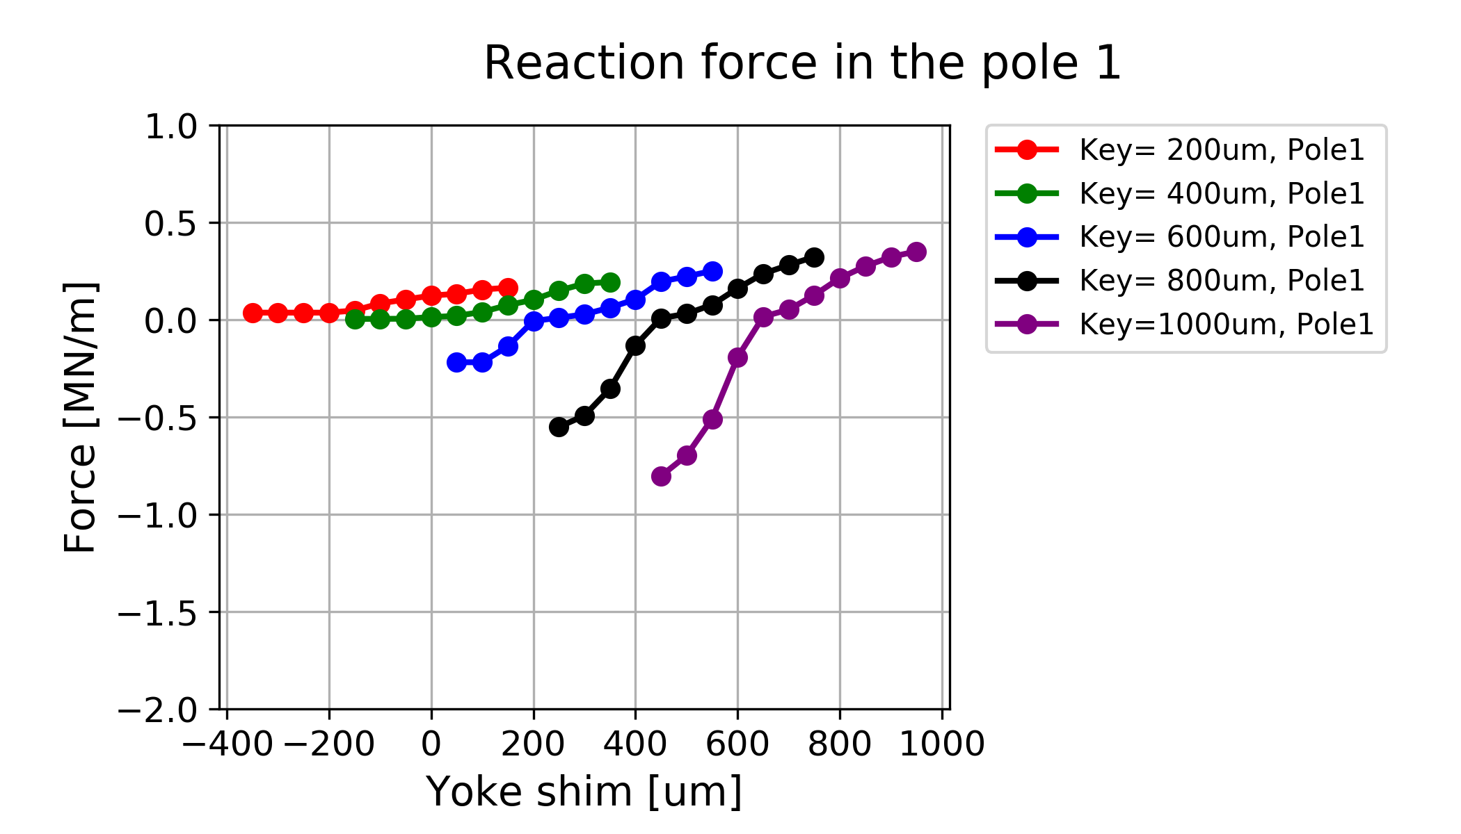
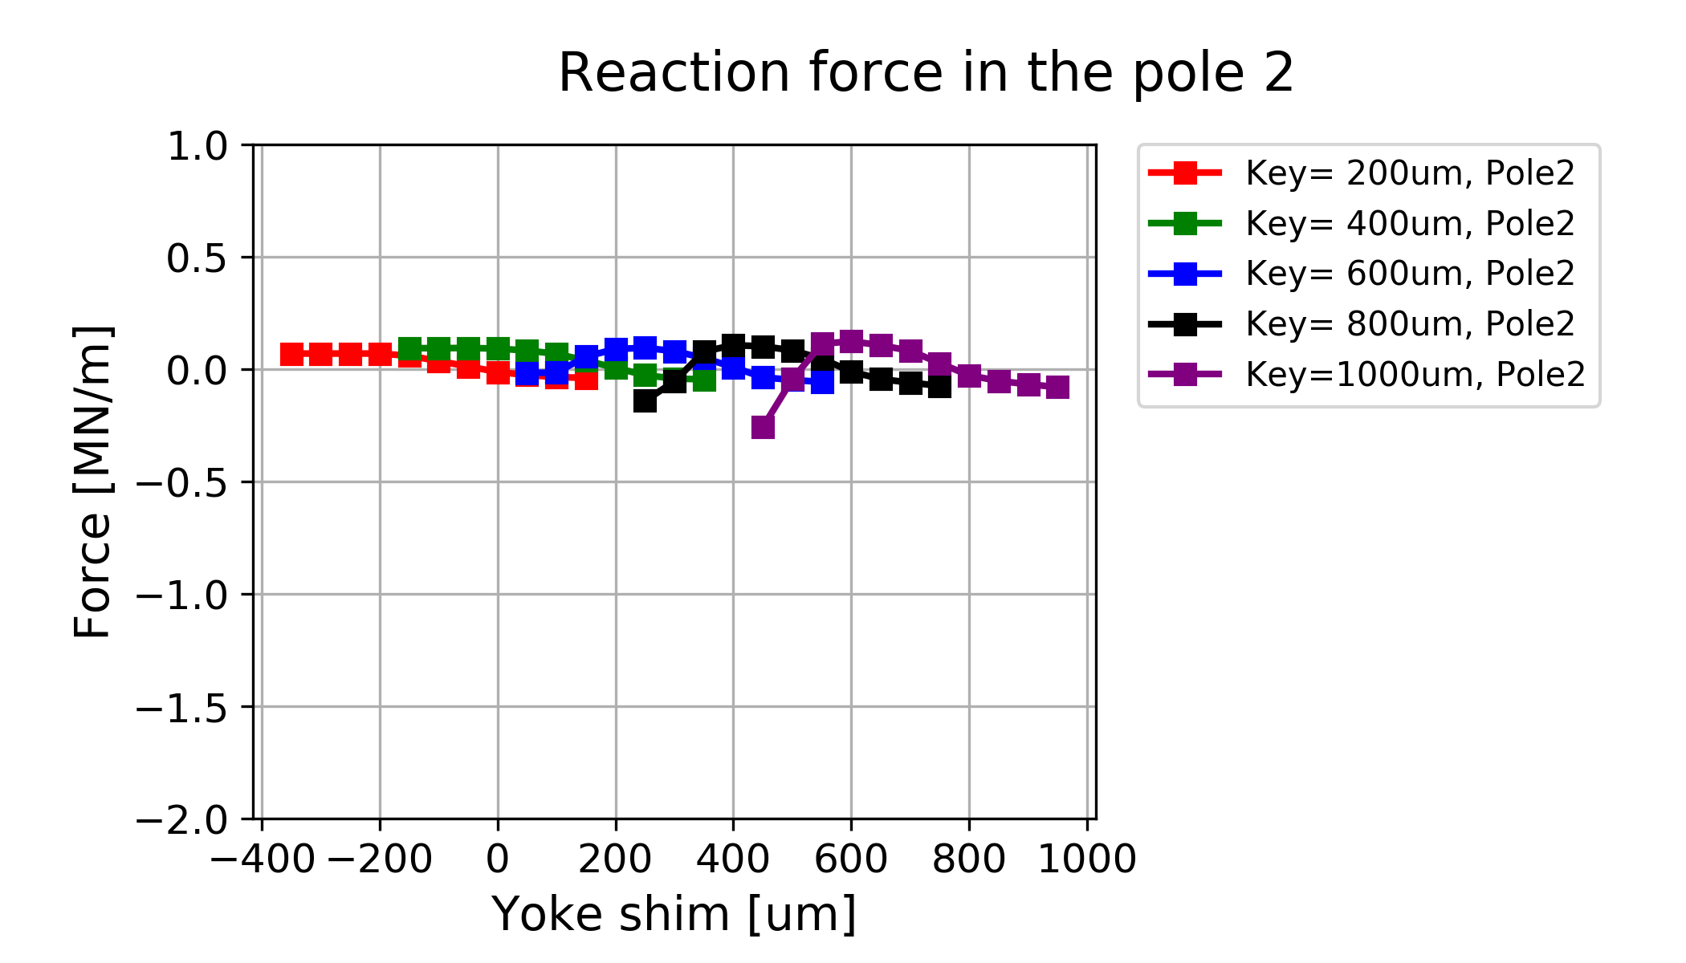
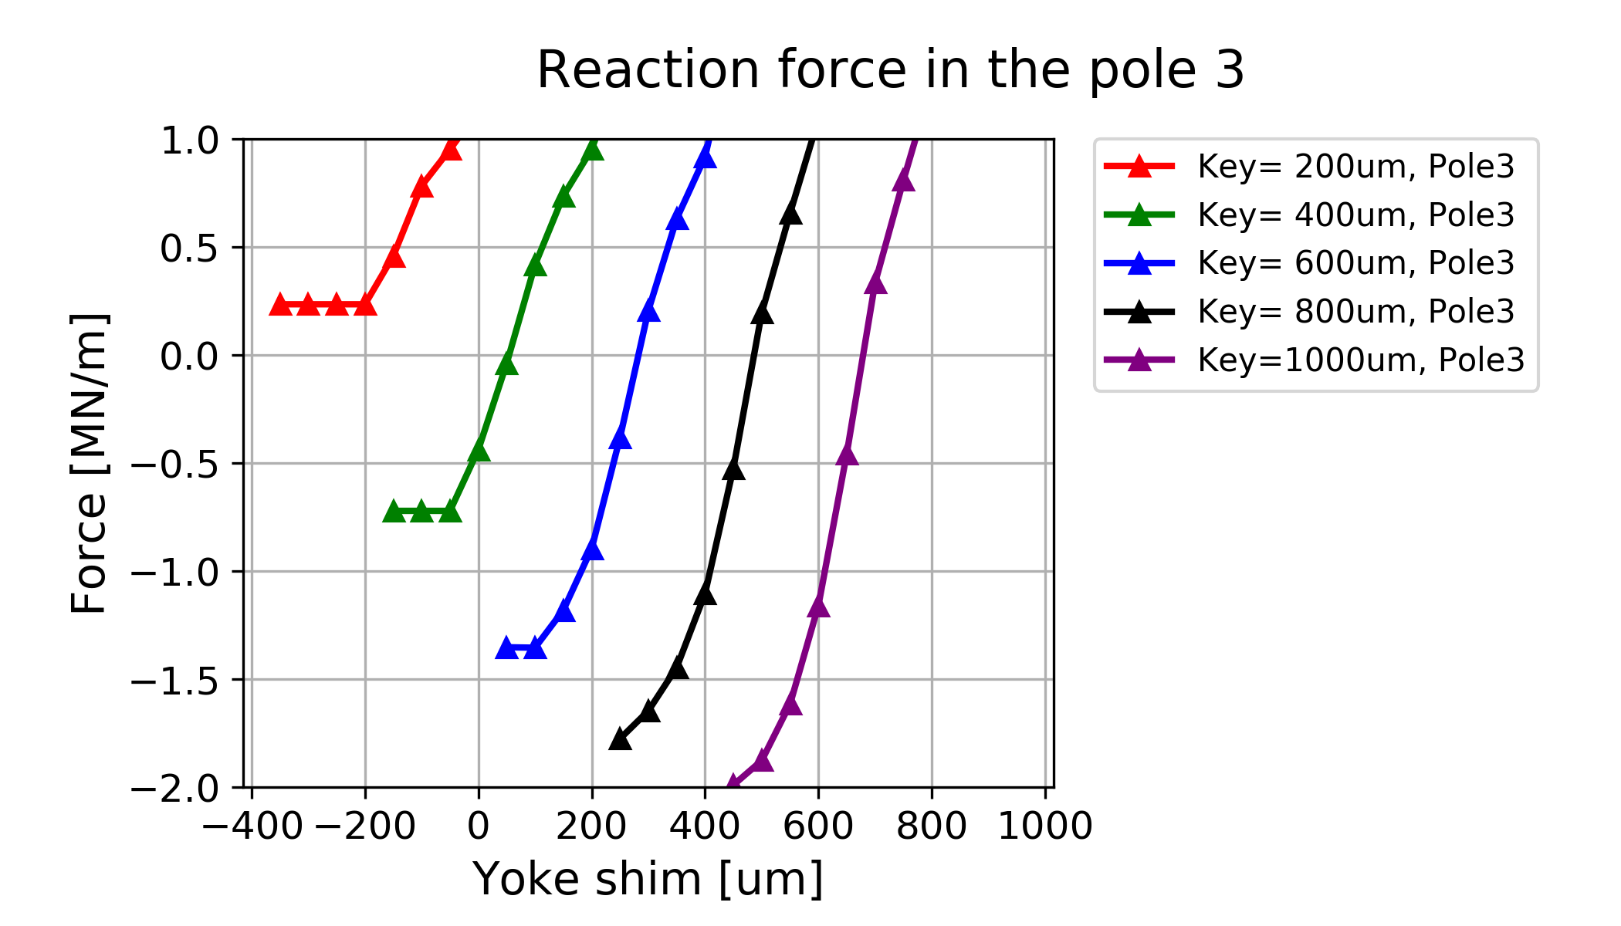
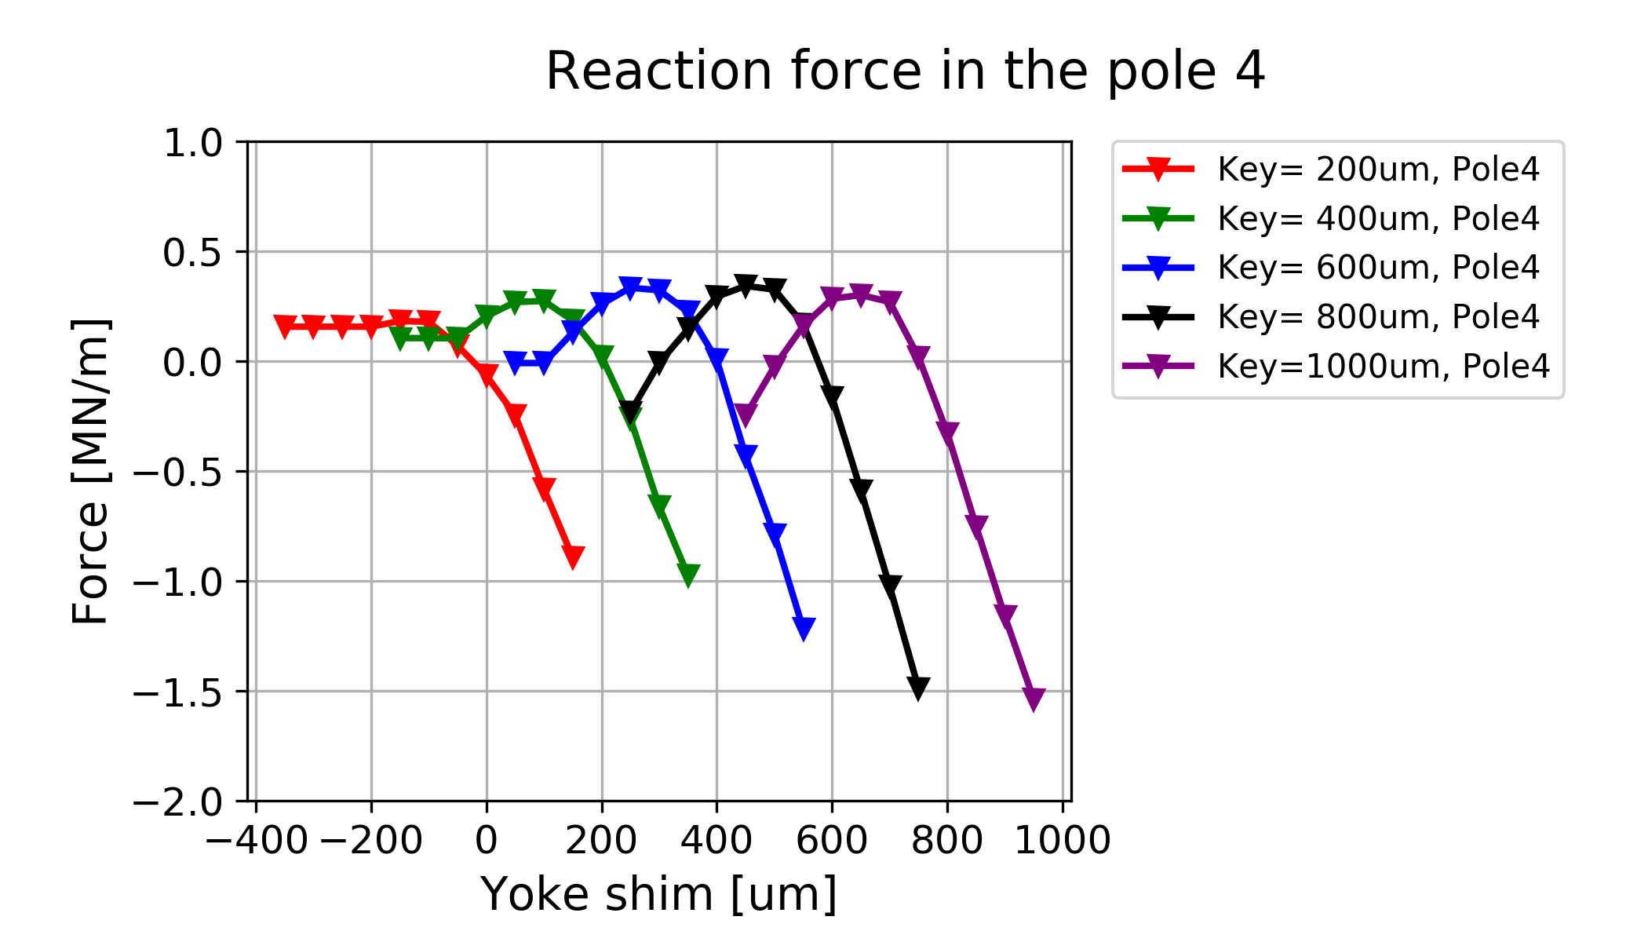
Reaction force in the pole

Slide 12
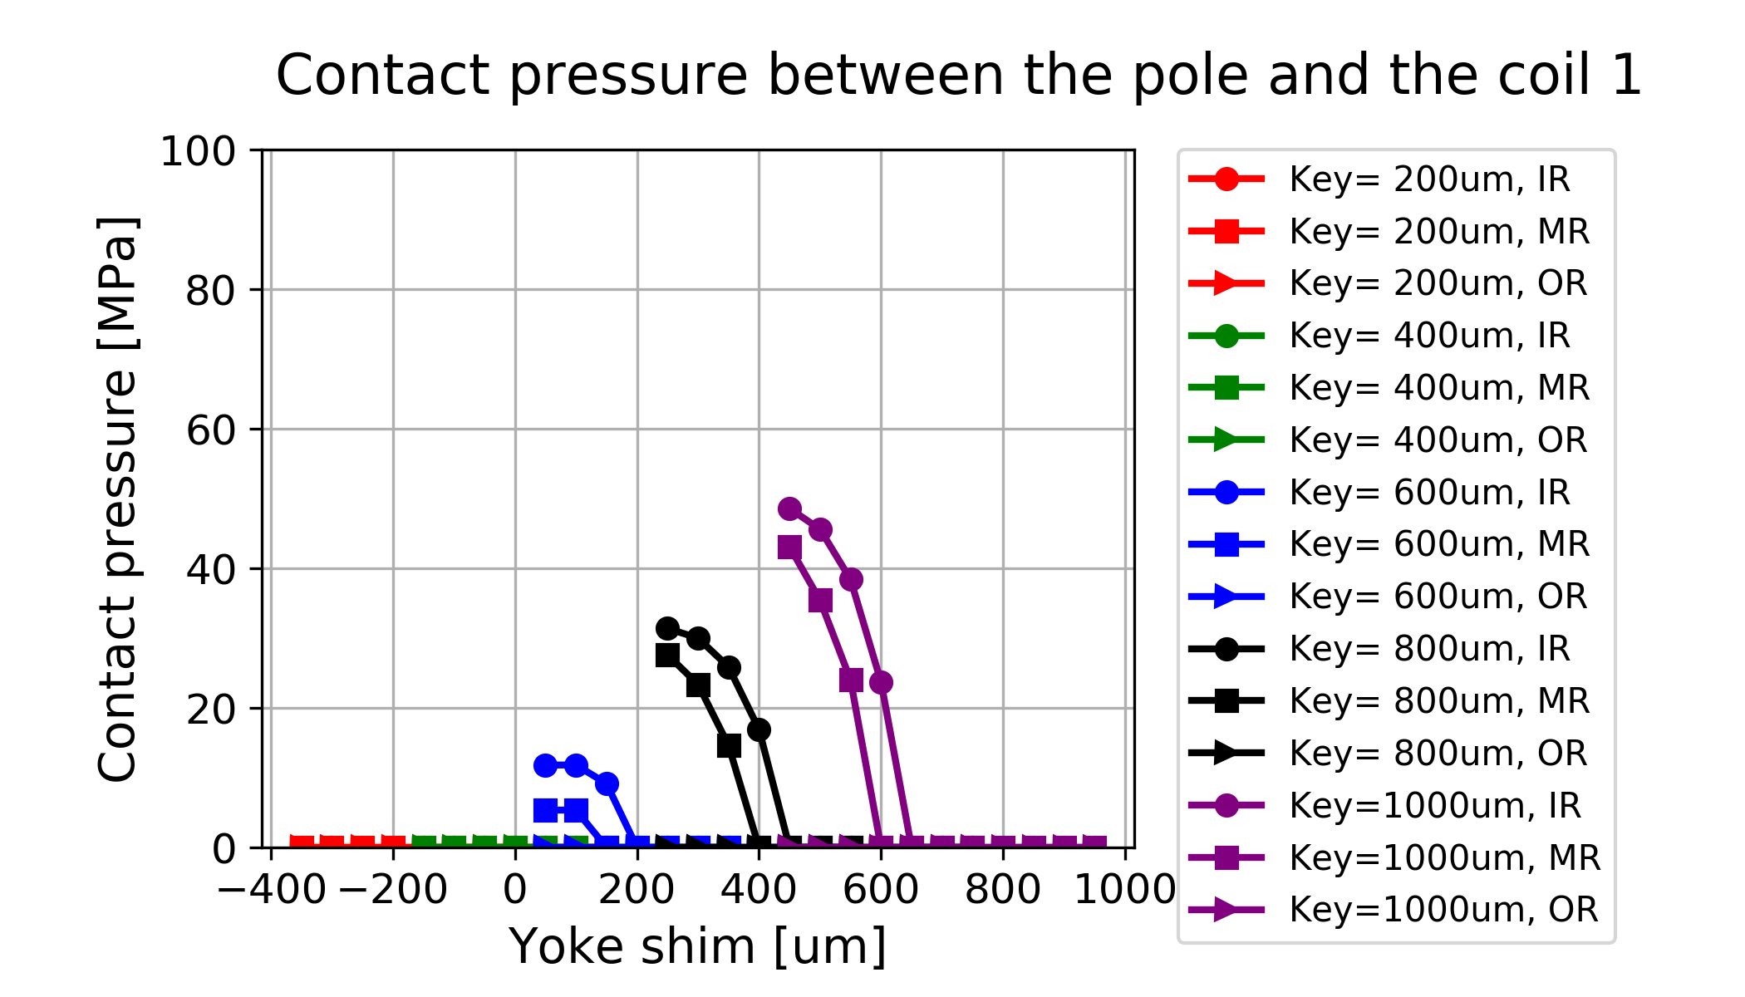
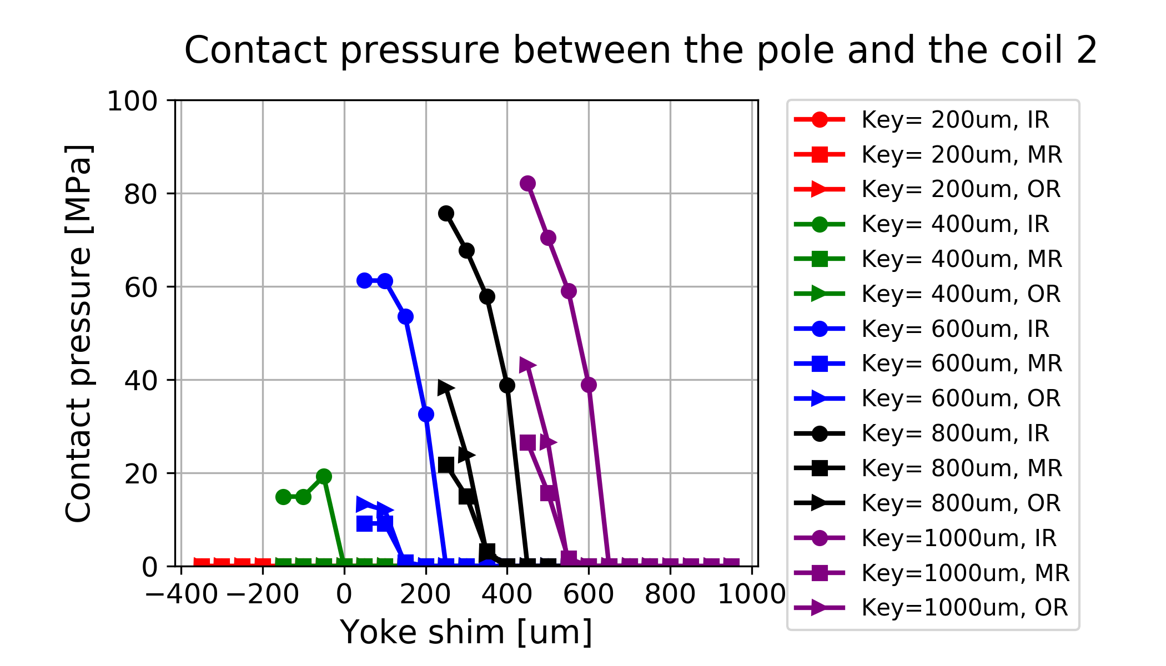
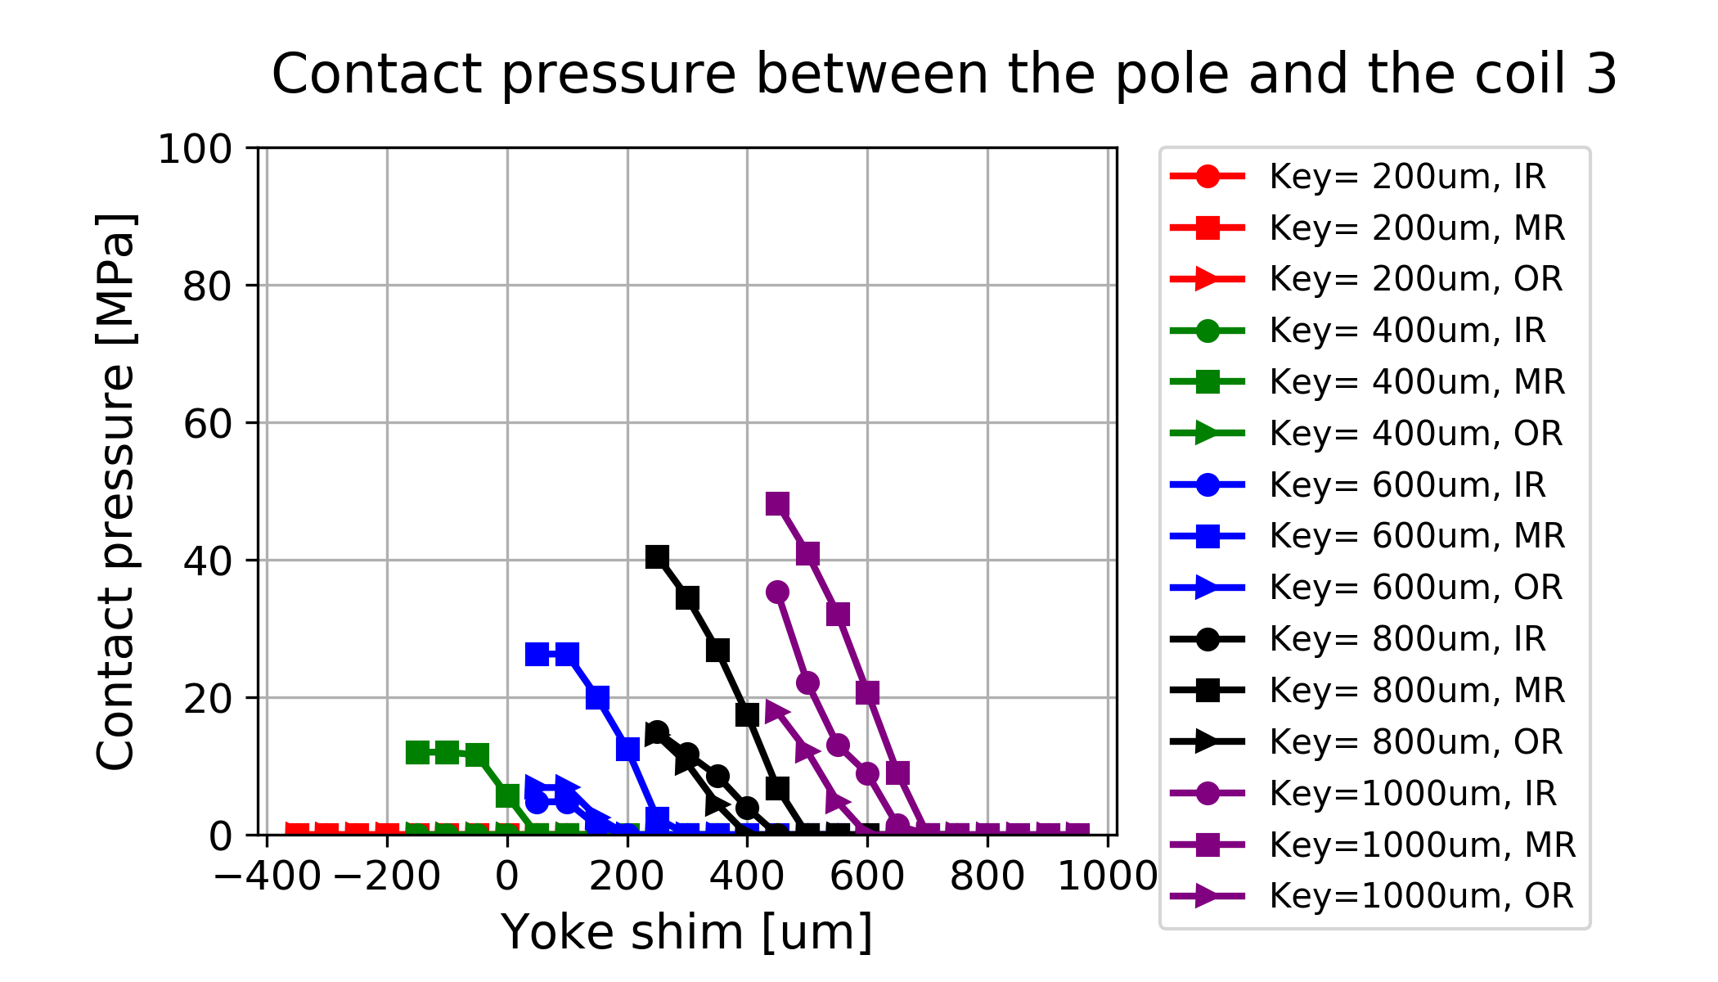
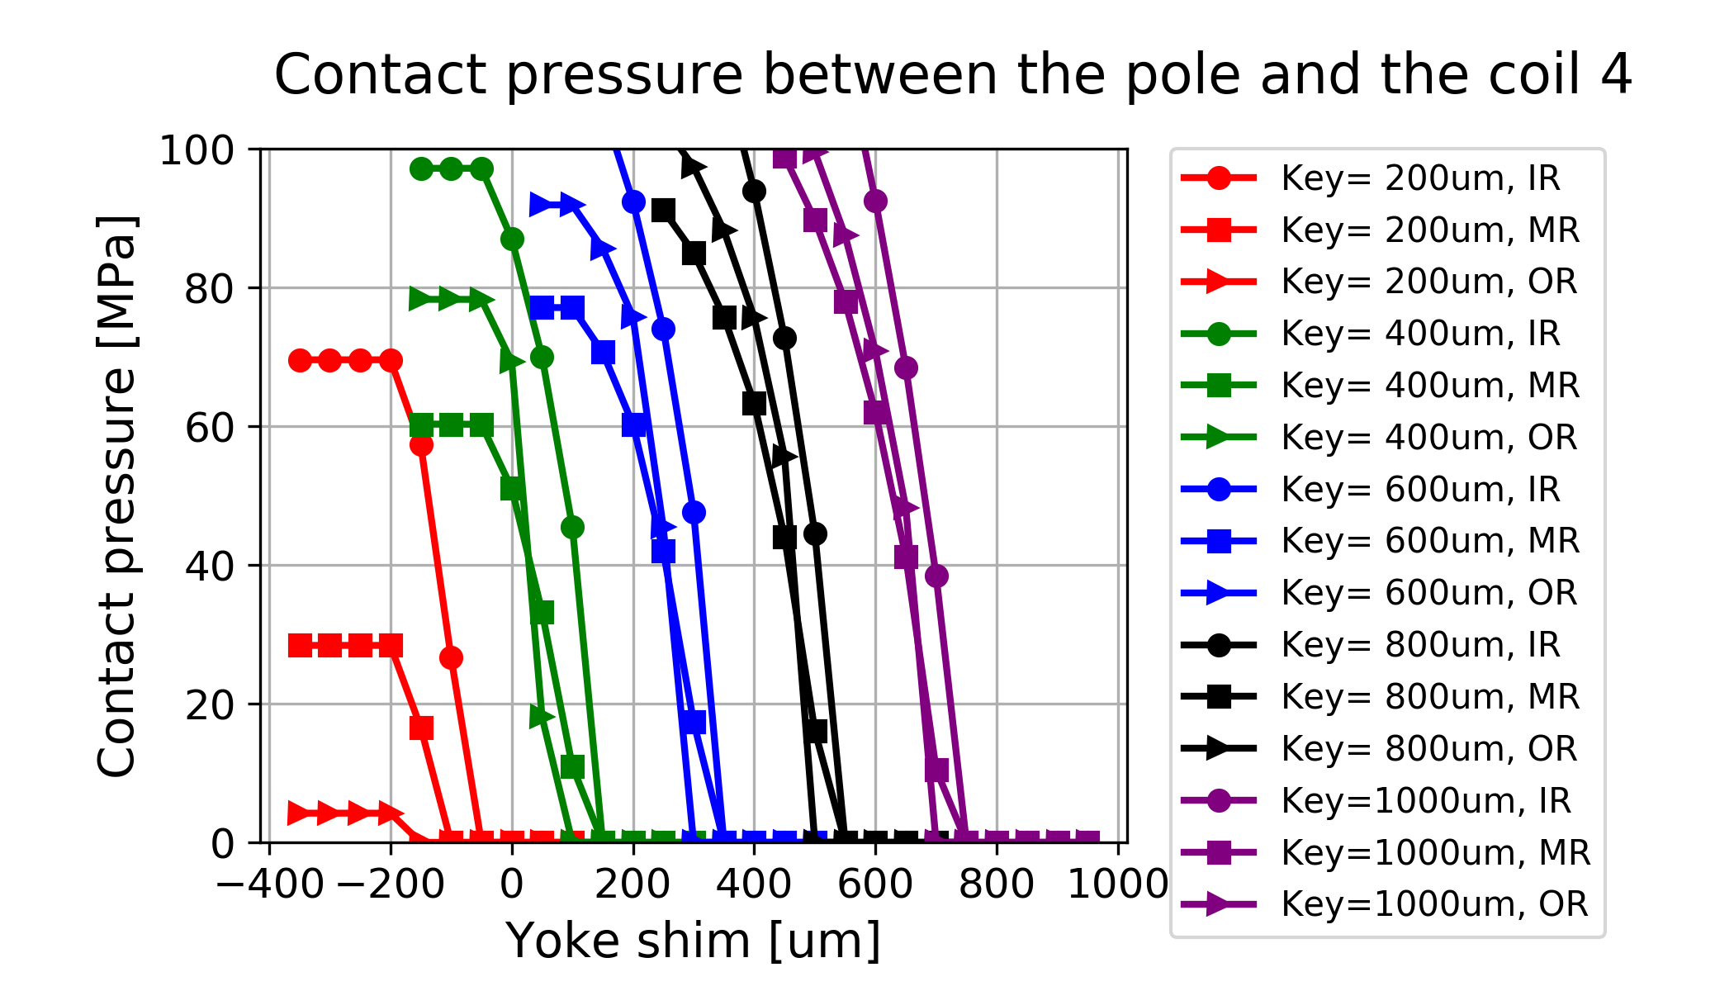
Contact pressure between pole-turn and the pole

Slide 13
Detailed values
(pole stress relief included)
Hor. Key [um] | Yoke shim [um] | σ_{max} CD [MPa] | σ_{max} MF [MPa] | P_{cont} MR [MPa]
700 | 0 | 238 | 224 | 17
 | 300 | 238 | 224 | 17
 | 350 | 229 | 208 | 7
 | 400 | 209 | 192 | 0
750 | 0 | 244 | 226 | 22
 | 350 | 244 | 222 | 21
 | 400 | 231 | 204 | 8
 | 450 | 210 | 189 | 0
800 | 0 | 250 | 227 | 27
 | 400 | 249 | 219 | 25
 | 450 | 232 | 201 | 8
 | 500 | 211 | 187 | 0

Slide 14
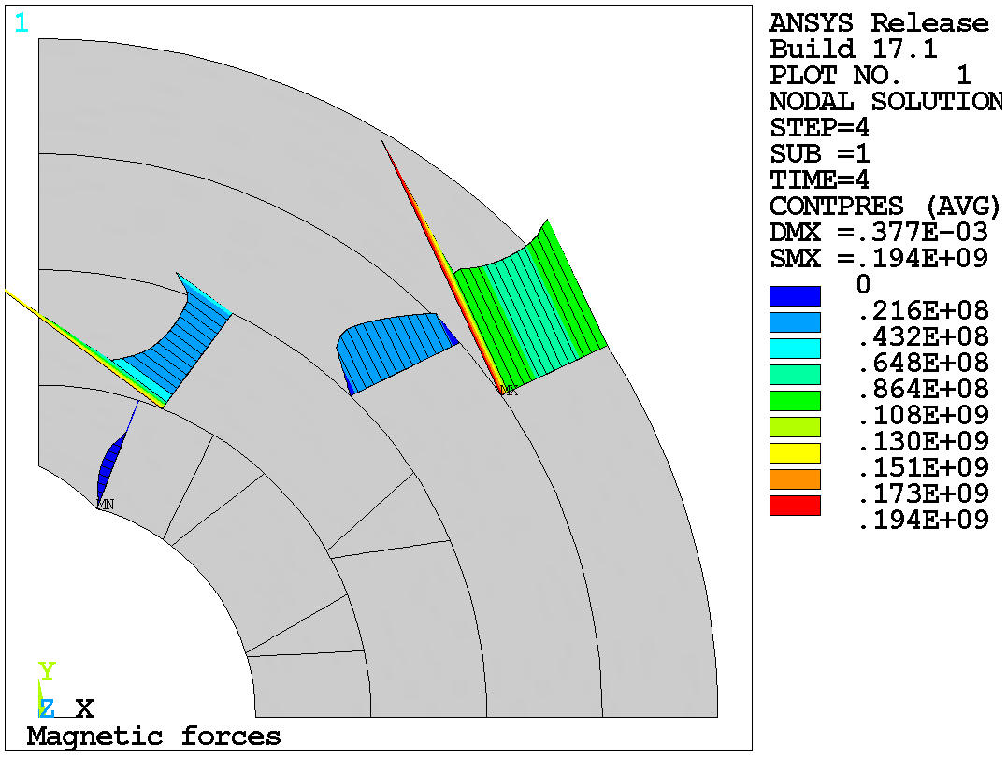
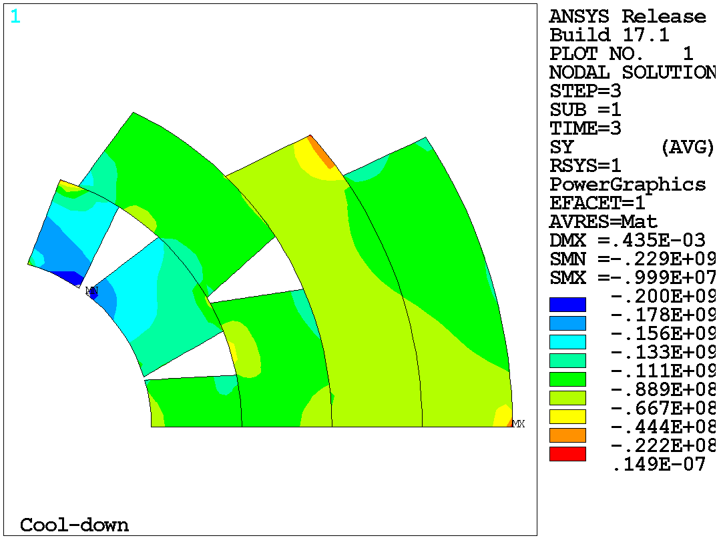
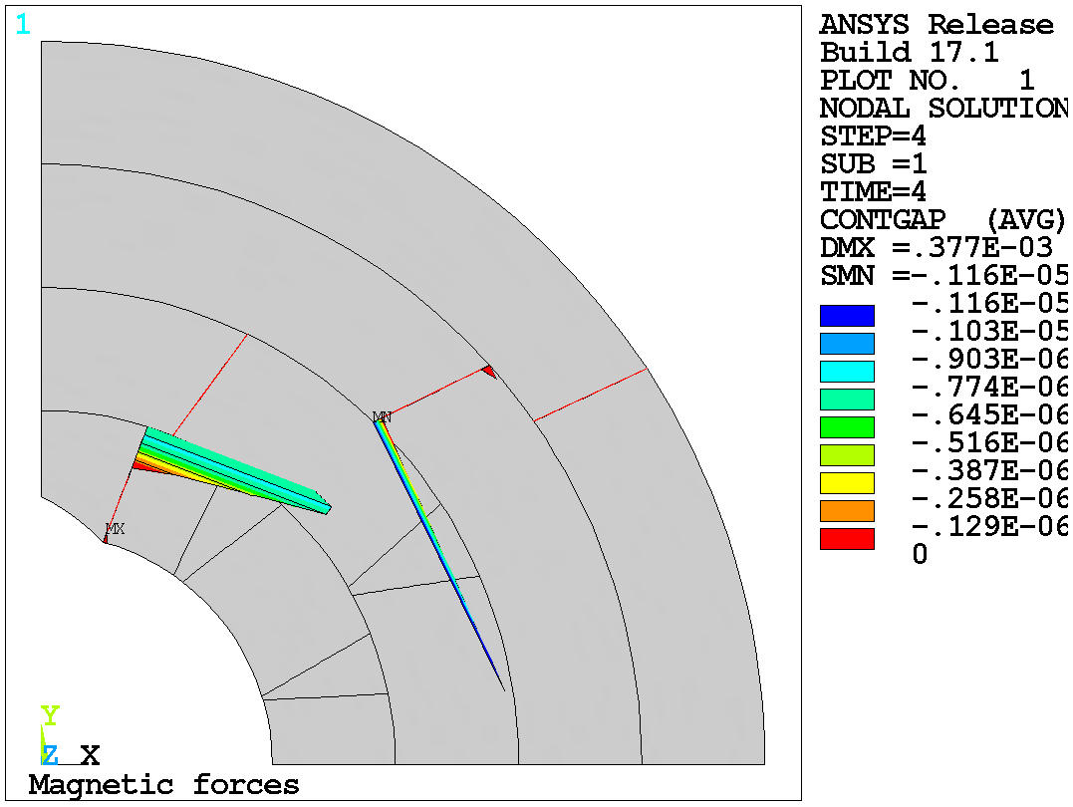
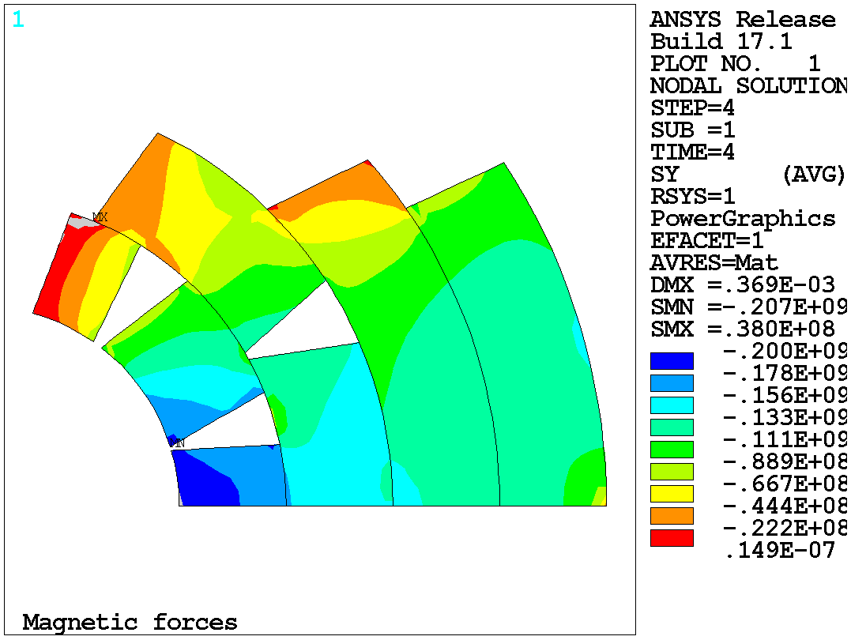
Coil stress and contact with yokes closed (optimal case)
Pole 1 in contact
4.3 K
~1 um gap
15 T

Slide 15
Conclusions
Current 4-layer cos-theta design
  Difficult to preload layer 1 & 2 due to force intercepted by 3 & 4
  Due to low radial rigidity, preload governed by azimuthal compression
  Limiting deformation prevents sufficient preload to applied to 1st layer
  Closing the yoke gap
    Fine tune-tuning, 10-15 MPa stress reduction
    High pre-load sensitivity
    Limited advantages in bladder and keys structure (without dedicated shimming? L1&2 mid-plane?)
CCT
  CCT spars and SM structures increases radial rigidity of the coil system
  Azimuthal compression role is less significant (CCT?)
  Closing the yoke gap
    Coil stress decrease up to 50 MPa
    Possible to decrease spar stress by 50 MPa (in presented geometry)

