Slide 1

Multiphysics modeling for REBCO CORC cables based on T-A formulation
S. Viarengo^{1,2}, P. Ferracin², Laura Savoldi¹, Fabio Freschi¹, X. Wang², L. Brouwer²
¹Politecnico di Torino, Torino, Italy
²Lawrence Berkeley National Lab, Berkeley, CA
MDP Collaboration Meeting, Virtual, 5/17/2022

Slide 2
Outline
Framework
Activity objective
Tape modeling
REBCO design
Critical current density evaluation
Mathematical model
Model setup, geometry and mesh
Results
CORC modeling
VPI test in LBL
Cable design
2D model
Full 3D model ongoing
Next steps
References

Slide 3
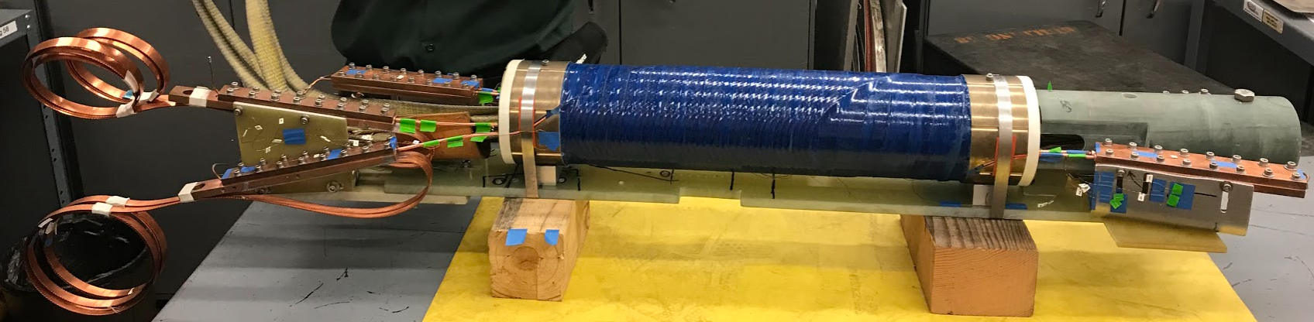
Framework
REBCO CORC cable for CCT application
[Status of CORC® cables and wires for use in highfield magnets and power systems a decade after their introduction, D.C. Van der Laan et al, 2019]
C2 wire layout
(Courtesy of LBL)

Slide 4
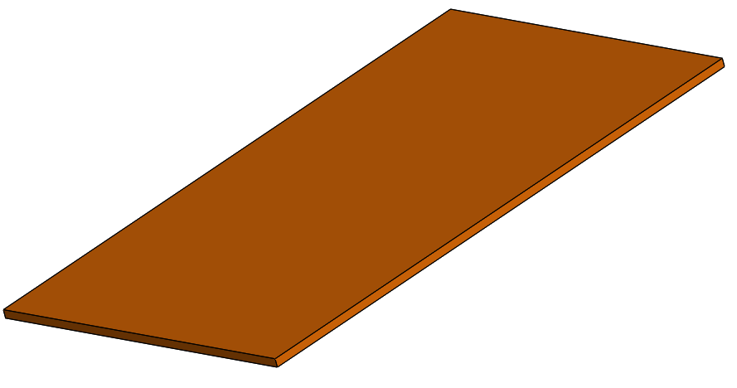
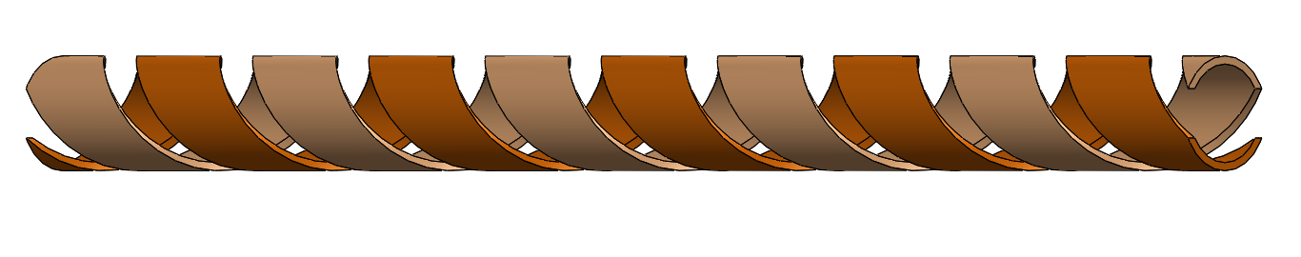
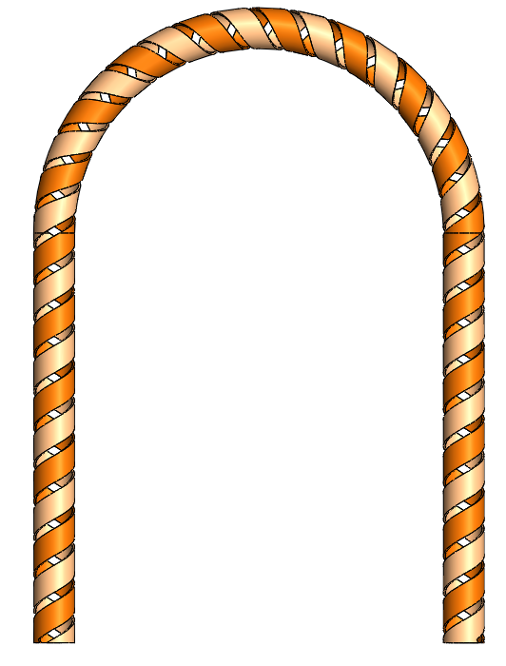
Activity objective: multi-scale approach
Jc characterization of a homogenous material for the single tape
Validation on a straigth Conductor on Round Core Cable (CORC)
Validation on a bended CORC
Scaling up to the CCT: development of an equivalent model based on AI?

Slide 5
Tape modeling

Slide 6
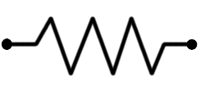
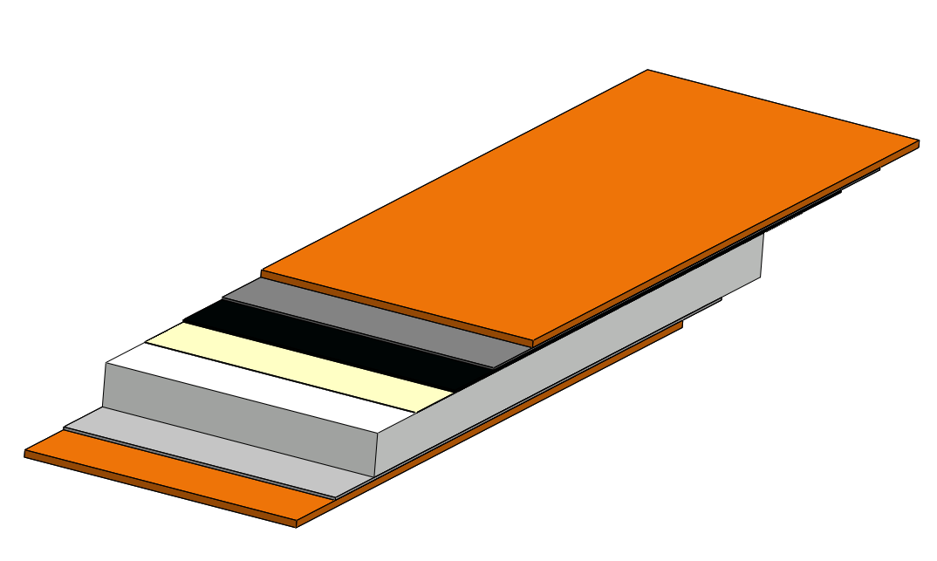
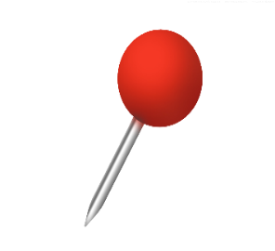
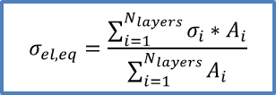


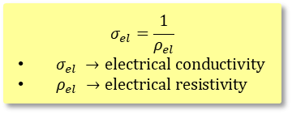

REBCO Tape design
SCS-4050 by SuperPower 2008
Power Law
Copper stabilizer
20 μm
R_{cu}
Silver layer
1.6 μm
i_{cu}
$$ρ_{el,YBCO}=\frac{E_{0}}{J_{c}}{\left(\frac{\left|J\right|}{J_{c}}\right)}^{n−1}$$
REBCO
1.6 μm
Buffer zone
0.4 μm
i_{silver}
R_{silver}
95.2 μm
Substrate
50 μm
i_{YBCO}
R_{YBCO}
2.2 mm
i
$$σ_{el, eq}=\frac{\sum_{i=1}^{N_{layers}}{σ_{i}∗A_{i}}}{\sum_{i=1}^{N_{layers}}{A_{i}}}$$
R_{substrate}
i_{sub}
$λ→thermal conductivit$y
$ρ→$ density
$c_{p} →specific heat$
$A →cross section$
Thermal-physical properties as function of temperature θ and RRR
λ, ρ weigthed on the cross section and c_{p} on the mass
R_{silver}
i_{silver}
i_{cu}
R_{cu}
$$σ_{el}=\frac{1}{ρ_{el}}$$
$σ_{el} →electrical conductivity$
$ρ_{el} →electrical resistivity$
[Two-Dimensional Anisotropic Model of YBCO Coated Conductors, Casali et. al, 2015]
[In-Field Electrical Resistance at 4.2 K of REBCO Splices, J. Fleiter and A. Ballarino, et. al, 2017]

Slide 7
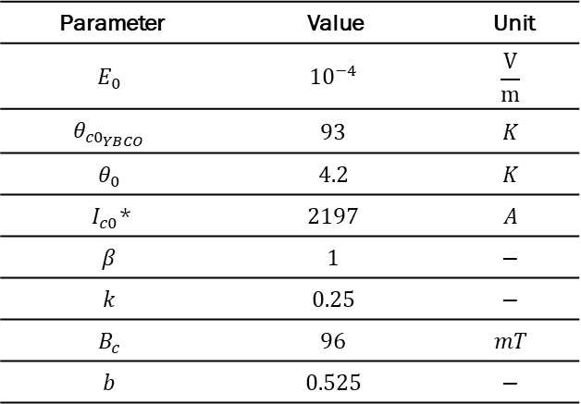
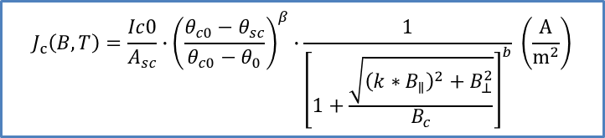

Critical current density
$$J_{c}\left(B,T\right)=\frac{Ic0}{A_{sc}}∙{\left(\frac{θ_{c0}−θ_{sc}}{θ_{c0}−θ_{0}}\right)}^{β}∙\frac{1}{{\left[1+\frac{\sqrt{{\left(k∗B_{∥}\right)}^{2}+B_{⊥}^{2}}}{B_{c}}\right]}^{b}} \left(\frac{A}{m^{2}}\right)$$
[Self-Consistent Modeling of the Ic of HTS Devices: How Accurate do Models Really Need to Be?, Grilli et. al, 2014]
Parameter | Value | Unit
$$E_{0}$$ | $${10}^{−4}$$ | $$\frac{V}{m}$$
$$θ_{{c0}_{YBCO}}$$ | $$93$$ | $$K$$
$$θ_{0}$$ | $$4.2$$ | $$K$$
$I_{c0}$* | $$2197$$ | $$A$$
$$β$$ | $$1$$ | $$−$$
$$k$$ | $$0.25$$ | $$−$$
$$B_{c}$$ | $$96$$ | $$mT$$
$$b$$ | $$0.525$$ | $$−$$
$$Err_{max}\sim 1.2\%$$
* At 4.2 K.
[Performance correlation between YBa₂Cu₃O_{7-δ} coils and short samples for coil technology development, X. Wang et. al, 2016]

Slide 8
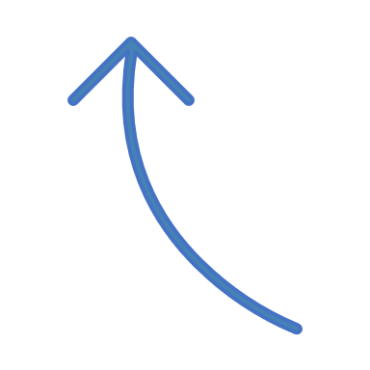









Mathematical model (1)
Thin shell approximation:
Governing equations:
T-formulation (Tape)
A-formulation (Air)
Heat conduction equation (Tape)
Air domain
$$J= ∇ ×T$$
$$∇ ×E=−\frac{∂B}{∂t}$$
$$ρ∙c_{p}∙\frac{∂θ}{∂t}=∇∙(−λ(T)∙∇θ)+q^{′′′}$$
$$B$$
$$J$$
REBCO tape
$$q^{′′′}$$
$∇ ×\left[\frac{1}{μ}\left(∇×A\right)\right]=J$
Joule losses from T-formulation!
$$B=∇×A$$
[Study of magnetization loss of CORC cables using 3D T-A formulation, Y. Wang, 2019]
[3D quench modeling base on T-A formulation for high temperature superconductor CORC cables, Y. Wang, 2019]

Slide 9

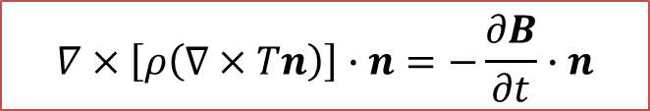

Mathematical model (2)
y
z
x
J_{x}=0
J_{z}
T
n
J_{z}
J_{y}=0
T
$$T=Tn$$
Final governing equation:
$$∇×\left[ρ\left(∇×Tn\right)\right]∙n=−\frac{∂B}{∂t}∙n$$

Slide 10





Model set up
Air domain
REBCO tape
$$T_{1}=0$$
$$T_{2}=\frac{I\left(t\right)}{t_{tape}}$$
Injection of a ramp of current on the tape cross section
Tape immersed in a bath of liquid nitrogen @ 77 K
External field applied
2D/3D simulations
$$J_{z}$$
$$B_{ext}$$
$T →current vector potential$
$I →curremt$
$t_{tape} →tape thickness$
$B_{ext} →external field applied$

Slide 11
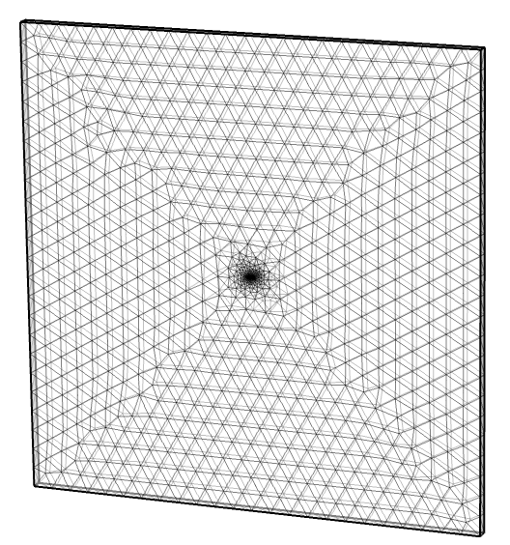
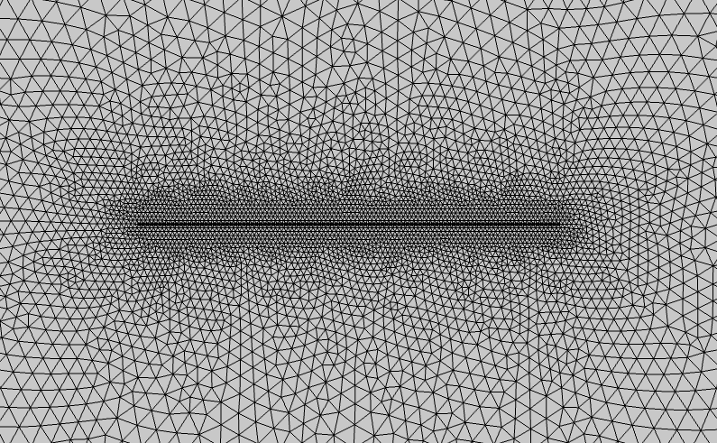
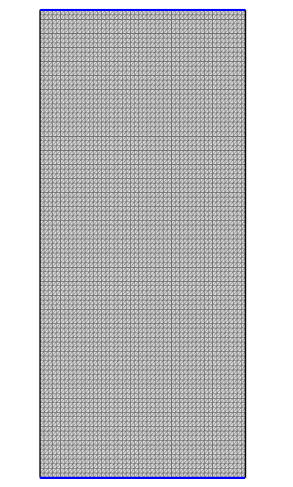
Geometry and mesh
Air domain: tetrahedral mesh
Tape domain: triangular mesh
Elements in tape width: 100
N° cells: ~60,000

Slide 12
Model validation @ 4.2 K
B_{app} (T) | N-value | Err_{n-value} (%) | Err_{av,V} (%)
0.4 | 45 | 6% | 7%
0.7 | 40 | 6% | 6%
1 | 32 | 0% | 3%
2 | 45 | 1% | 4%
4 | 37 | 7% | 8%
7 | 35 | 9% | 9%
10 | 45 | 3% | 5%
12 | 32 | 0% | 2%
13 | 40 | 1% | 3%
15 | 40 | 18% | 10%

Slide 13
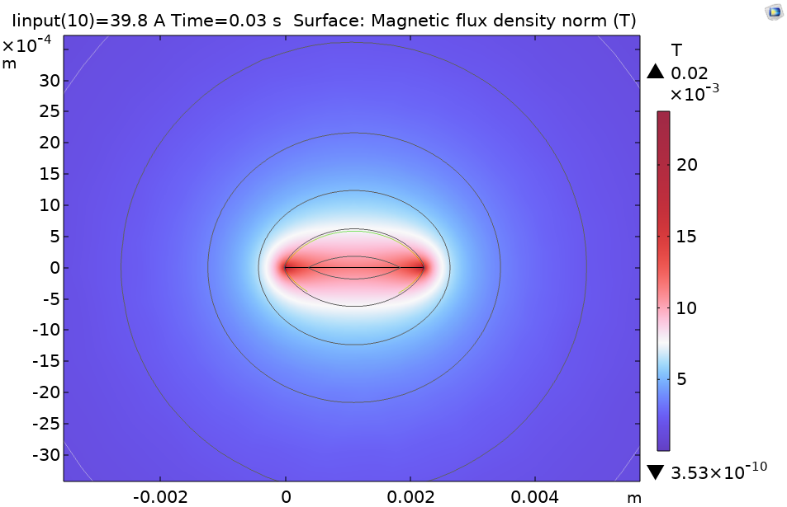
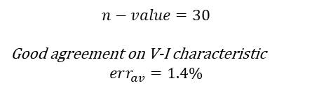
Results : self-field at @ 77 K
$$n−value=30$$
Good agreement on V-I characteristic
$$err_{av}=1.4\%$$
$$I=39.8 A <I_{crit} →SC conditions$$

Slide 14
Results: vertical field applied at @ 77 K
Wrt 4.2 K
Strong Ic degradation
Lower n-value: 30-25

Slide 15
CORC modeling

Slide 16
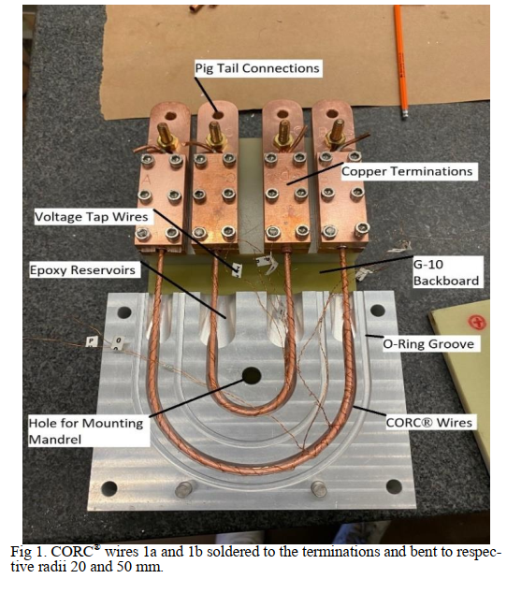
VPI test in LBNL
3 layers
2 REBCO tapes/layer (6 tapes total)
2.9 mm diameter
Bending radii: 20 – 50 mm
3 set of experiments:
Set 1: straigth CORC cable, before bending
Set 2: bended CORC cable, before epoxy impregnation
Set 3: bended CORC cable, after epoxy impregnation
[Developing a Vacuum Pressure Impregnation Procedure for CORC® Wires, J. Sterne et. al, MT27, 2021]
[Distributed fiber optic sensing to identify locations of resistive transitions in REBCO conductors and magnets, L. Luo et. al, MT27 2021]

Slide 17
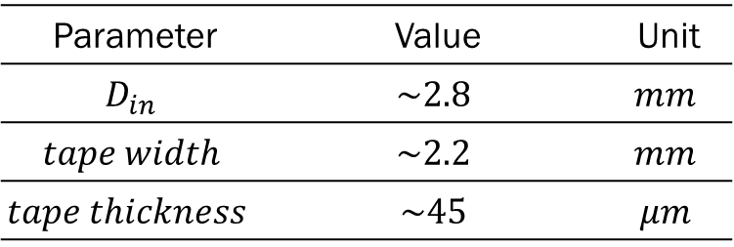
Cable layout
Copper stabilizer
5 μm
Silver layer
1.6 μm
REBCO
1.6 μm
Buffer zone
0.4 μm
45.2 μm
Substrate
30 μm
Parameter | Value | Unit
$$D_{in}$$ | $$\sim 2.8$$ | $$mm$$
$$tape width$$ | $$\sim 2.2$$ | $$mm$$
$$tape thickness$$ | $$\sim 45$$ | $$μm$$
2.02 mm
D_{in}
pitch

Slide 18
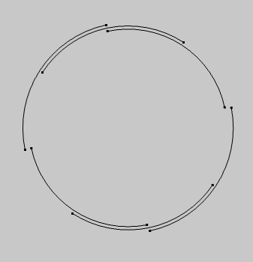
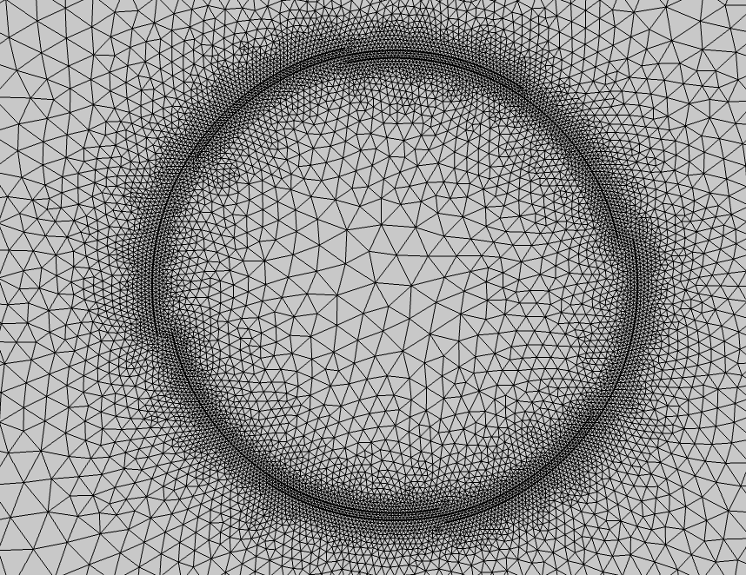
Geometry and mesh
2D cross section
Triangular mesh
Elements per tape: 100 - 200
N° cells: 13,000

Slide 19
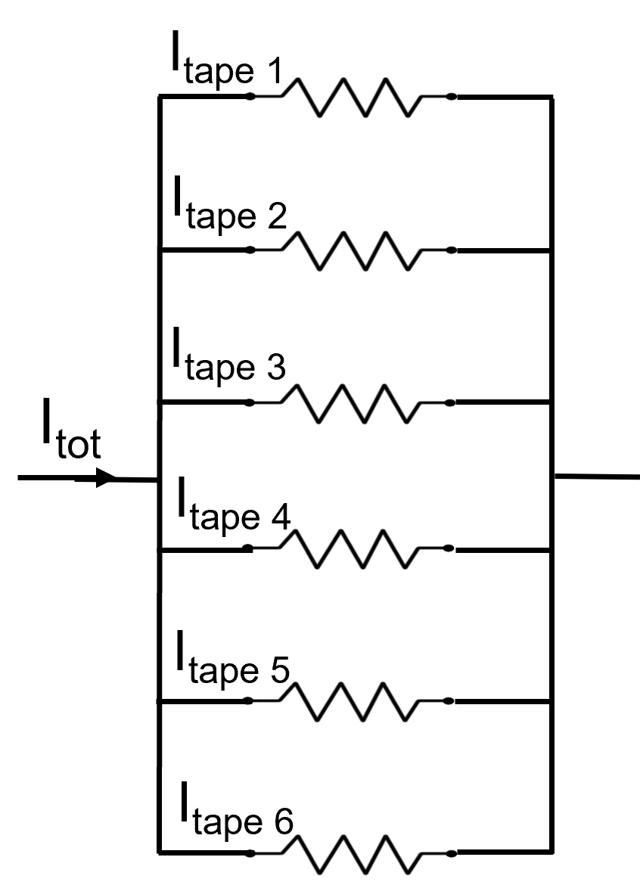

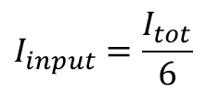

Model set up
Temperature imposed @ 77 K
Purely resistive flow
No current sharing between layers
Equivalent electric network:
$$T_{1}=0$$
$$T_{2}=\frac{I_{input}}{d_{S}}$$
$$I_{input}=\frac{I_{tot}}{6}$$

Slide 20

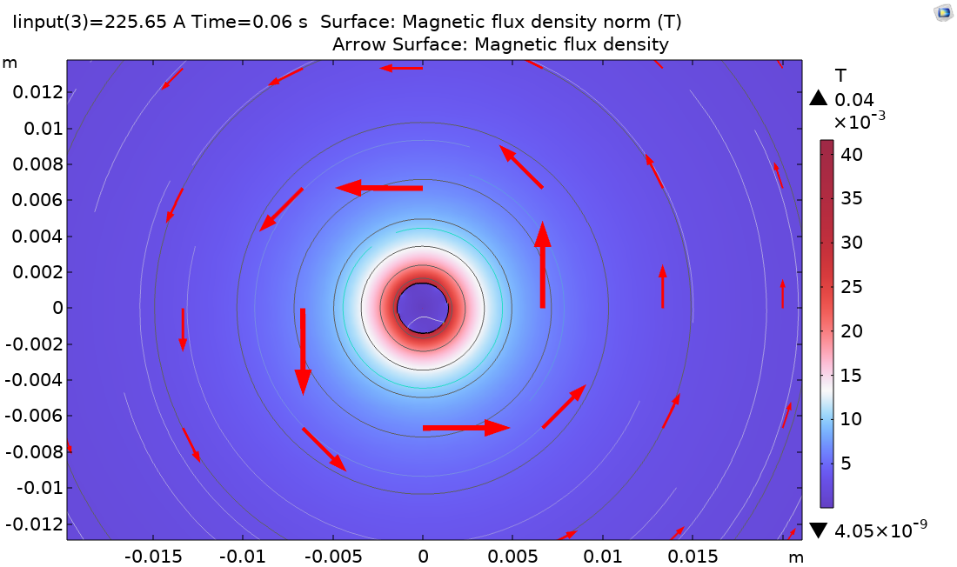
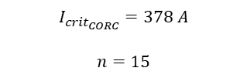

Results (1): self-field at @ 77 K
Rigth direction
$$I_{crit_{CORC}}=378 A$$
$$n=15$$
$$J<J_{crit} →SC conditions$$

Slide 21


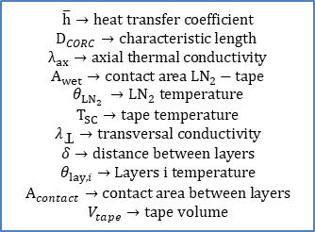

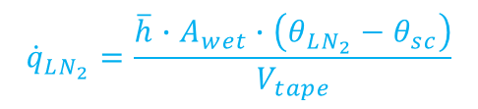

Improvements (1)
Thermal model
$$ρ∙c_{p}∙\frac{∂θ}{∂t}=∇∙\left(−λ_{ax}\left(θ\right)∙∇θ\right)+{\dot{q}}_{joule}+{\dot{q}}_{LN_{2}}+{\dot{q}}_{layers}\left[\frac{W}{m^{3}}\right]$$
$${\dot{q}}_{layers}$$
$${\dot{q}}_{LN_{2}}$$
$${\dot{q}}_{layers}=\frac{\frac{λ_{Ʇ}}{δ}\left(θ_{lay1}−θ_{lay2}\right)∙A_{contact}}{V_{tape}}$$
$${\dot{q}}_{LN_{2}}=\frac{\overline{h}∙A_{wet}∙\left(θ_{LN_{2}}−θ_{sc}\right)}{V_{tape}}$$
$$\overline{h}→heat transfer coefficient$$
$$D_{CORC}→characteristic length$$
$λ_{ax}→axial thermal conductivit$y
$$A_{wet}→contact area LN_{2}−tape$$
$$θ_{LN_{2}} →LN_{2} temperature$$
$$T_{SC}→tape temperature$$
$$λ_{Ʇ}→transversal conductivity$$
$$δ→distance between layers$$
$$θ_{lay,i}→Layers i temperature$$
$$A_{contact}→contact area between layers$$
$$V_{tape}→tape volume$$
Free convection
$$\overline{h}(Nu_{\left(Ra\right)},D_{CORC},λ_{LN_{2}})$$

Slide 22
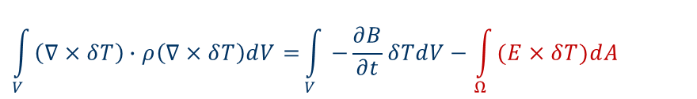
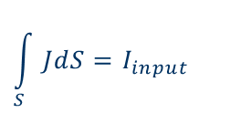
Improvements (2)
Electromagnetic model
[Calculations of the AC losses in superconducting cables and coils: Neumann boundary conditions of T-A formulation. S. Wang, 2022]
Weak form T-A formulation:
$$\int_{V}{\left(∇×δT\right)∙ρ\left(∇×δT\right)dV=}\int_{V}{−\frac{∂B}{∂t}δTdV}−\int_{Ω}{(E×δT)dA}$$
New BC!
Current injection weak constraint!
$$\int_{S}{JdS}=I_{input}$$

Slide 23
Next steps
Complete full 3D model
Thermal and electromagnetic model improvements
3D model of bended CORC cable (before\after epoxy)
Modeling more layers and tapes

Slide 24
References
Status of CORC® cables and wires for use in highfield magnets and power systems a decade after their introduction, D.C. Van der Laan et al, 2019
Two-Dimensional Anisotropic Model of YBCO Coated Conductors, Casali et. al, 2015
In-Field Electrical Resistance at 4.2 K of REBCO Splices, J. Fleiter and A. Ballarino, et. al, 2017
Self-Consistent Modeling of the Ic of HTS Devices: How Accurate do Models Really Need to Be?, Grilli et. al, 2014
Performance correlation between YBa₂Cu₃O_{7-δ} coils and short samples for coil technology development, X. Wang et. al, 2016
Study of magnetization loss of CORC cables using 3D T-A formulation, Y. Wang, 2019
3D quench modeling base on T-A formulation for high temperature superconductor CORC cables, Y. Wang, 2019
Developing a Vacuum Pressure Impregnation Procedure for CORC® Wires, J. Sterne et. al, MT27, 2021
Distributed fiber optic sensing to identify locations of resistive transitions in REBCO conductors and magnets, L. Luo et. al, MT27 2021
Calculations of the AC losses in superconducting cables and coils: Neumann boundary conditions of T-A formulation, S. Wang, 2022

