Slide 1
CCT Subscale Quench Antenna Update
May 25, 2022

Slide 2
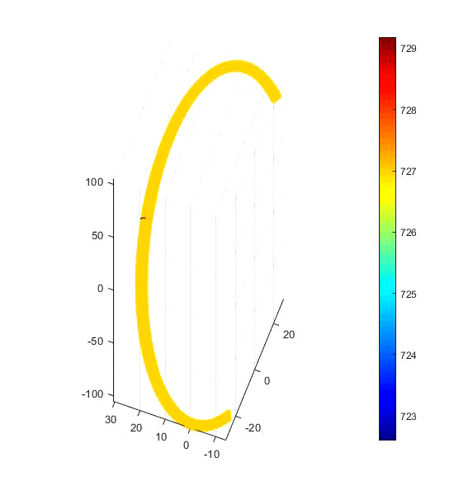
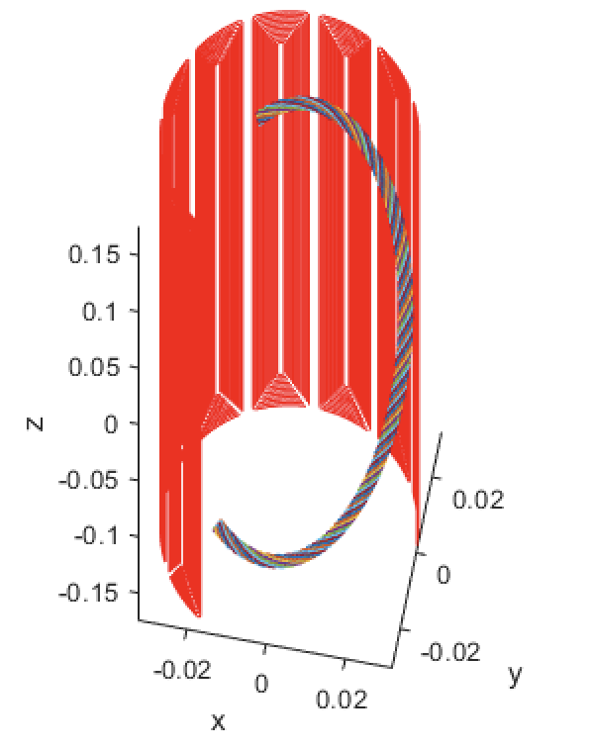
Quench Antenna Modeling
Quench antennas give quench locations, but lots of additional “hidden” information we seek to interpret
Ruben Keijzer, student of Gerard Willering, has performed quench simulations under similar conditions to CCT
Diego has been processing simulations into expected quench antenna responses
Will be shown at a later date

Slide 3
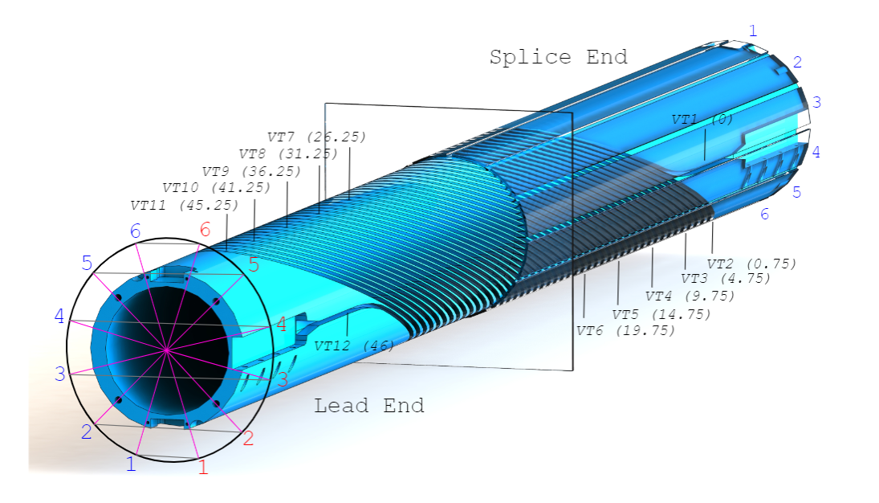
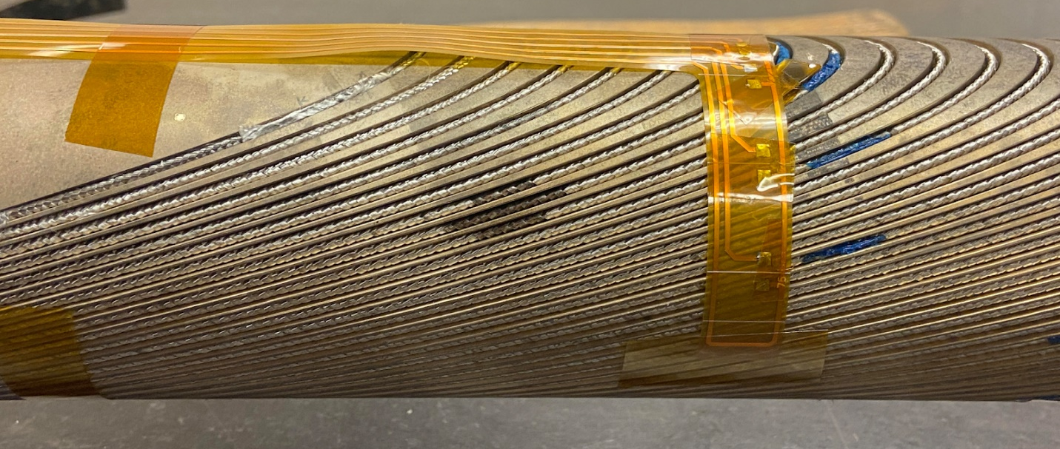
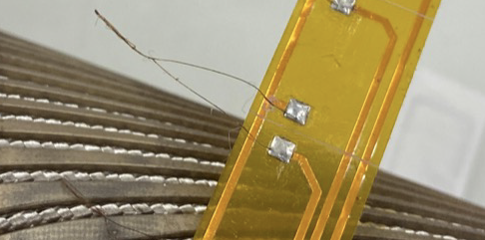
Quench Heaters
Upcoming test (wax) has flex PCB array of heaters
Manganin heater wire, ~ 12 Ohms, bifilar loops
Objectives
Compare responses with modeling
Create quench at known position under imposed conditions, measure quench antenna response
See antenna responses with heater at antenna middle vs. edge
Probe potential recovery after small pulse

